Slide 1
Module 2
Capital budgeting
Prepared by
Dr. Muhammed Rafi.P Assistant Professor PG Department of Commerce & Management studies

Slide 2
Situations of capital budgeting
Mechanization of a process
Replacing and modernizing a process
Choosing between alternative machines
Introducing anew product
Expanding the business
Accept-reject decisions
Contingent decisions
Investment for research and development

Slide 3
Information required for capital budgeting
Cash flows :
In capital budgeting decision, the cost and benefit of a project are measured in terms of cash flows. Cash flow may be cash inflow or outflow. Cost are referred to as cash outflows and benefits are denoted as cash inflows.
Types of cash flows:
a) Initial cash flows (initial investment):
Investment required for beginning a new project. Eg – cost of new assets, initial working capital etc. It includes:
Cost of new asset, including insurance, freight, installation charges etc.
Opportunity cost of the assets
Increase in working capital or additional working capital

Slide 4
b) Net annual cash inflows or Operating cash flows:
Regular cash outflow and inflows (profits).
c) Terminal cash flows:
It is the cash inflows for the last or terminal year of the project. It occurs in two ways:
The estimated salvage or scrap value realizable at the end of the life of the project.
The working capital which was invested in the beginning will no longer be required as the project is being terminated.

Slide 5
2. Required rate of return :
The expected rate of return from a proposal is required in order to A) adjust the future cash flows of a project B) determining the profitability of the proposal or project. An investment proposal is accepted when the return from it is more the required rate of return.
3. Other information :
a) Economic life of project
b) Available funds
c) Risk

Slide 6
Kinds of capital budgeting decision
Capital budgeting decisions can be broadly classified into two categories:
Those which increase revenue
Those which reduce costs

Slide 7
Profitability statement (in revenue increasing decisions)
Annual sales revenue xxx
Less: Operating expenses including depreciation xxx
Income before tax xxx
Less: Income Tax xxx
Net income after tax xxx
Add: Depreciation xxx
Net cash inflows xxx

Slide 8
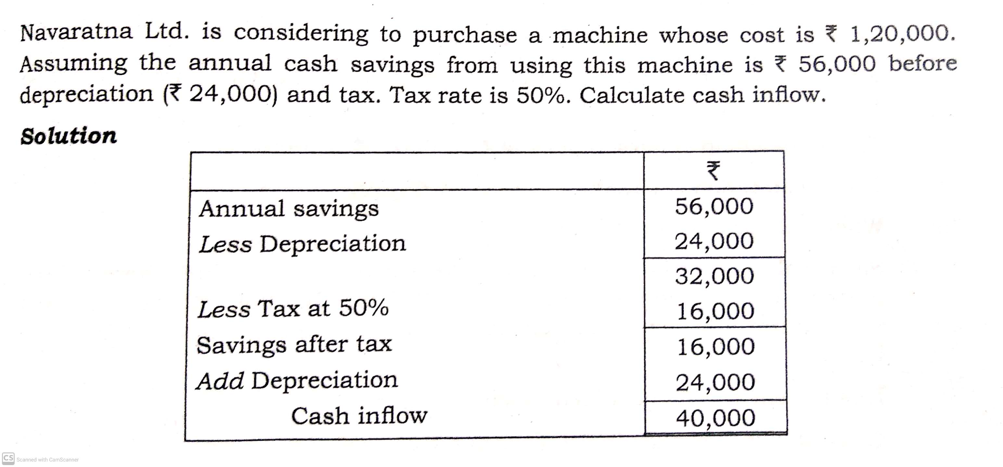
Example 1

Slide 9
Profitability statement (in cost reduction decisions)
A. Estimated savings:
Estimated savings in direct wages xxx
Estimated savings in scrap xxx
Total savings (a) xxx
B. Estimated additional costs:
Additional cost of maintenance xxx
Additional cost of supervision xxx
Additional Cost of indirect material xxx
Additional Depreciation xxx
Total additional costs (b) xxx
Net savings before tax (a-b) xxx
Less: Income Tax xxx
Net Savings after Tax xxx
Add: Additional depreciation xxx
Cash Inflows xxx

Slide 10
Example
X Ltd is producing articles mostly by manual labour and is considering to replace it by a new machine. There are two alternative models M and N of the new machine. Prepare a statement of profitability from the following data:
Machine M Machine N
Estimated life of machine 4 years 5 years
Cost of machine Rs.90,000 Rs.180,000
Estimated savings in scrap 5000 8000
Estimated savings in direct wages 60,000 80,000
Additional cost of maintenance 8000 10,000
Additional cost of supervision 12,000 18,000

Slide 11
Solution

