Slide 1
Module 2
Urgency method, Payback Period
Prepared by
Dr. Muhammed Rafi.P Assistant Professor PG Department of Commerce & Management studies

Slide 2
Traditional Methods
1) URGENCY METHOD
Urgency is a method used to justify the acceptance of projects on the basis of emergency requirements. In short most urgent project is taken up first.
ADVANTAGES
Simple technique
It useful in case of short term projects
DISADVANTAGES
It is not based on scientific analysis
Does not consider time value
A project even though it is profitable, will not be accepted for the very simple reason that it can be postponed.

Slide 3
2) Pay Back Method
Payback period is the length of time required to recover the initial cost or investment of the project. It is the period required to recover the cost of investment. It is also called pay off method, pay out method etc. The payback period is computed by dividing the initial investment by net annual cash inflows.
DECISION RULE (SELECTION CRITERIA)
According to pay back criterion, the shorter the pay back, the better the project. This means project having shorter payback period is chosen.

Slide 4
The pay back period can be calculated in two different situations as follows:
When annual cash inflows are equal:
Pay back period = Orginal cost of the project or I
Annual net cash inflow C

Slide 5
Example 1
If a project involves a cash outlay of Rs.5,00,000 and generates cash inflow of Rs.1,00,000 annually for 7 years. Calculate Pay back period.
Solution:
Pay back period = 5,00,000
1,00,000
= 5 Years.

Slide 6
Example 2

Slide 7
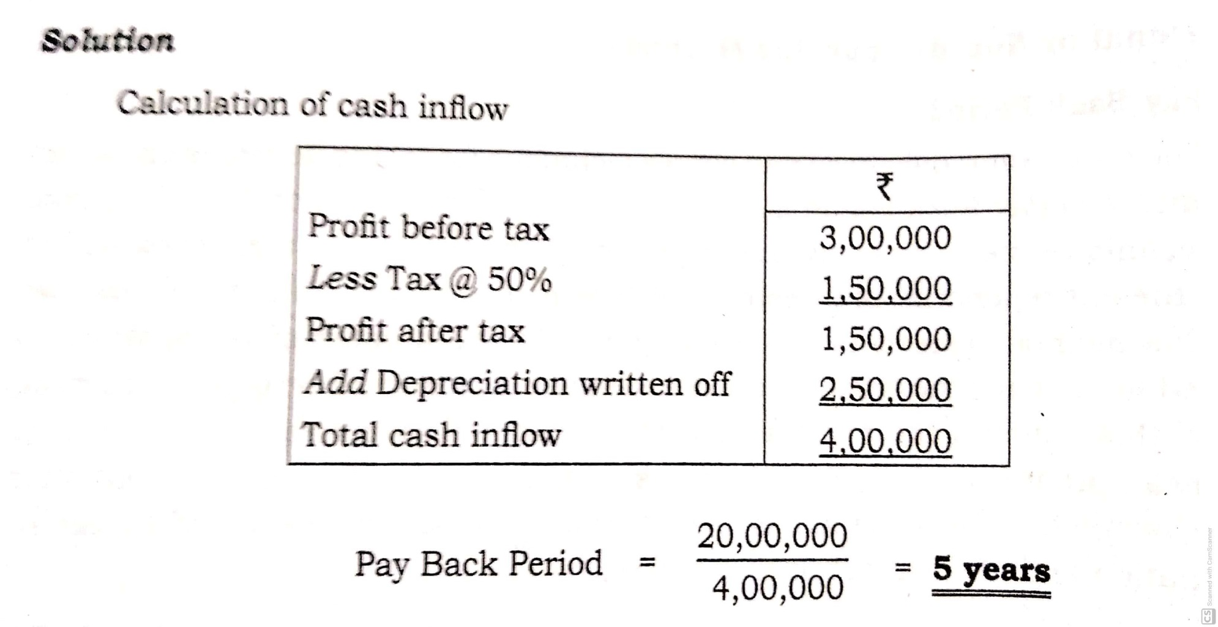

Slide 8
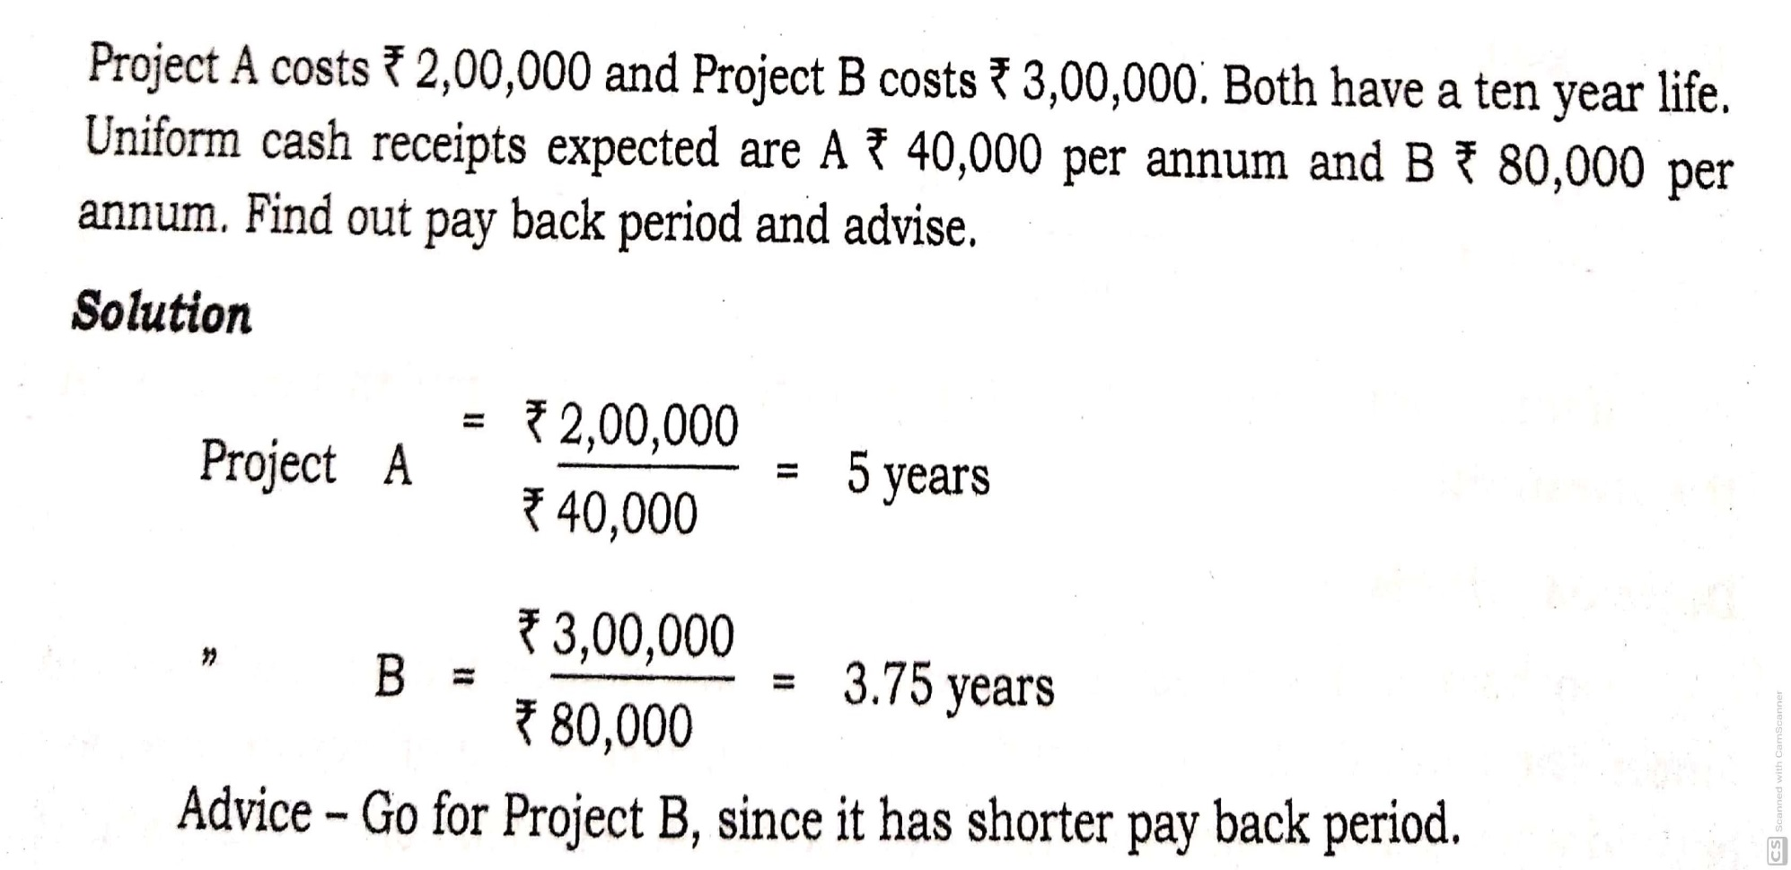
Example 3

Slide 9
2. When annual cash inflows are unequal:
Here, pay back period is calculated by cumulating the cash inflows until the original investment is recovered. It is ascertained by cumulating cash inflows till the time when the cumulative cash inflows become equal to initial investment.
Pay back period = E+ B
C
Where,
E = No.of years immediately preceding the year of final recovery.
B = Balance amount still to be recovered.
C = Cash inflow during the year of final recovery.

Slide 10
Example 1
If the cost of the project is Rs.1,00,000 and cash inflows are:
Year Cash inflow
10,000
15,000
25,000
30,000
30,000
Calculate Pay back period.

Slide 11
Solution
Year Cash inflow Cumulated cash inflow
10,000 10,000
15,000 25,000
25,000 50,000
30,000 80,000
30,000 1,10,000
Pay back period = E + B
C
= 4 + 20,000
30,000
= 4 Years and 8 months

Slide 12
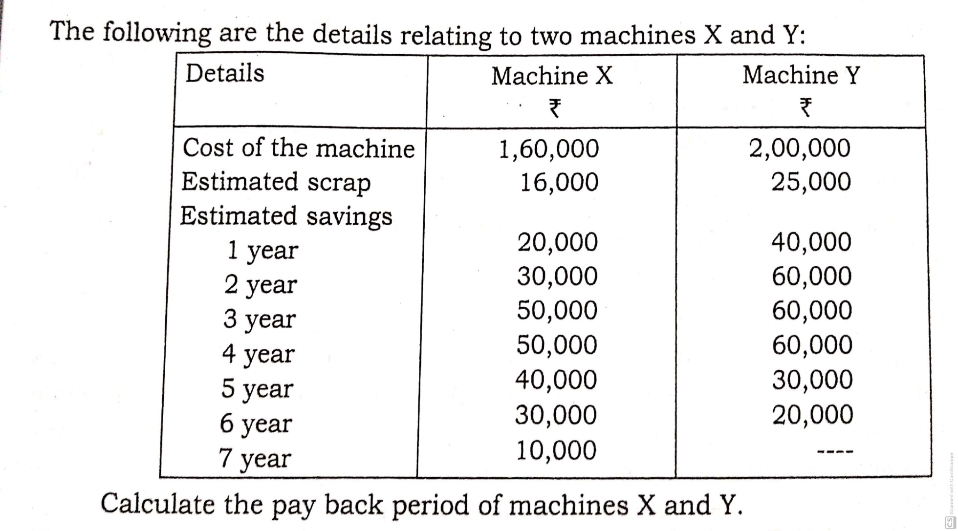
Example 2

Slide 13
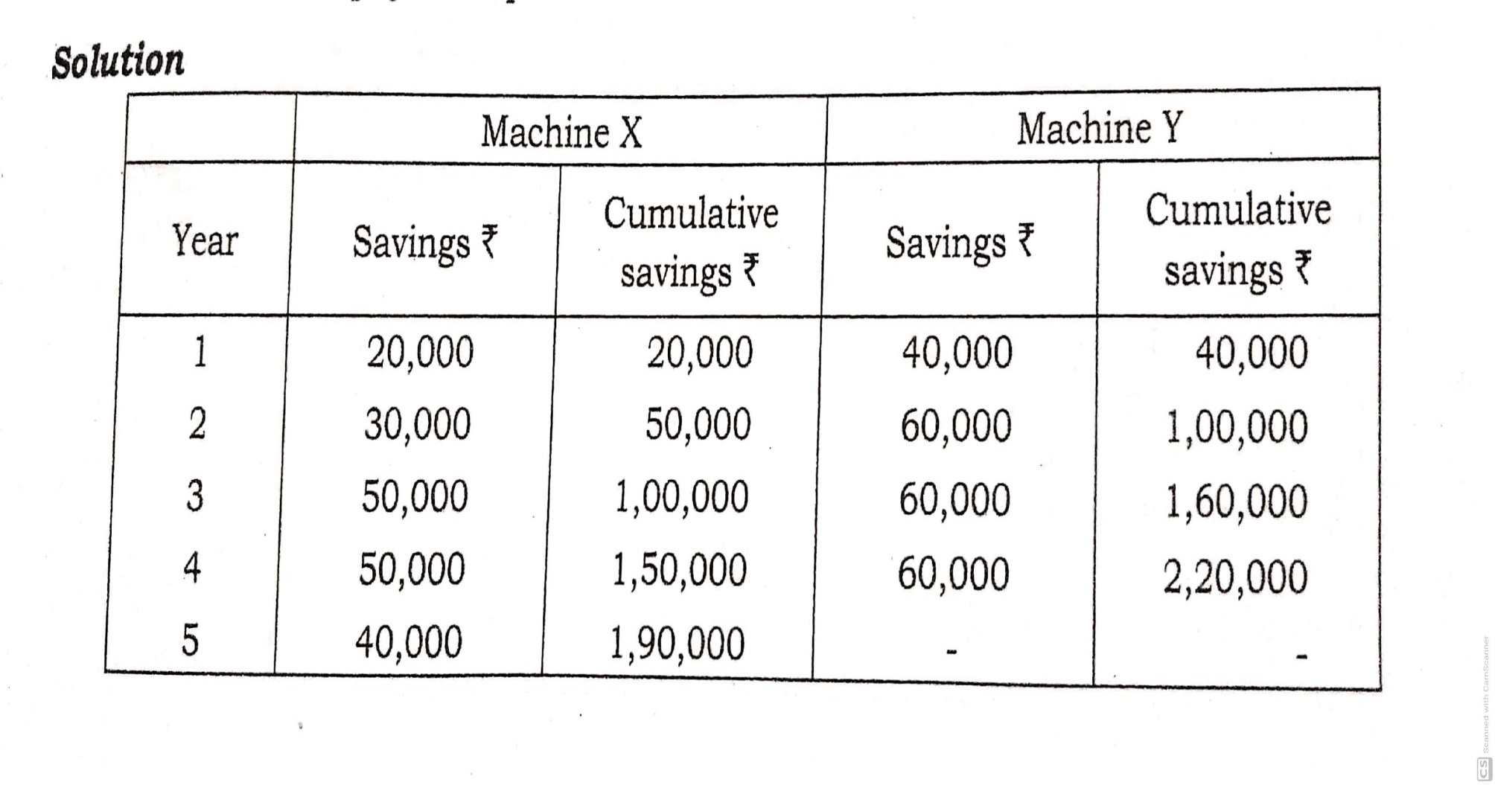

Slide 15
Advantages of Pay back period
Simple to understand
Easy to apply
Important for cash forecasting, budgeting
Can be used profitably for short term project
It take into consider liquidity.
Disadvantages of Pay back Period
Ignore time value of money
Completely ignore cash inflows after pay back
Does not measure profitability
Does not measure rate of return

