Slide 1
Module 2
Discounted Pay Back Period method
Prepared by
Dr. Muhammed Rafi.P Assistant Professor PG Department of Commerce & Management studies

Slide 2
Discounted Payback Period
A major shortcoming of the conventional payback period is that it does not consider time value money.
To overcome this limitation the discounted payback period method is suggested.
In this modified method, cash flows are first converted into their present values and then added to ascertain the period of time require to recover the initial cost of investment.

Slide 3
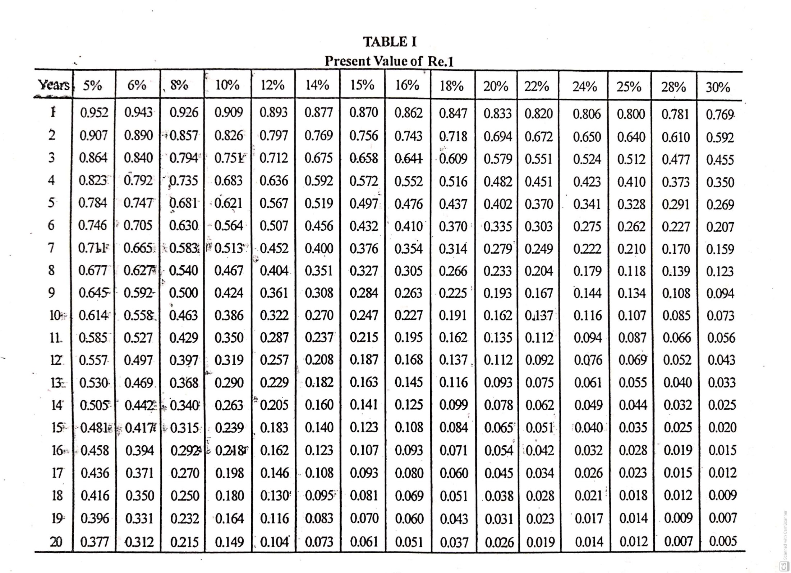

Slide 4
Example 1
The following information is given, calculate the pay back period as well as discounted pay back period.
Cost of the project : 3,00,000
Life of the project : 5 Years
Annual cash flow : 1,00,000
Expected rate of return : 10%
Present value factor : 10%
Year : 1 2 3 4 5
PV Factor : .909 .826 .751 .683 .621

Slide 5
Traditional pay back period : Investment
Annual inflow
= 3,00,000
1,00,000
= 3 Years

Slide 6
b) Discounted Pay Back Period method:
= E+ B
C

Slide 7
= E+ B
C
= 3 + 51,400 x 12
68,300
= 3 Years 9 months

Slide 8
Example 2
Kerala Ltd is implementing a project with an initial capital outlay of Rs.7,600. Its cash inflows:
Year Cash inflows
1 6,000
2 2,000
3 1,000
4 5,000
The expected rate of return on the capital invested is 12%. Calculate the discounted pay back period of the project.

Slide 9
Computation of present value of cash flows

Slide 10
= E+ B
C
= 2 + 712 x 12
712
= 3 Years

