Slide 1
Module 2
Net Present Value Method (NPV)
Prepared by
Dr. Muhammed Rafi.P
Assistant Professor
PG Department of Commerce & Management studies

Slide 2
2) Net Present Value Method (NPV)
This method is used only when the rate of return on investment is predetermined by the management.
Under the NPV method, all cash outflows & inflows are converted in to present values (values of future cash flows at the present time).
The NPV is obtained by deducting the present value of cash outflow from the present value cash inflows.
NPV = Present values of all cash inflows – Present values of all cash outflows

Slide 3
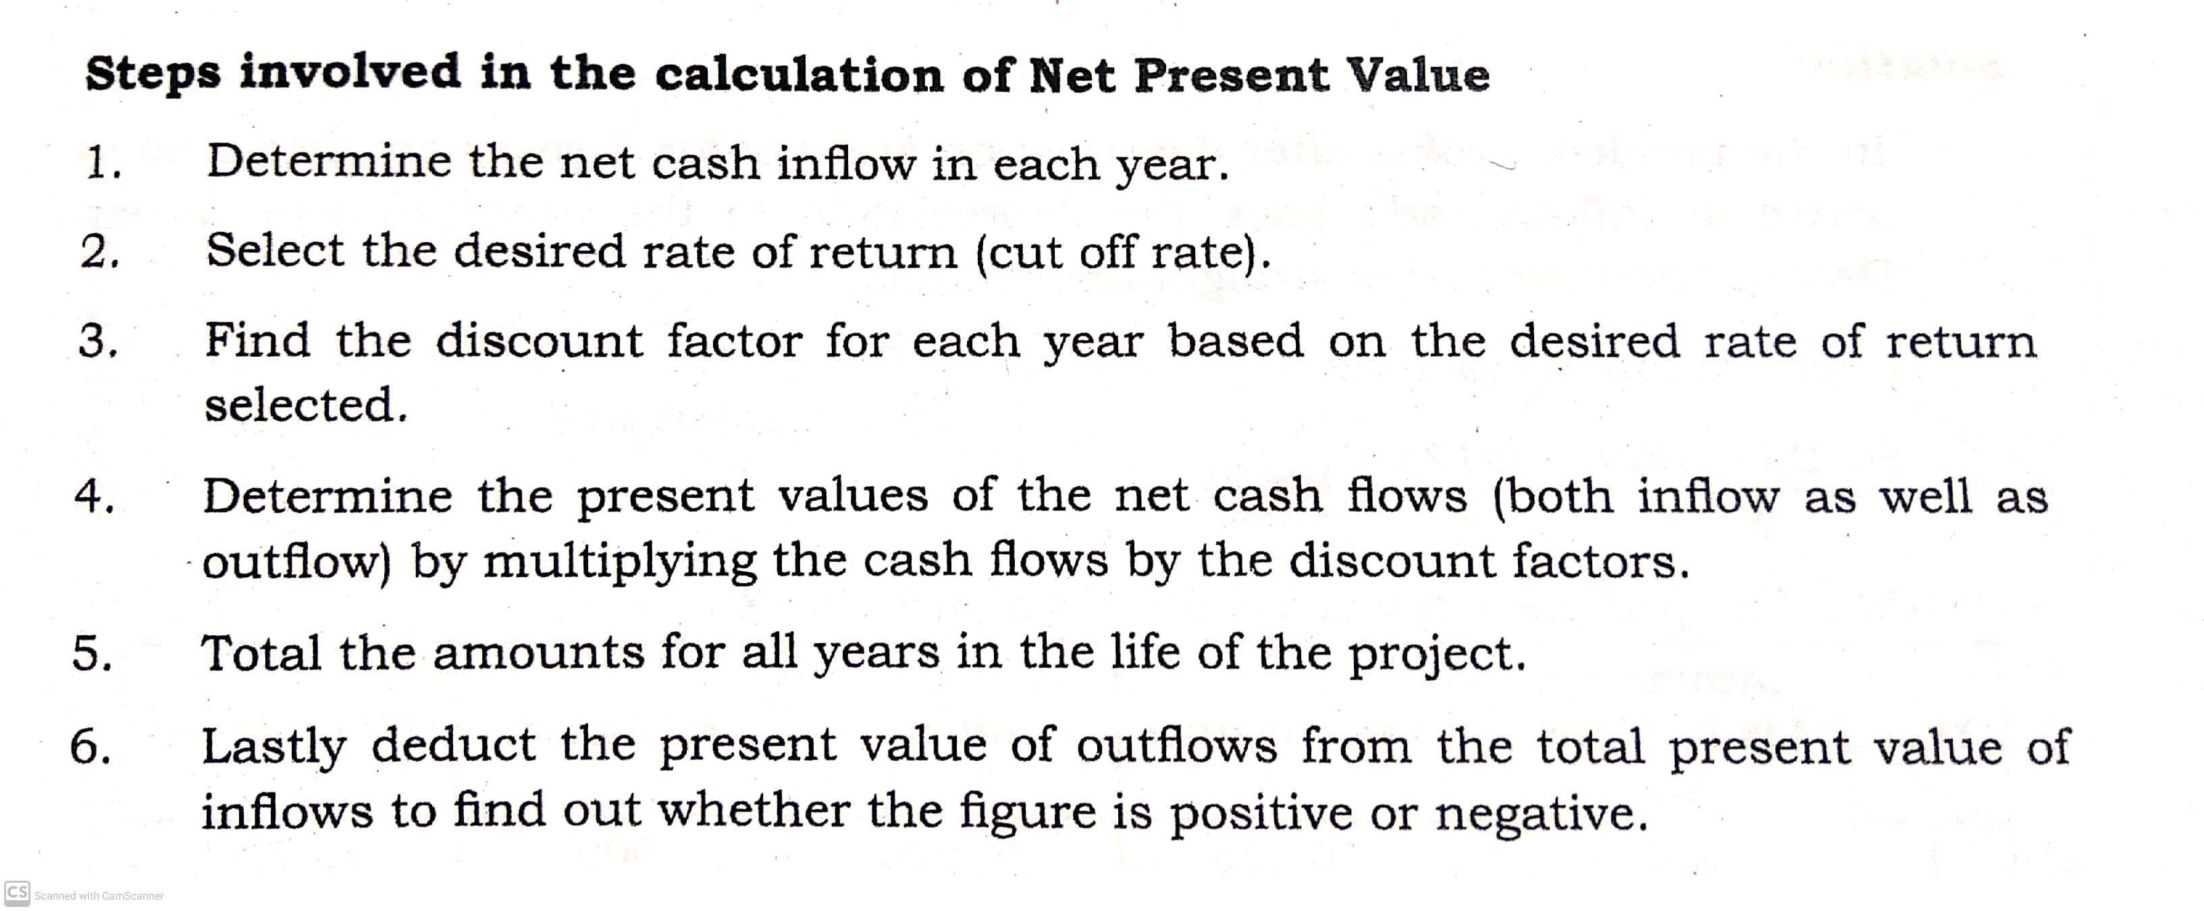

Slide 4
Decision Rule
Accept the project which have highest NPV. If the project’s NPV is zero or positive, accept it and if the NPV is negative reject it.
(Under NPV, Cash inflow means Profit before depreciation and after tax)

Slide 5
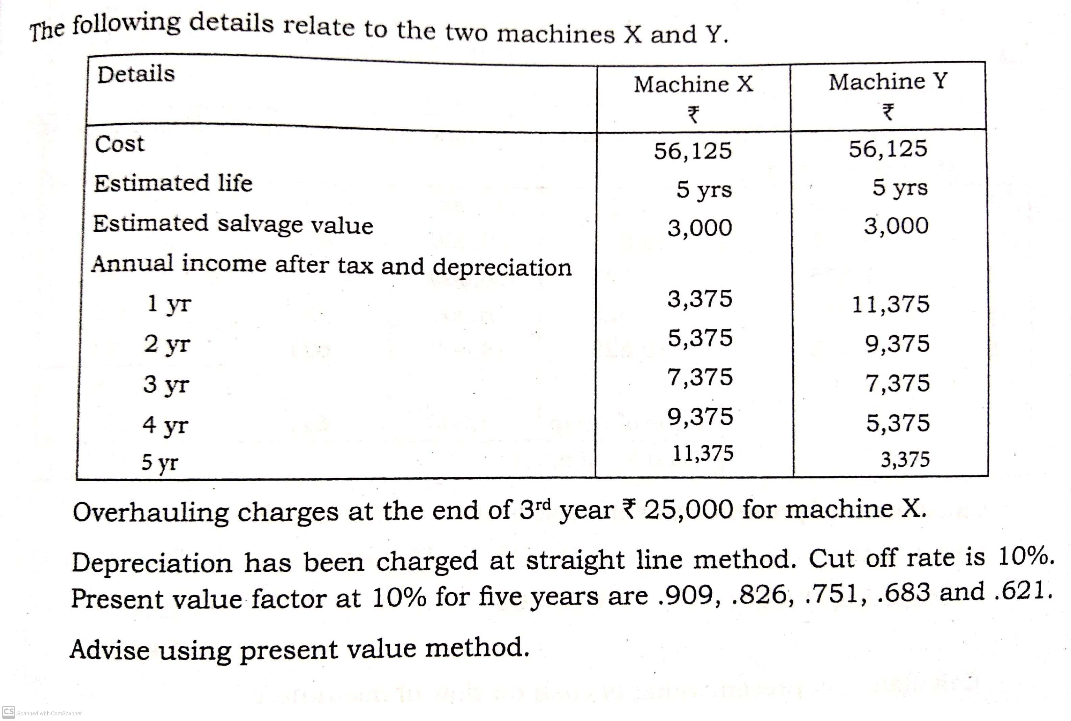
Example 1

Slide 6
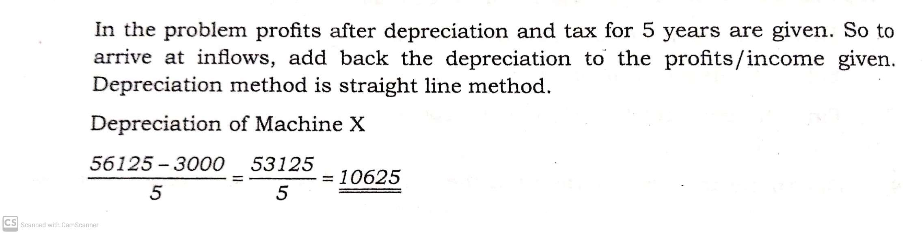
Solution

Slide 7
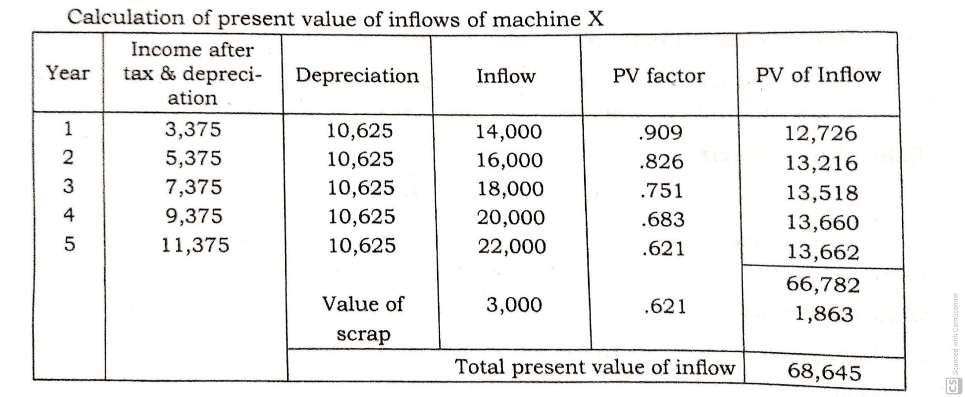

Slide 8
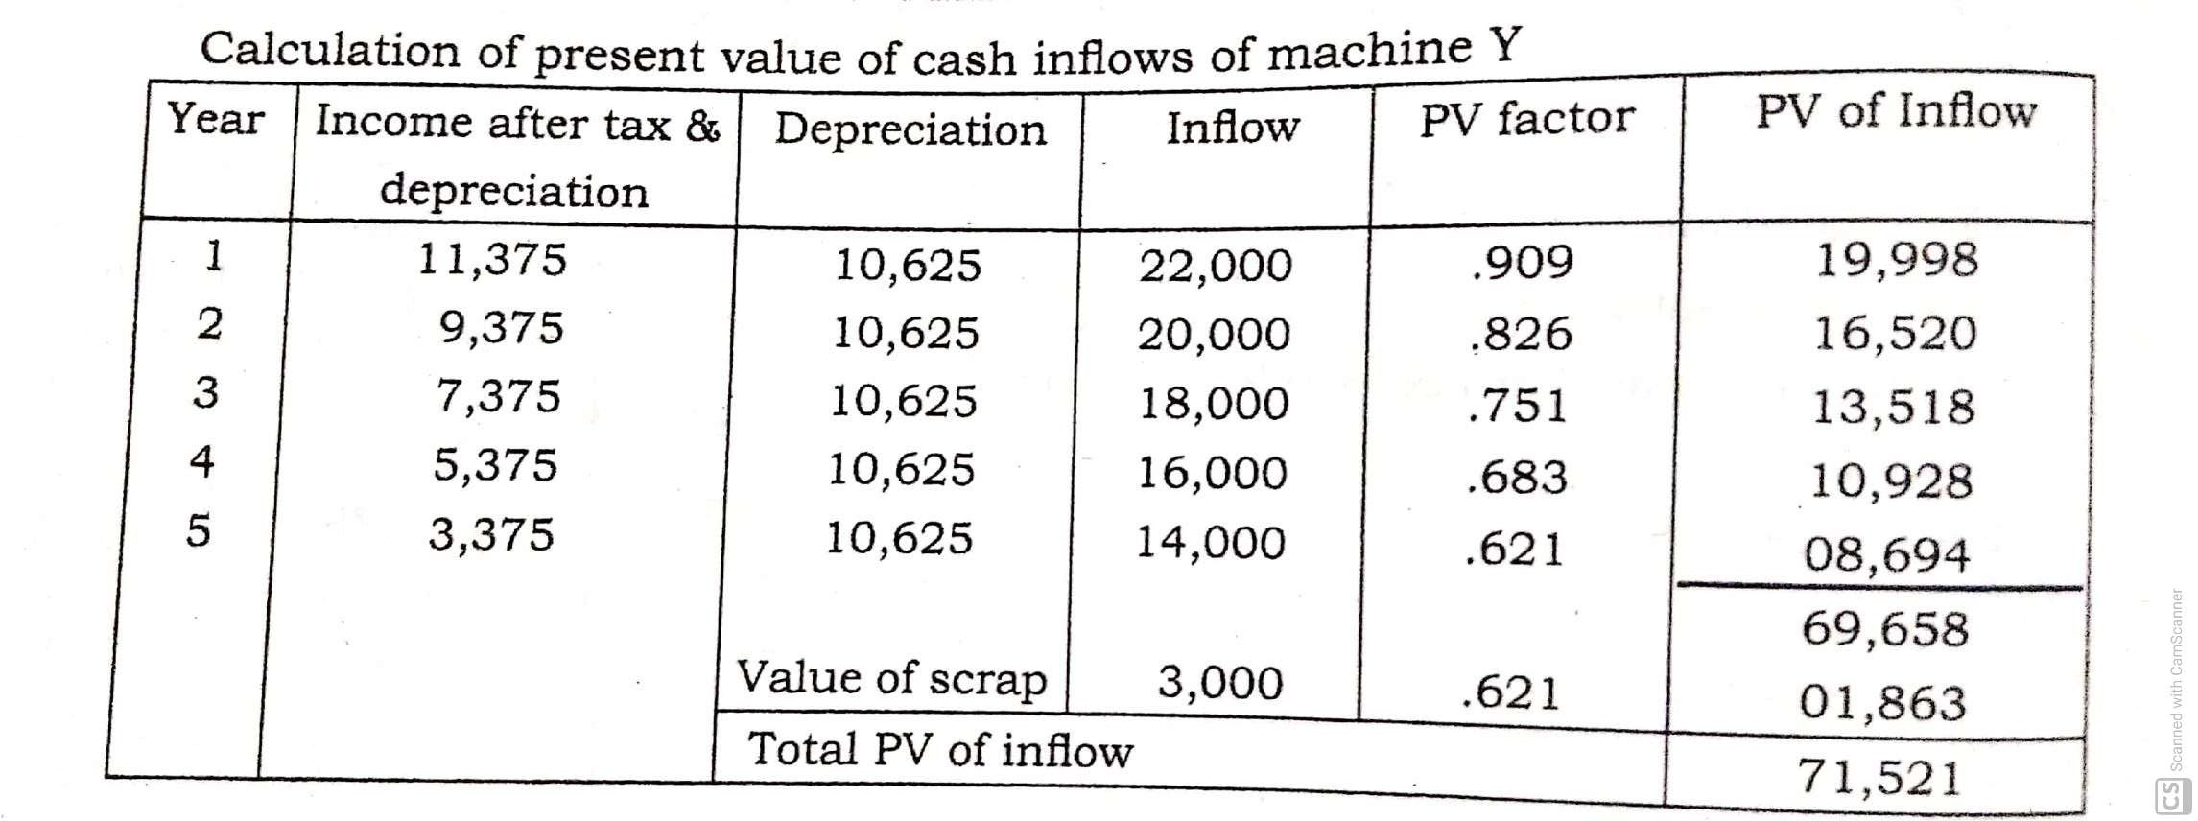

Slide 9
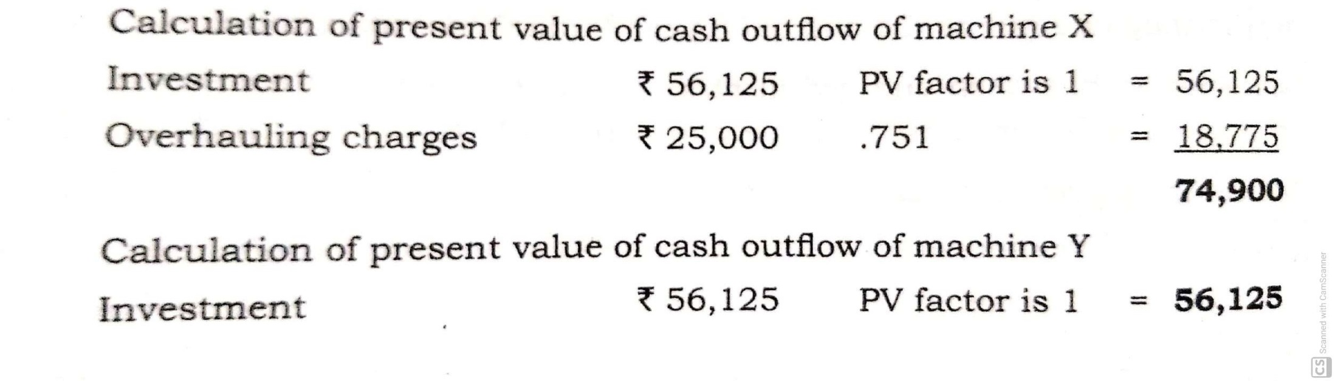

Slide 10
NPV = Present values of all cash inflows – Present values of all cash outflows
NPV of machine X:
= 68,645 – 74,900
= -6,255
NPV of machine Y:
= 71521 – 56125
= +15,396
Here, the NPV of Machine Y is positive. So the advice is go for Machine Y

Slide 11
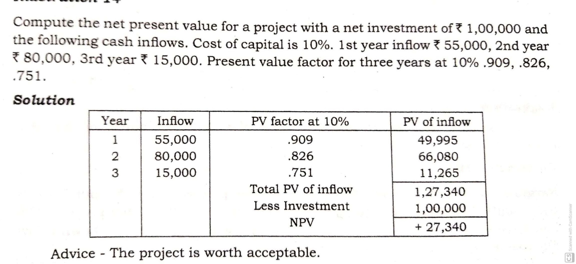

Slide 12
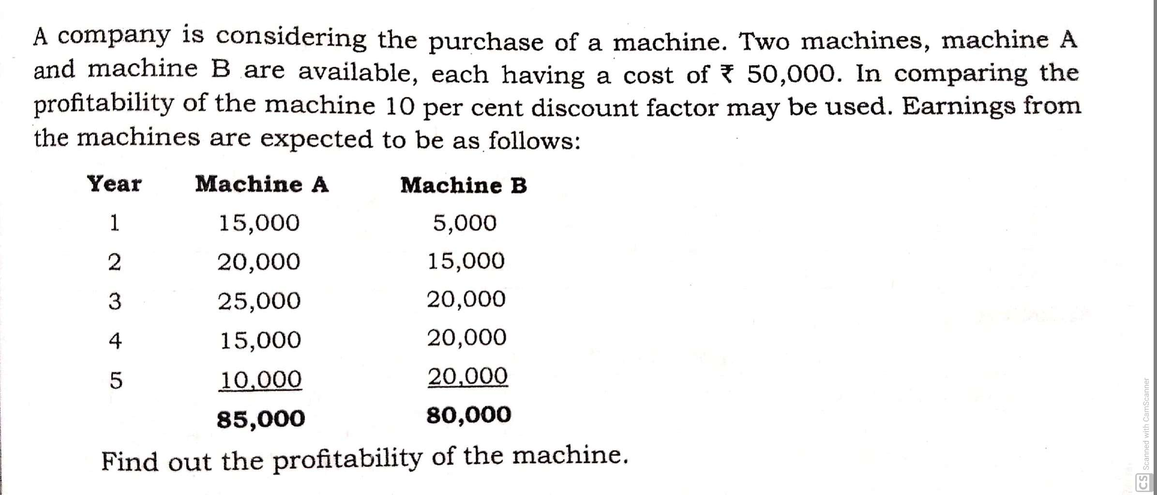

Slide 13
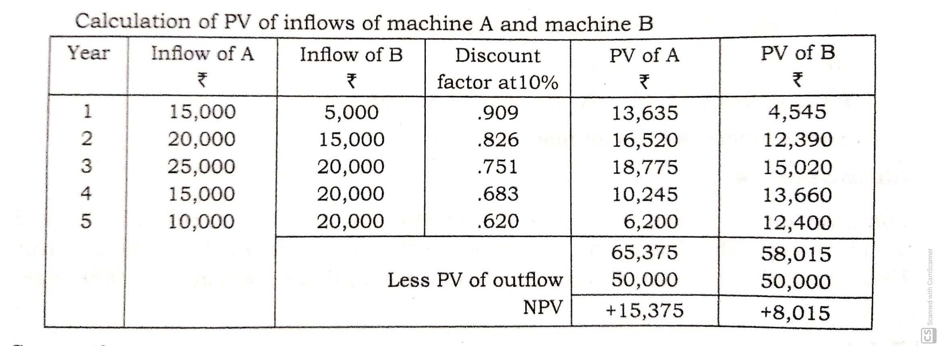

Slide 14
Advantages of NPV
Consider time value of money.
It consider the cash flow over entire life of project.
It focus attention on objective of wealth maximization.
Suitable when cash flows are not uniform.
This method is generally preferred by economists

Slide 15
Disadvantages of NPV
May not provide satisfactory in case of two projects of different useful life.
This method is not suitable in case of projects involving different amount of investment.
Different discount rate give different present value.
It involve complicated calculations

