Slide 1
Module 2
Profitability Index Method
Prepared by
Dr. Muhammed Rafi.P Assistant Professor PG Department of Commerce & Management studies

Slide 2
Profitability Index/ Desirability Factor/ Benefit Cost Ratio
NPV method is suitable only to compare two projects with the same cash outlay.
If the cash outlay differ for different projects, Profitability Index is applied.
Profitability Index is a capital budgeting tool used to rank projects based on their profitability. It is calculated by dividing present value of all cash inflows by the initial investment.

Slide 3
Profitability index can be computed using the following formula:
Profitability Index = Present Value of Cash Flows
Initial Investment
This method may be calculated in two ways:
Gross Profitability Index: Total PV of cash inflow
Total PV of cash outflows
2. Net Profitability Index : Net Present Value
Total PV of cash outflow

Slide 4
Decision rule
A project is acceptable if its profitability index value is greater than 1. If the projects are mutually exclusive, Projects with higher profitability index is to be selected.

Slide 5
Example 1
The initial cash outlay of a project is Rs.50,000 and it generates cash inflows of Rs.20,000, Rs.15,000, Rs.25,000 and Rs.10,000 in four years. Using present value index method, appraise profitability of the proposed investment assuming 10% rate of discount.

Slide 6
Solution

Slide 7
Gross Profitability Index: Total PV of Cash inflow
Total PV of cash outflows
= 56,175 = 1.12
50,000
As the PI is greater than 1, the proposal can be accepted.
2. Net Profitability Index : Net Present Value
Total PV of cash outflow
= 6,175 = 0.12
50,000
As the PI is positive, the proposal can be accepted.

Slide 8
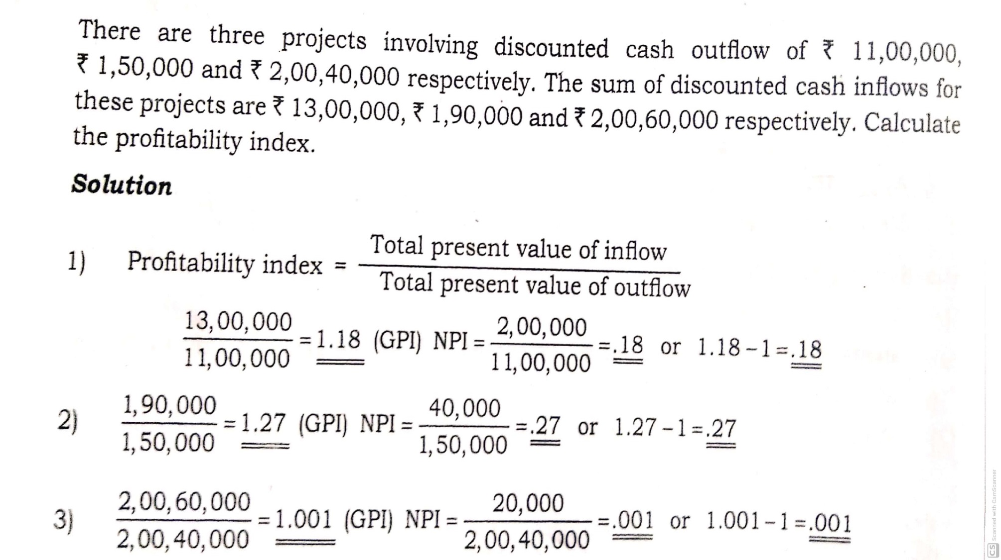
Example 2

Slide 9
