Slide 1
Module 2
INTERNAL RATE OF RETURN METHOD
(IRR)
Prepared by
Dr. Muhammed Rafi.P Assistant Professor PG Department of Commerce & Management studies

Slide 2
Internal Rate of Return (IRR)
It is also called time adjusted rate of return method
Internal rate of return is the rate of return or discount rate at which total present value of future cash inflow is equal to initial investment.
In order to find the rate of return, estimated net cash inflows of each year discounted at various rates till a rate obtained at which the present value of cash inflow is equal to the initial investment.

Slide 3
Decision Rule
The calculated IRR is compared with the desired minimize rate of return. If IRR is equal to or greater than the desired minimize rate of return, then the project is accepted. If it is less than minimum rate of return then the project is rejected.

Slide 4
a) When cash inflows are equal over the life of the project:
1. Find out PV Factor by dividing investment by annual cash inflow:
PVF = Investment
Annual cash inflow
Search for a value nearest to PV factor in the last year of project from Table II (Cumulative PV value Table).
The rate given in the column of the P.V Factor will be the IRR.
In order to make a precise estimation of IRR, find out the present values of higher and lower rate identified form the table.
Find out the exact IRR by using interpolation formula:

Slide 5
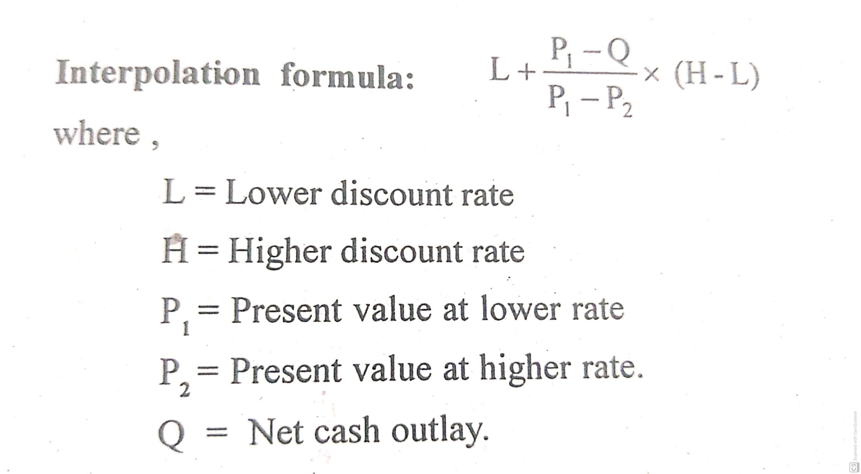

Slide 6
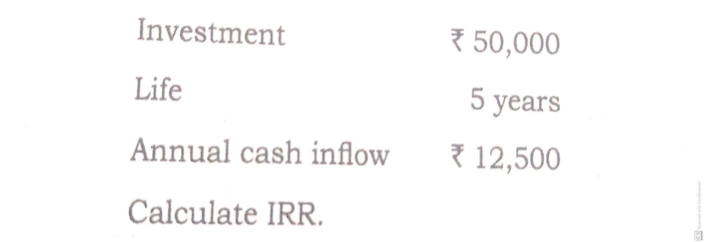
Example 1. (I Case)

Slide 7
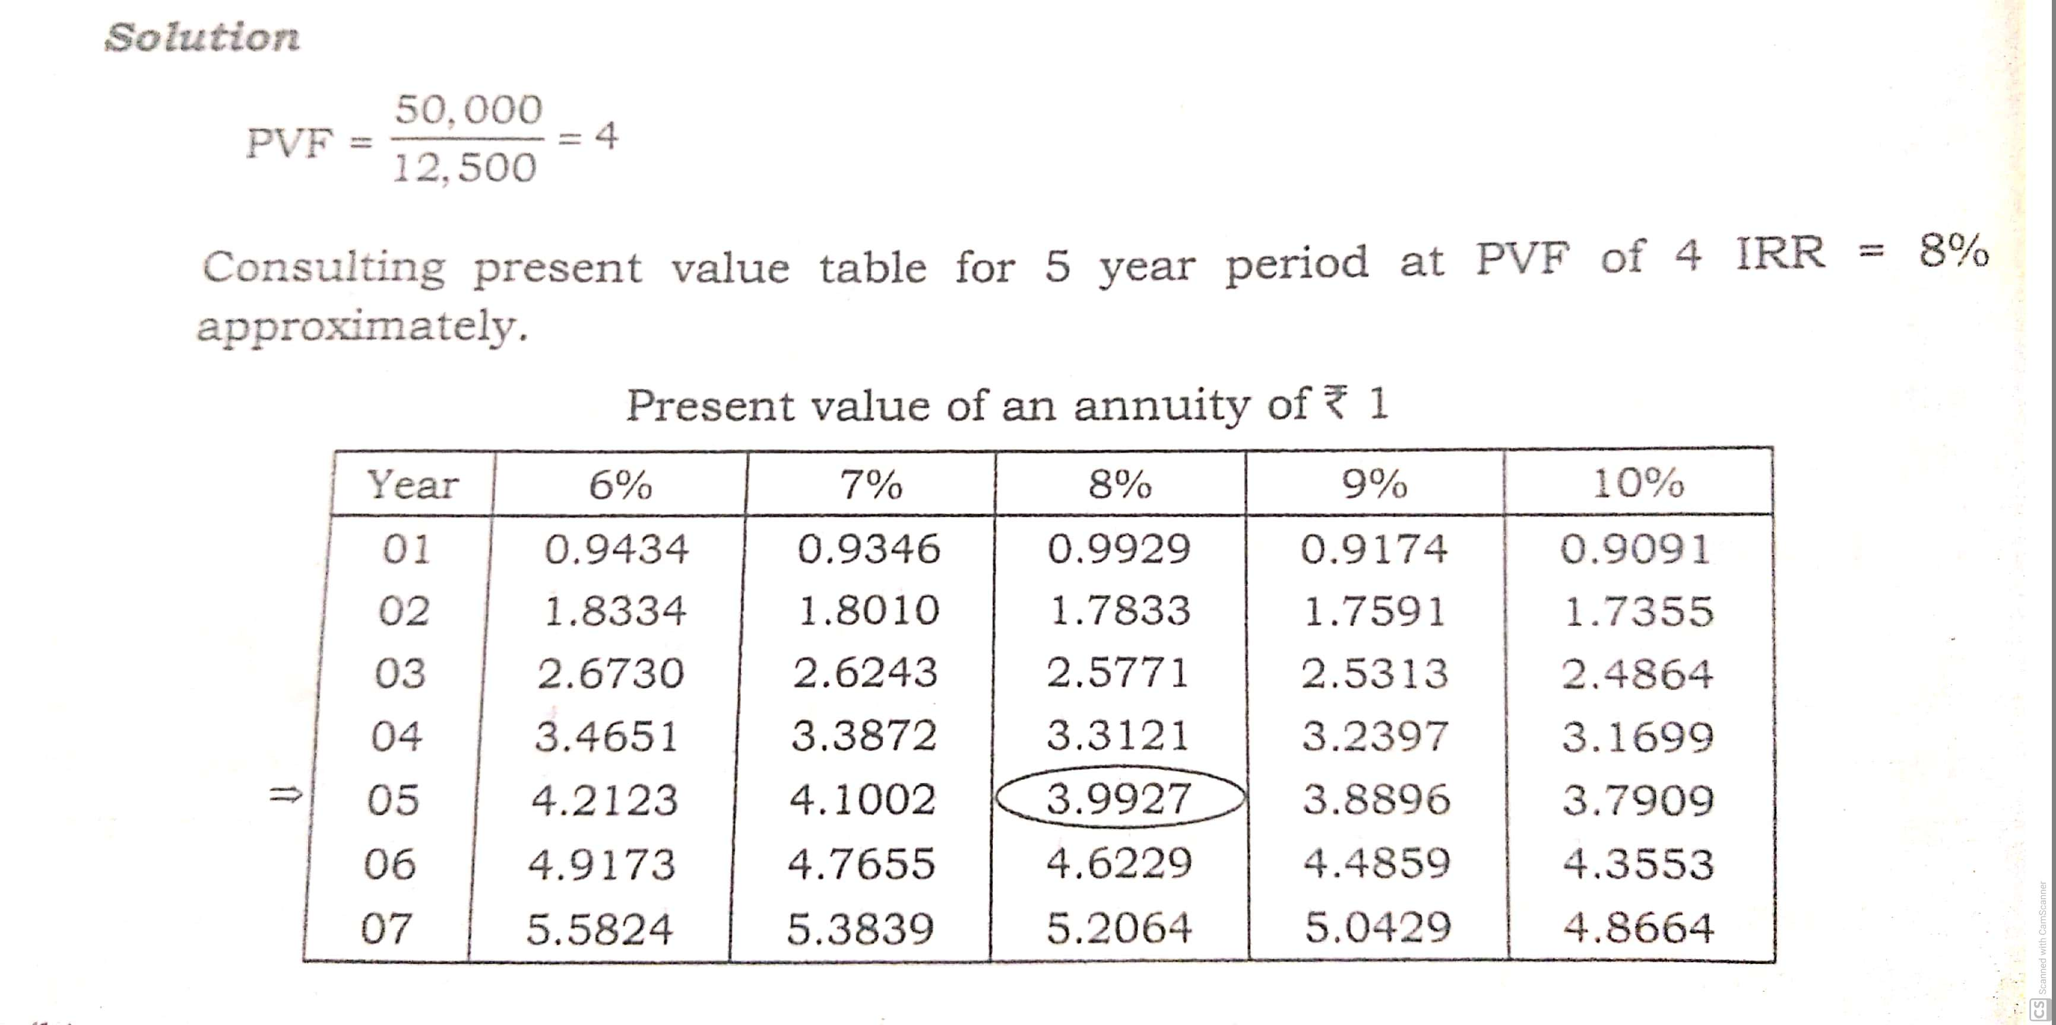

Slide 8
Example 2 (II Case)
A project cost Rs. 6000/- and is expected to generate cash inflow of Rs.2,000 over its life of 5 years. Calculate IRR.
Step 1 : PV Factor = Investment
Annual cash inflow
= 6,000 = 3
2,000
Step 2 : Search for a value nearest to PV factor in the last year of project from Table II (Cumulative PV value Table).
PV Factor 3 is not available in the table. Then take closest rates nearest to 3. (18% and 20%).

Slide 9
Stage 3: In order to make a precise estimation of IRR, find out the present values of higher and lower rate identified form the table.
P.V at 18% = 2,000 x 3.127 = 6,254
P.V at 20% = 2,000 x 2.9 = 5,800
Stage 4 : Find out the exact IRR by using interpolation formula:
= L + P₁ – Q x (H – L)
P₁ – P₂
= 18% + 6254 – 6000 x (20% – 18%)
6254 – 5800
= 18% + 254 x (2)
454
= 19.12 %

