Slide 1
IRR method
(when cash inflows are unequal)
Prepared by
Dr. Muhammed Rafi.P Assistant Professor PG Department of Commerce & Management studies

Slide 2
Steps
Calculate average cash inflow and find out PV Factor
P.V Factor = Initial investment
Average annual cash inflows
Establish first trial rate
First trial rate can be calculated on the basis of average annual cash inflow. Search for a value nearest to PV factor in the row of year of life in the Table II. The rate given in the column against this value will be first trial rate. Then compute the PV of cash inflows of all the years using the first trial rate and find the NPV.

Slide 3
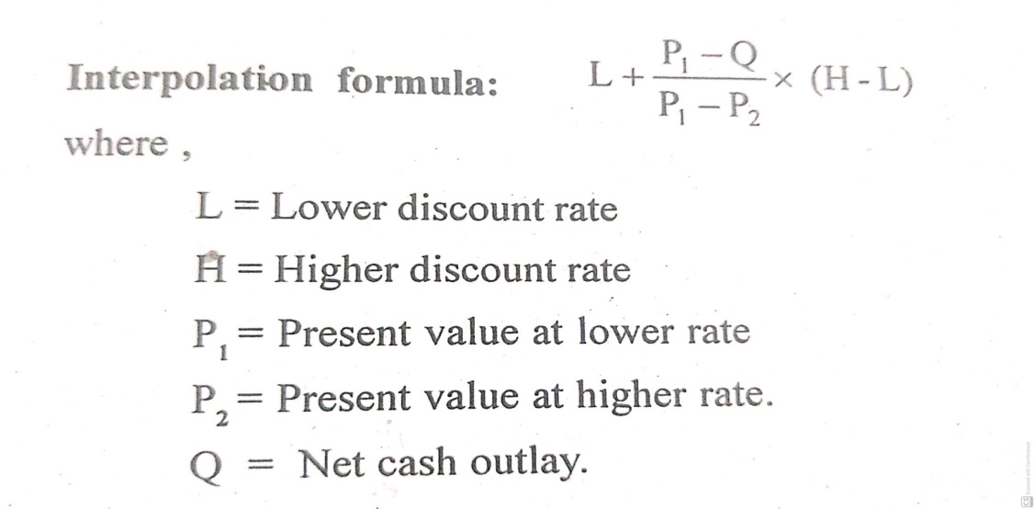
Try the second trial rate:
If the NPV at the first rate comes positive, a higher rate should be tried. If the NPV comes negative a lower rate should be tried. This exercise is done till the NPV comes to zero.
Compute actual IRR by using Interpolation formula

Slide 4
Decision rule
The calculated IRR is compared with the desired minimize rate of return. If IRR is equal to or greater than the desired minimize rate of return, then the project is accepted. If it is less than minimum rate of return then the project is rejected.

Slide 5
Example 1
From the following information, calculate IRR.
Cost : 22,000
Cash inflows:
Year 1 : 12,000
2 : 4,000
3 : 2,000
4 : 10,000

Slide 6
Steps
Calculate average cash inflow:
P.V Factor = Initial investment
Average annual cash inflows
Average annual cash inflows = 12,000 + 4,000 + 2,000 + 10,000 = 7,000
4
PV Factor = 22,000 = 3.14
7,000
Establish first trial rate
The value nearest to PV factor in the row of 4 year in the Table II IS 3.170 at 10%. So the first trial rate is 10%. Then find the NPV.

Slide 7
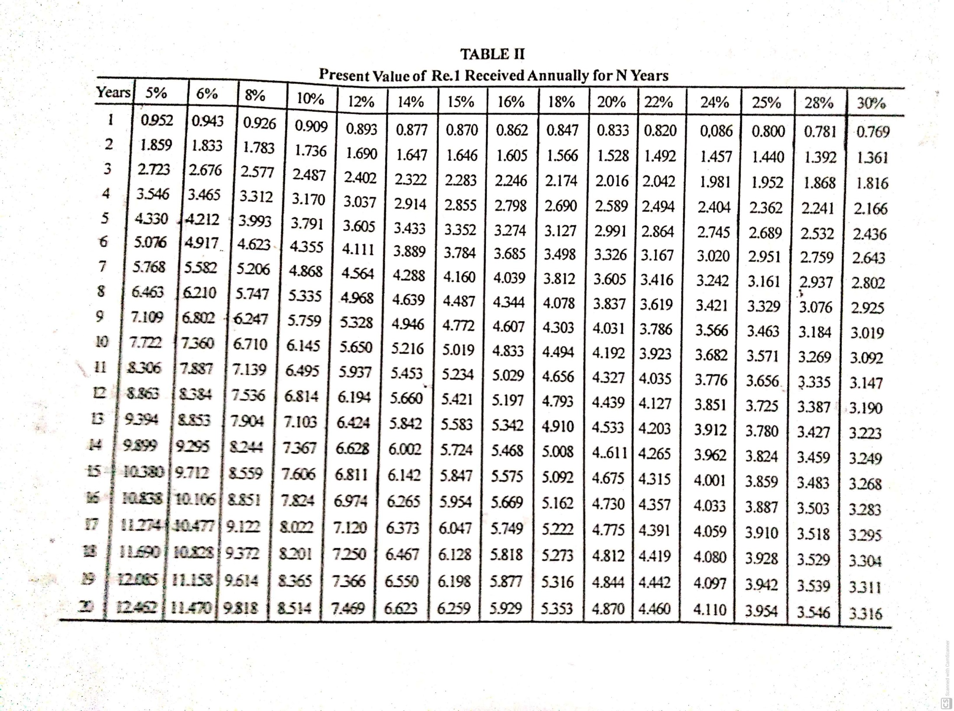

Slide 8
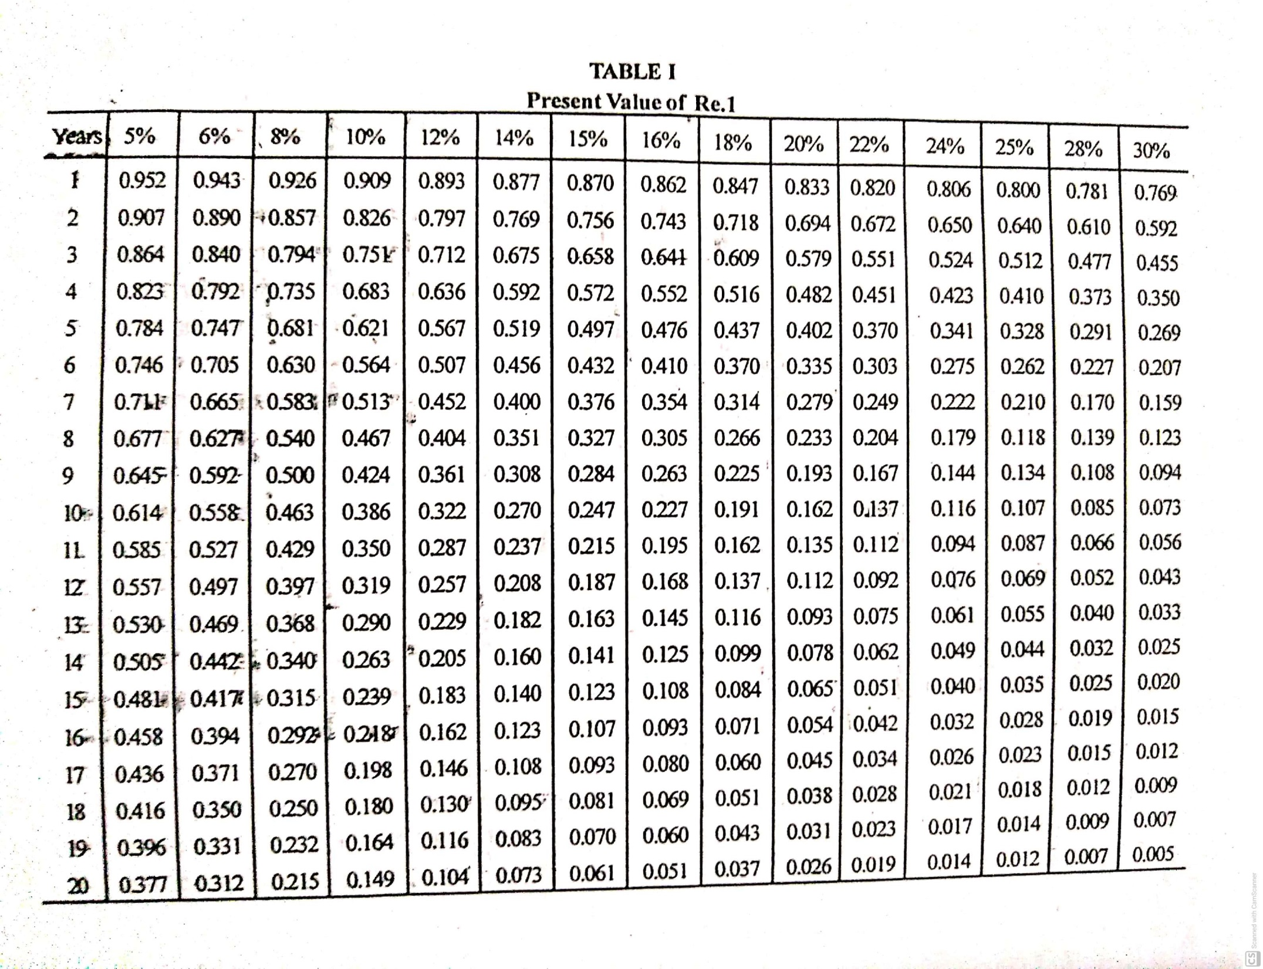

Slide 9
Calculation of NPV at DF 10%
Year | Cash inflow | Discount Factor at 10% | PV
1 | 12,000 | 0.909 | 10,908
2 | 4,000 | 0.826 | 3,304
3 | 2,000 | 0.751 | 1,502
4 | 10,000 | 0.683 | 6,830
Total present value of cash inflow |  |  | 22,544
Less : Cost of the project |  |  | 22,000
NPV |  |  | + 544

Slide 10
Since NPV is positive, let us try a higher rate, say 12%
Calculation of NPV at DF 12%
Year | Cash inflow | Discount Factor at 12% | PV
1 | 12,000 | 0.893 | 10,716
2 | 4,000 | 0.797 | 3,188
3 | 2,000 | 0.712 | 1,424
4 | 10,000 | 0.636 | 6,360
Total present value of cash inflow |  |  | 21,688
Less : Cost of the project |  |  | 22,000
NPV |  |  | -312

Slide 11
Compute actual IRR by using Interpolation formula:

Slide 12
IRR = 10% + 22,544 – 22,000 x ( 12% – 10%)
22,544 -21,688
= 10 + 1.27 = 11.27%

Slide 13
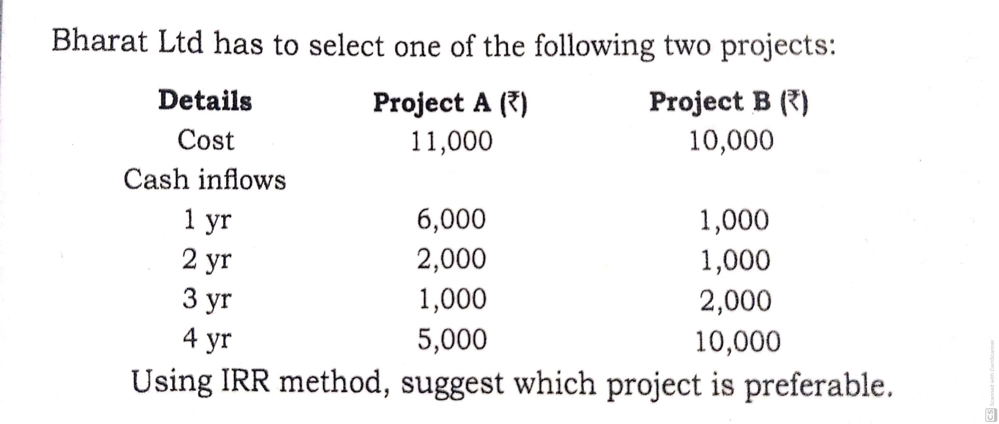
Example 2

Slide 14
When cash inflows are unequal Project A
Steps
Calculate average cash inflow:
P.V Factor of Project A = Initial investment
Average annual cash inflows
Average annual cash inflows = 6,000 + 2,000 + 1,000 + 5,000 = 3,500
4
PV Factor = 11,000 = 3.14
3,500
Establish first trial rate
The value nearest to PV factor in the row of 4 year in the Table II is 3.17 at 10%. So the first trial rate is 10%. Then find the NPV.

Slide 15
Calculation of NPV at DF 10%
Year | Cash inflow | Discount Factor at 10% | PV
1 | 6,000 | 0.909 | 5,454
2 | 2,000 | 0.826 | 1,652
3 | 1,000 | 0.751 | 751
4 | 5,000 | 0.683 | 3,415
Total present value of cash inflow |  |  | 11,272
Less : Cost of the project |  |  | 11,000
NPV |  |  | + 272

Slide 16
Since NPV is positive, let us try a higher rate, say 12%
Calculation of NPV at DF 12%
Year | Cash inflow | Discount Factor at 12% | PV
1 | 6,000 | 0.893 | 5,358
2 | 2,000 | 0.797 | 1,594
3 | 1,000 | 0.712 | 712
4 | 5,000 | 0.636 | 3,180
Total present value of cash inflow |  |  | 10,844
Less : Cost of the project |  |  | 11,000
NPV |  |  | -156

Slide 17
Compute actual IRR by using Interpolation formula:

Slide 18
IRR = 10% + 11,272 – 11,000 X ( 12% – 10%)
11,272 -156
= 10 + 1.27 = 11.27%

Slide 19
Project B
Steps
Calculate average cash inflow:
P.V Factor of Project B = Initial investment
Average annual cash inflows
Average annual cash inflows = 1,000 + 1,000 + 2,000 + 10,000 = 3,500
4
PV Factor = 10,000 = 2.86
3,500
Establish first trial rate
The value nearest to PV factor in the row of 4 year in the Table II is 2.855 at 15%. So the first trial rate is 15%. Then find the NPV.

Slide 20
Calculation of NPV at DF 15%
Year | Cash inflow | Discount Factor at 15% | PV
1 | 1,000 | 0.870 | 870
2 | 1,000 | 0.756 | 756
3 | 2,000 | 0.658 | 1,316
4 | 10,000 | 0.572 | 5,720
Total present value of cash inflow |  |  | 8662
Less : Cost of the project |  |  | 10,000
NPV |  |  | -1,338

Slide 21
Since NPV is negative, let us try a lower rate, say 14%
Calculation of NPV at DF 14%
Year | Cash inflow | Discount Factor at 14% | PV
1 | 1,000 | 0.877 | 877
2 | 1,000 | 0.679 | 679
3 | 2,000 | 0.675 | 1,350
4 | 10,000 | 0.592 | 5920
Total present value of cash inflow |  |  | 8,826
Less : Cost of the project |  |  | 10,000
NPV |  |  | -1174

Slide 22
Since NPV is high negative, let us try a lower rate, say 10%
Calculation of NPV at DF 10%
Year | Cash inflow | Discount Factor at 10% | PV
1 | 1,000 | 0.909 | 909
2 | 1,000 | 0.826 | 826
3 | 2,000 | 0.751 | 1,502
4 | 10,000 | 0.683 | 6,830
Total present value of cash inflow |  |  | 10,067
Less : Cost of the project |  |  | 10,000
NPV |  |  | +67

Slide 23
Compute actual IRR by using Interpolation formula:

Slide 24
IRR = 10% + 10,067 – 10,000 X ( 14% – 10%)
10,067 – 8,826
= 10 + 0.215 = 10.21%
Thus, IRR in case of Project A is higher than Project B. Hence project A is preferable.

Slide 25
Advantages and Disadvantages of IRR
ADVANTAGES OF IRR
This method consider all the cash flows over the entire life of the project.
Consider time value of money
Cost of capital need not be calculated
IRR gives a true picture of the profitability of the project.
Projects having different degrees of risk can easily compared.
DISADVANTAGES OF IRR
Difficult to understand
Complicated calculations
It is applicable mainly in large projects

Slide 26
Difference between IRR and NPV
 | IRR | NPV
1 | The minimum desired rate of return is assumed to be known | The minimum desired rate of return is to be determined
2 | It gives absolute return | It gives percentage return
3 | The NPV of different projects can be added | The IRRs of different projects cannot be added
4 | It implies that the cash inflows are invested at the rate of firms’s cost of capital | It implies that the cash inflows are reinvested at the IRR of the project.

