Slide 1
Net Terminal Value Method (NTV Method)
This method is based on the assumption that each annual cash inflow is received at the end of year and is reinvested in another asset at a certain rate of return from the moment it is received till the termination of the project.

Slide 2
Net Terminal Value Method (NTV Method)
Prepared by
Dr. Muhammed Rafi.P Assistant Professor PG Department of Commerce & Management studies

Slide 3
Net Terminal Value Method (NTV Method)
This method is based on the assumption that each annual cash inflow is received at the end of year and is reinvested in another asset at a certain rate of return from the moment it is received till the termination of the project.

Slide 4
Decision rule
If the present value of the sum total of the compounded reinvested cash flow is greater than the present value of the outflows, the proposed project is accepted, otherwise rejected.

Slide 5
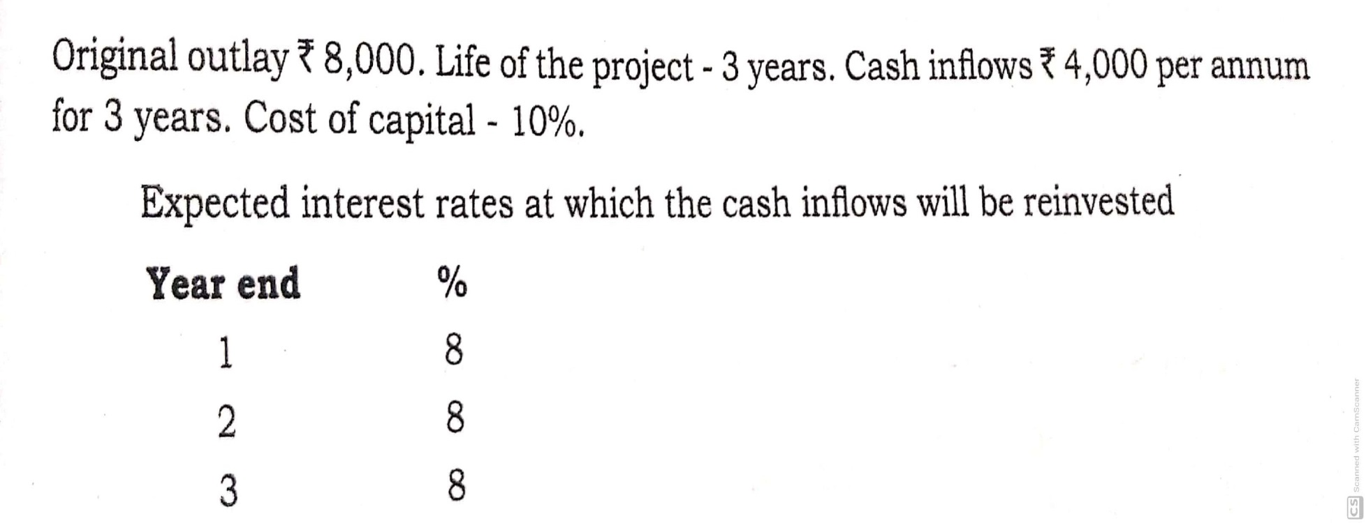
Example 1

Slide 6
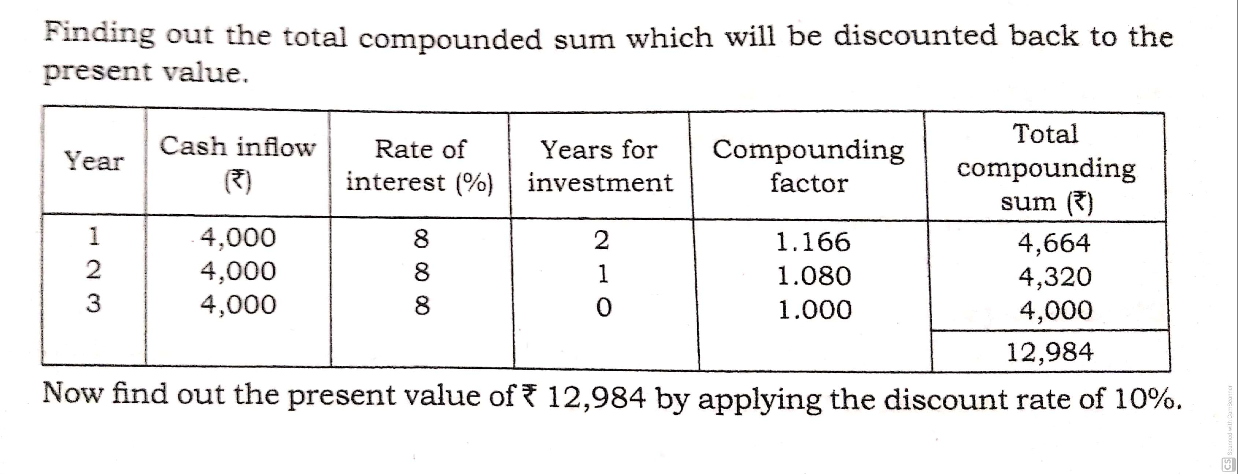
Solution Here, we use Table III (The Compound Sum of One Rupee) to calculate Compounding factor.

Slide 7
Present value of Rs.12,984 for the discount rate of 10% at the 3rd year:
= 12,984 x .751
= 9751
The present value of reinvested cash flow, ie, Rs.9751 is greater than the original cash outlay of Rs.8,000, the project is worth acceptable.

Slide 8
or

Slide 9
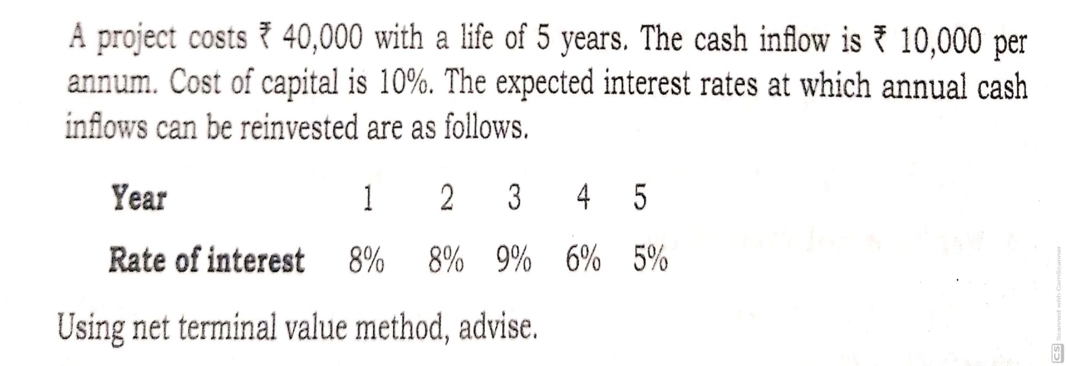
Example 2

Slide 10
Solution

Slide 11
or
Present value of Rs.58,660 for the discount rate of 10% at the 5th year:
= 58,660 x .621
= 36,427
The present value of reinvested cash flow, ie, Rs.36,427 is lesser than the original cash outlay of Rs.40,000 . So reject the proposal.

Slide 12
Advantages
Simple technique
Simple to understand
It avoids influence of cost of capital
More suitable for cash budgeting

Slide 13
Disadvantages
It is difficult to project the future rate of interest
Comparative evaluation is not considered

