Slide 1
Assignment II
Capital budgeting techniques
Prepared by
Dr. Muhammed Rafi.P
Assistant Professor
PG Department of Commerce & Management studies

Slide 2
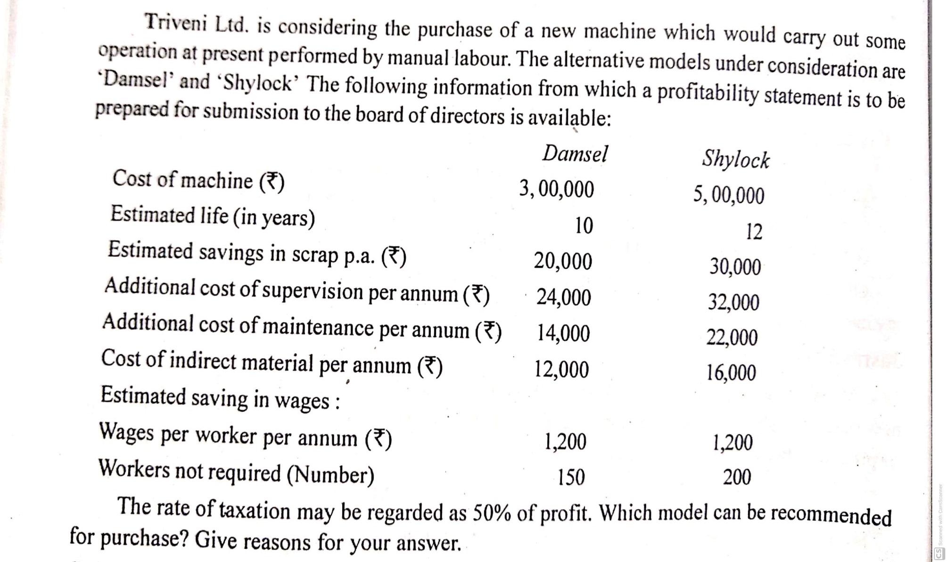
Question.1

Slide 3
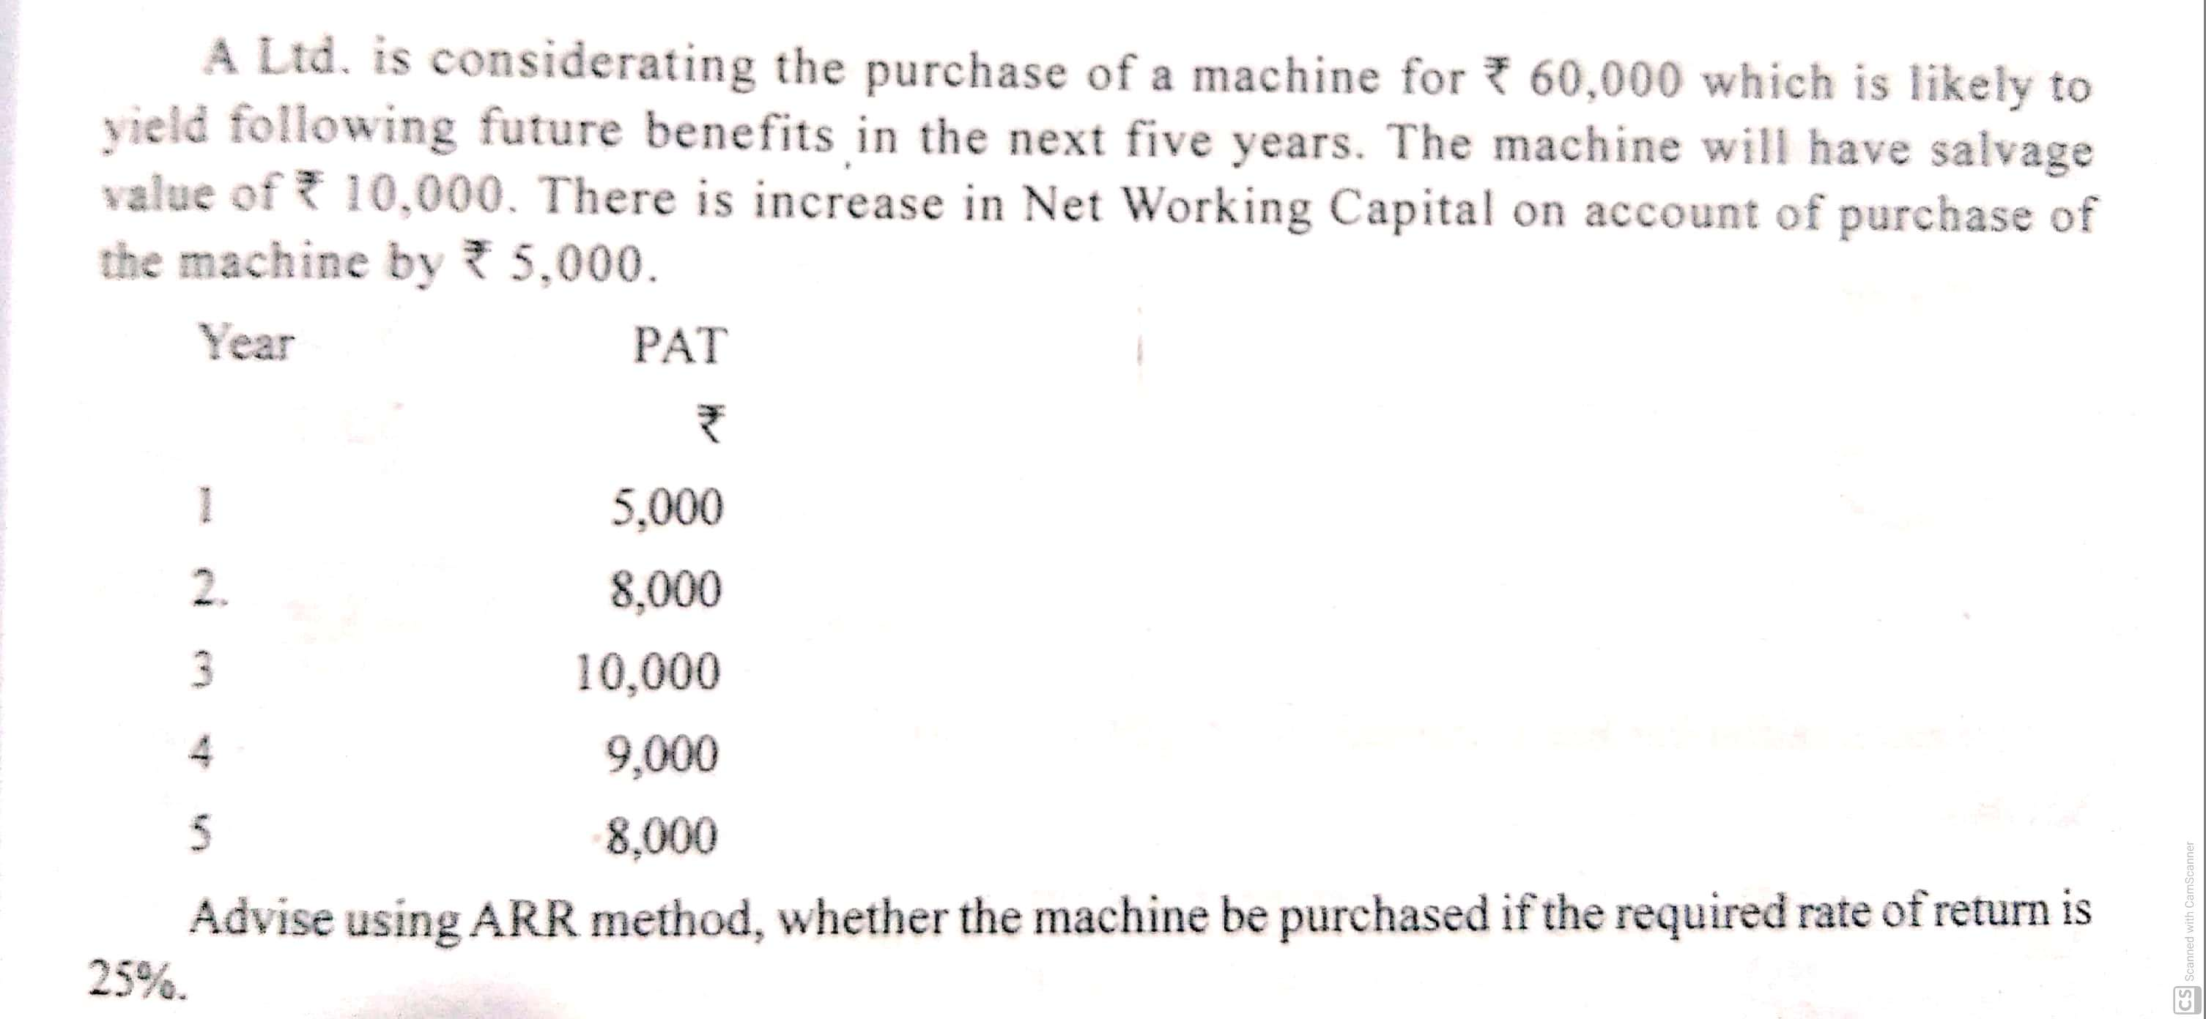
Question.2

Slide 4
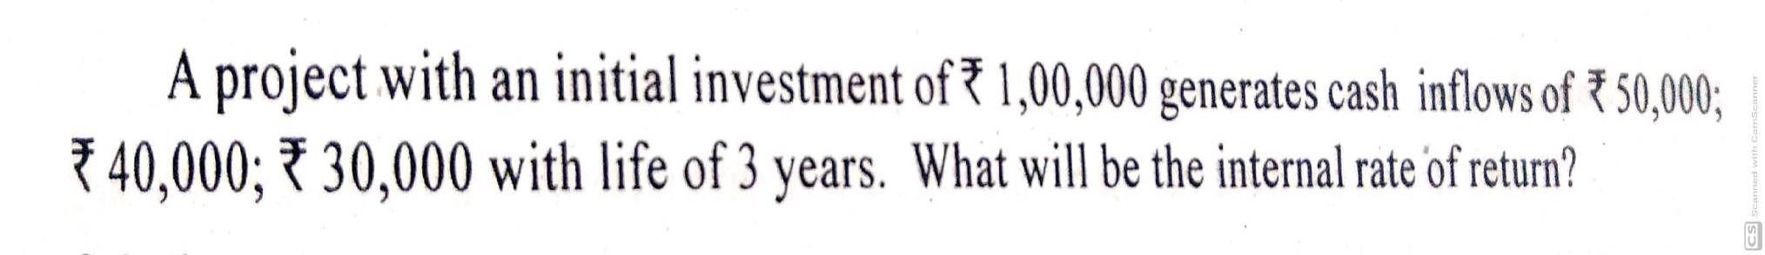
Question.3

Slide 5
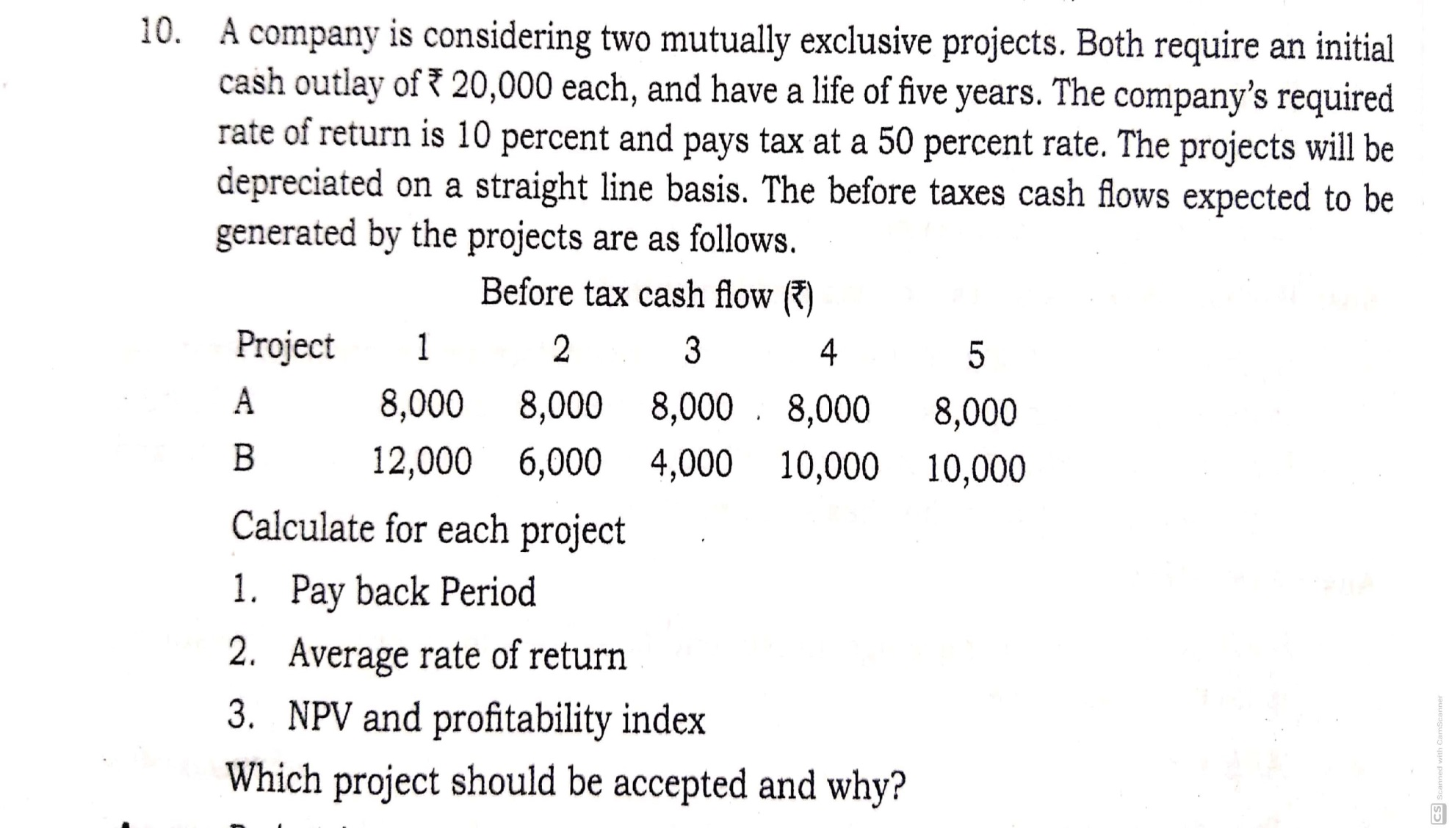
Question.4

Slide 6
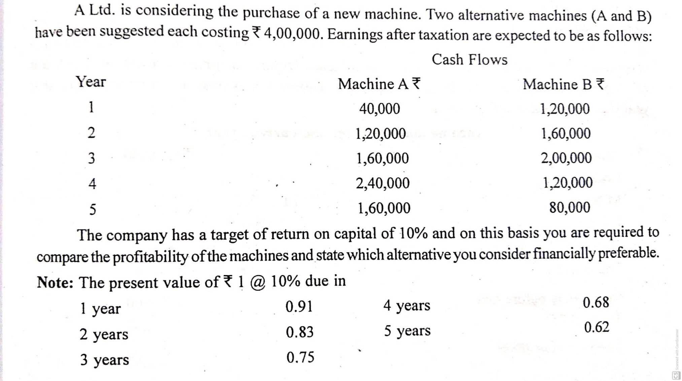
Question.5

