Slide 1
Cost of equity share capital
Prepared by
Dr. Muhammed Rafi.P
Assistant Professor
PG Department of Commerce & Management studies

Slide 2
Cost of equity share capital
The cost of equity capital is the most difficult to measure.
It is so because the rate of dividend is not fixed. It depends upon the profitability.
However it does not mean that equity share capital is cost free. It also has certain cost.
The cost of equity capital is the minimum rate of return that the company must earn on its equity share capital.
It is the return which the shareholder expects on his investment.

Slide 3
The cost of equity capital can be calculated under six methods:
• Dividend yield method
• Dividend yield plus growth method
• Earning yield method
• Realized yield method
• CAPM
• Gordon dividend growth model

Slide 4
1. Dividend Yield Method
This method is based on the assumption that each shareholder, while investing his savings in the company, expects to receive dividend at the current rate of return.
Therefore, dividend received is capitalized by the market value of shares to ascertain the cost of shares.
This method is also known as dividend price ratio method. To ascertain the cost of capital, dividend is divided by net proceeds.

Slide 5
Formula
a) In the case of existing equity shares:
K_{e} = D x 100
MP
K_{e =} Cost of equity capital
D = Dividend per share (expected)
MP = Market price per share
b) In the case of new equity shares:
K_{e} = D x 100
NP
NP = Net proceeds

Slide 6
2. Dividend Yield plus Growth Method
When the dividend expected to grow at a constant rate and dividend pay out ratio is constant, this method may be used.
Under this method the cost of equity is based on the present rate of dividend and expected growth rate of dividend.

Slide 7
Formula
In the case of existing equity shares:
K_{e} = D₁ x 100 + G
MP
K_{e =} Cost of equity capital
D₁ = Expected dividend per share at the end of the year.(D₁ ₌ D₀(1+g).
D₀ = Previous year’s dividend or declared dividend
MP = Market price per share
G = Rate of growth in dividend
b) In the case of new equity shares:
K_{e} = D₁ x 100 + G
NP
NP = Net proceeds per share

Slide 8
From the above equations, MP or NP can be calculated as follows:
MP or NP = D1
K_{e}- G

Slide 9
Example 1
ABC Ltd plans to issue 1,000 new equity share of Rs.100 each at par. The floatation costs are expected to be 5% of the share price. The company pays a dividend of Rs.10 per share initially and the growth rate in dividend is expected to be 5%. Compute the cost of new equity share. If the current market price is Rs.150, compute the cost of existing equity share.
In the case of new equity shares:
K_{e} = D₁ x 100 + G
NP
K_{e} = 10 x 100 + 5% = 15.53%
100 - 5

Slide 10
If the market price of an equity share is Rs.150:
K_{e} = D₁ x 100 + G
MP
K_{e} = 10 x 100 + 5% = 11.67%
150

Slide 11
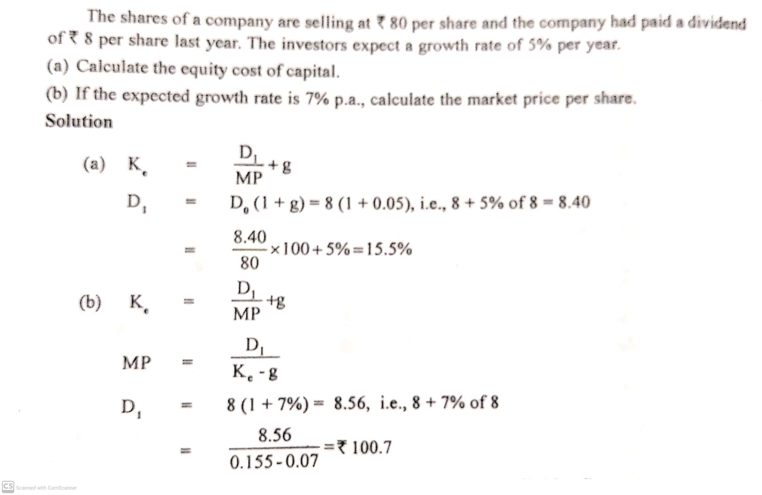
Example 2

