Slide 1
Earning yield method
Prepared by
Dr. Muhammed Rafi.P Assistant Professor PG Department of Commerce & Management studies

Slide 2
Earning yield method
It is also called earning price method.
According to this method, the cost of equity capital is the discount rate that equates the present value of expected future earnings per share with the current market price or net proceeds per share.
This method is used in the following cases:
When the EPS is expected to remain constant
When the dividend payout ratio is 100 %
The share price is influenced by the EPS

Slide 3
Formula
K_{e} = EPS x 100 + G
MP or NP
EPS = Earning Per Share

Slide 4
Example 1

Slide 5
Realised yield method
When future dividend and market price are uncertain, it is very difficult to estimate the rate of return on investment.
In order to overcome this difficulty, the average rate of return actually realized in the past few years by the investor is used to determine the cost of capital.
Under this method, the realized yield is discounted at the present value factor and then compared with the value of investment.

Slide 6
Capital Asset Pricing Model (CAPM) or Approach
Under this method the cost of equity is divided into two components-
(i) the near risk free return available on investing in government bonds and
(ii) an additional risk premium for investing in a particular share or investment.
This risk premium in turn comprises the average return on the overall market portfolio and the beta factor (or risk) of the particular investment.

Slide 7
Formula

Slide 8
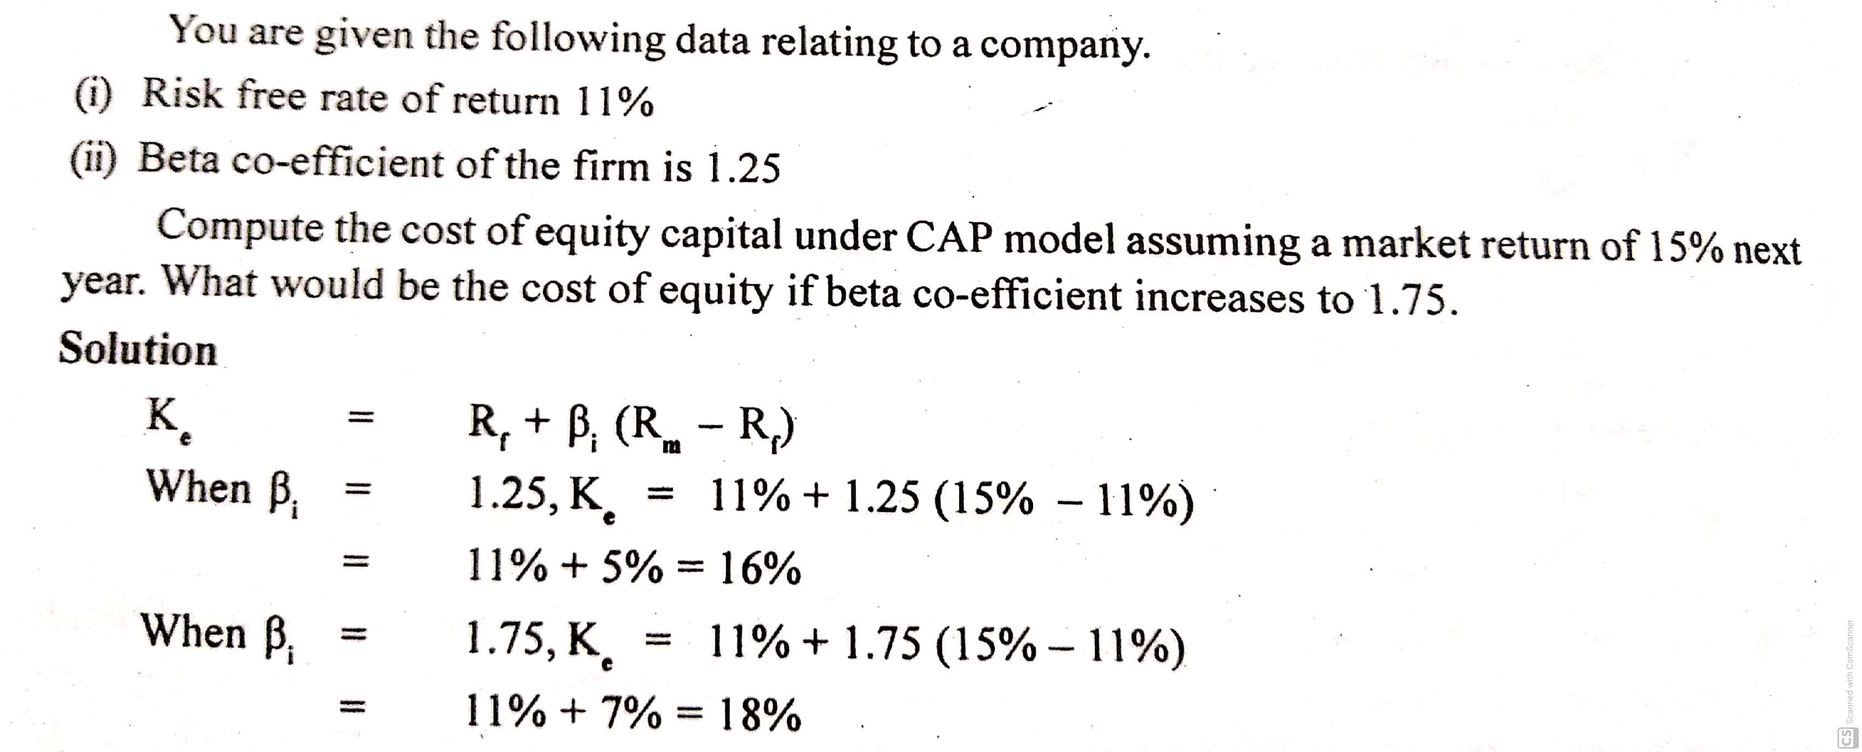
Example 1

Slide 9
Gordon Dividend Growth Model
This is yet another technique to determine cost of equity.
This approach takes into account annual growth in dividend in perpetuity.
The dividend and its growth is shown as the ratio of expected rate of return plus growth rate.

Slide 10
Formula

