Slide 1
Cost of retained earnings
Prepared by
Dr. Muhammed Rafi.P Assistant Professor PG Department of Commerce & Management studies

Slide 2
Cost of Retained Earnings
Generally, it is thought that retained earnings do not involve any cost and it is a cost free source of finance.
Thus the retained earnings involve opportunity cost. So cost of retained earnings is the rate of return which the shareholder is not receiving the dividend.
It refers to the rate of return which shareholder can obtain by investing the after tax dividend in other securities.

Slide 3
Formula

Slide 4
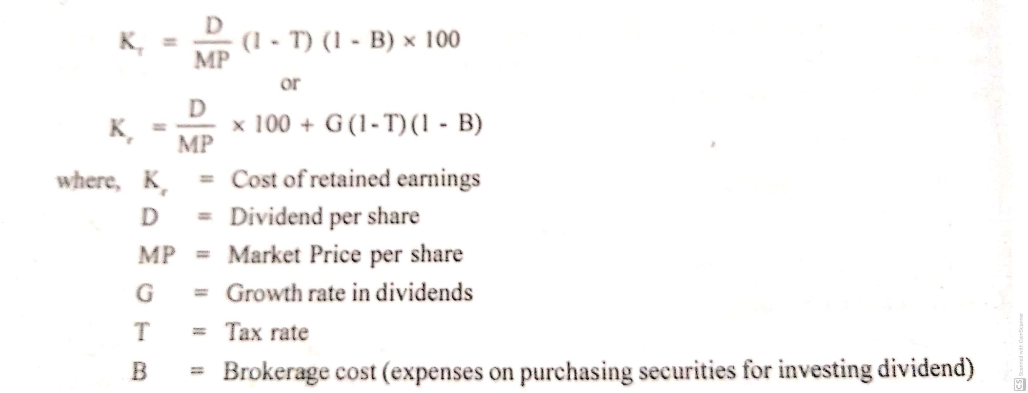
To make adjustments in the cost of retained earnings for tax and expenses, any of the following formula maybe used:

Slide 5
Example 1

