Slide 1
Weighted Average Cost of capital
Prepared by
Dr. Muhammed Rafi.P Assistant Professor PG Department of Commerce & Management studies

Slide 2
Weighted Average Cost Of Capital (WACC)
WACC simply refers to the average cost of the various sources of finance.
It is an average of the cost of all sources of funds in the capital structure, properly weighted by the proportion of each source in the capital structure.
It is also known as composite cost of capital or overall cost of capital.
We use no simple average but weighted average.

Slide 3
Steps involved in calculating WACC
Assigning of weights:
First of all weights have to be assigned to each source. It can be either book value weights or market value weights.
a) Book value weights: These are the relative proportion of various sources of capital to the total capital.
b) Market value of weights: It may calculated on the basis of the market value of the different sources of capital.
2. Computation of specific cost of each source :
After assigning weights, the next step is to calculate the specific cost of each source.
3. Computation of WACC:
After ascertaining specific cost of each source, the WACC is calculated. This is calculated by multiplying the cost of each source by its respective weights.

Slide 4
Merits of WACC
Straight forward and logical approach.
Takes into consideration all changes in the capital structure.
More accurate when profit are normal.
Useful in budgeting decision.

Slide 5
Demerits of WACC
Not suitable in case of excessive low cost debt.
Not suitable in case of low profits
Difficult to assign weights

Slide 6
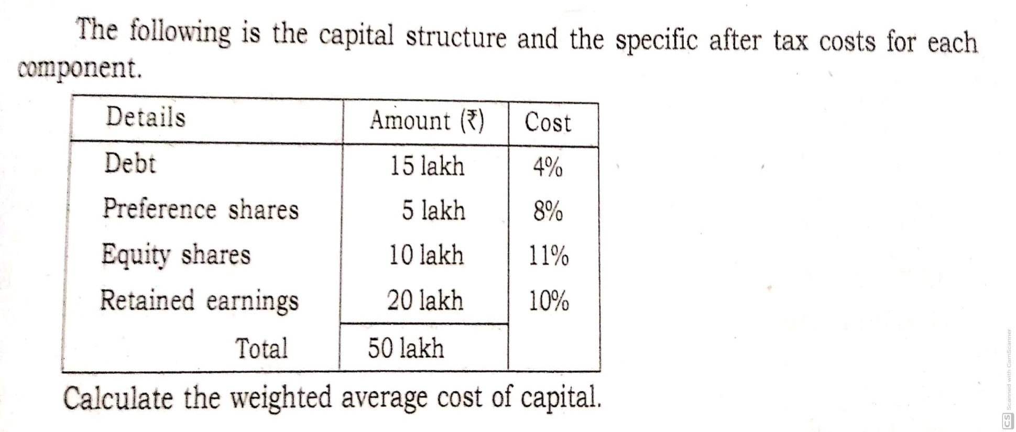
Example 1

Slide 7
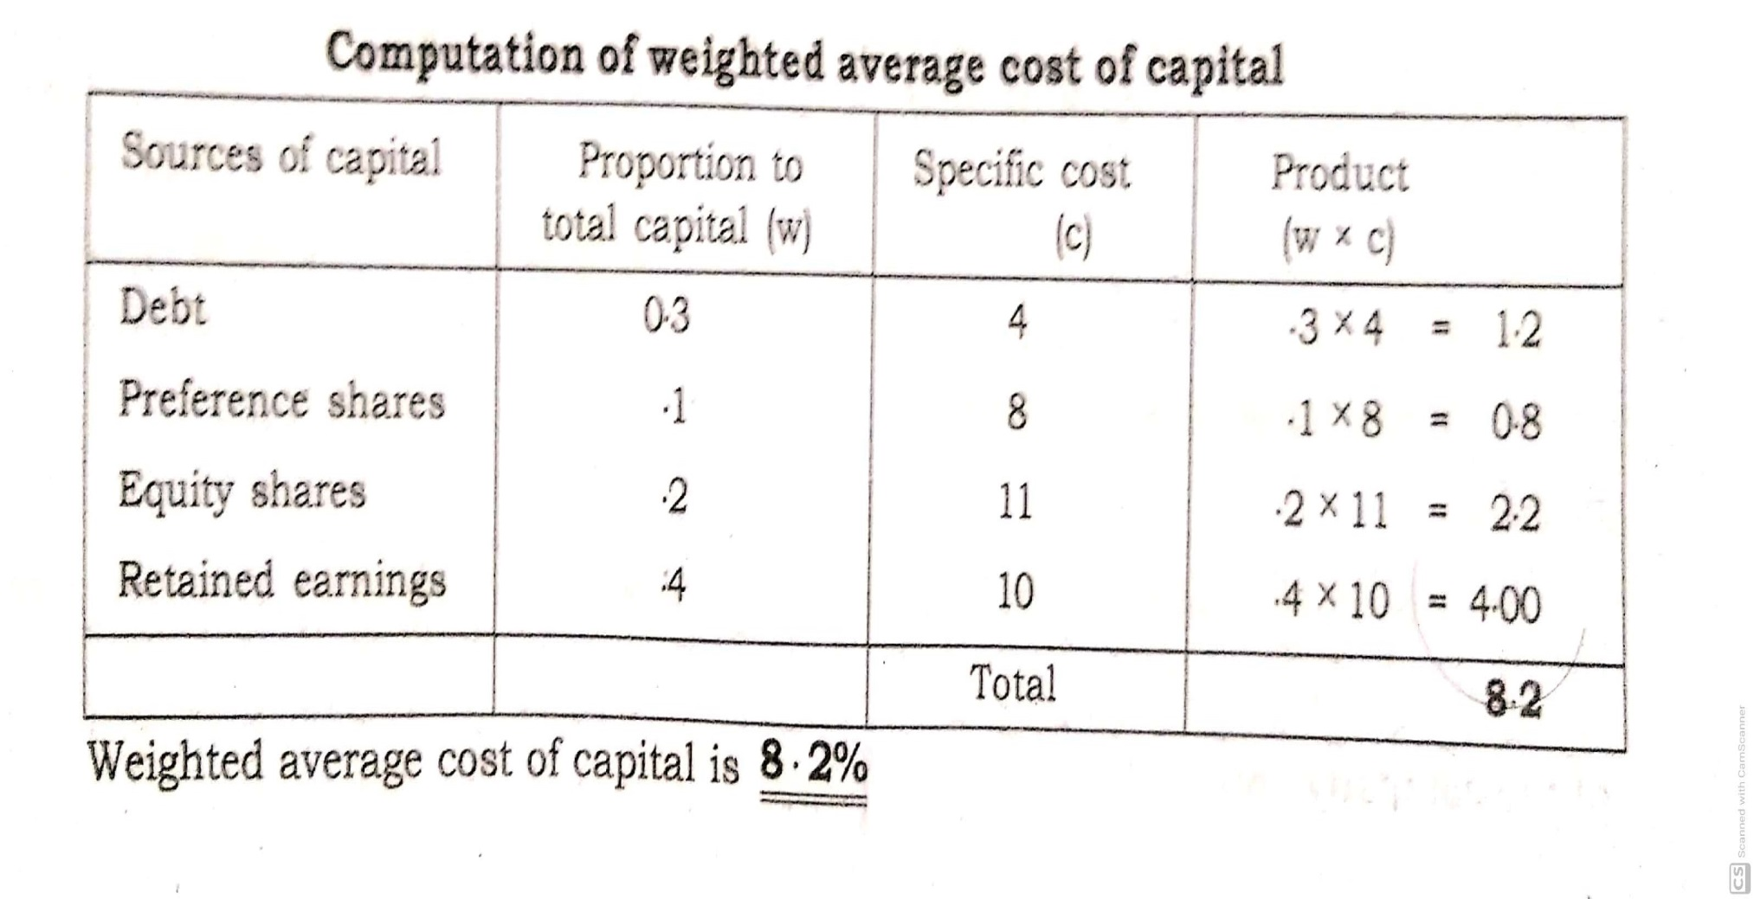
Solution

Slide 8
Example 2

Slide 9
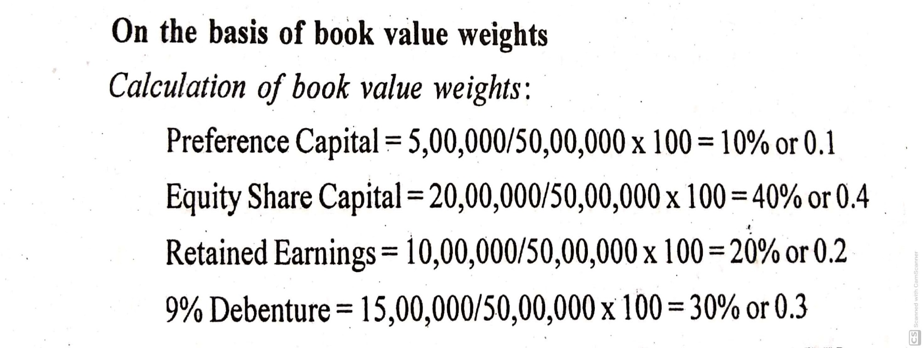
Solution

Slide 10
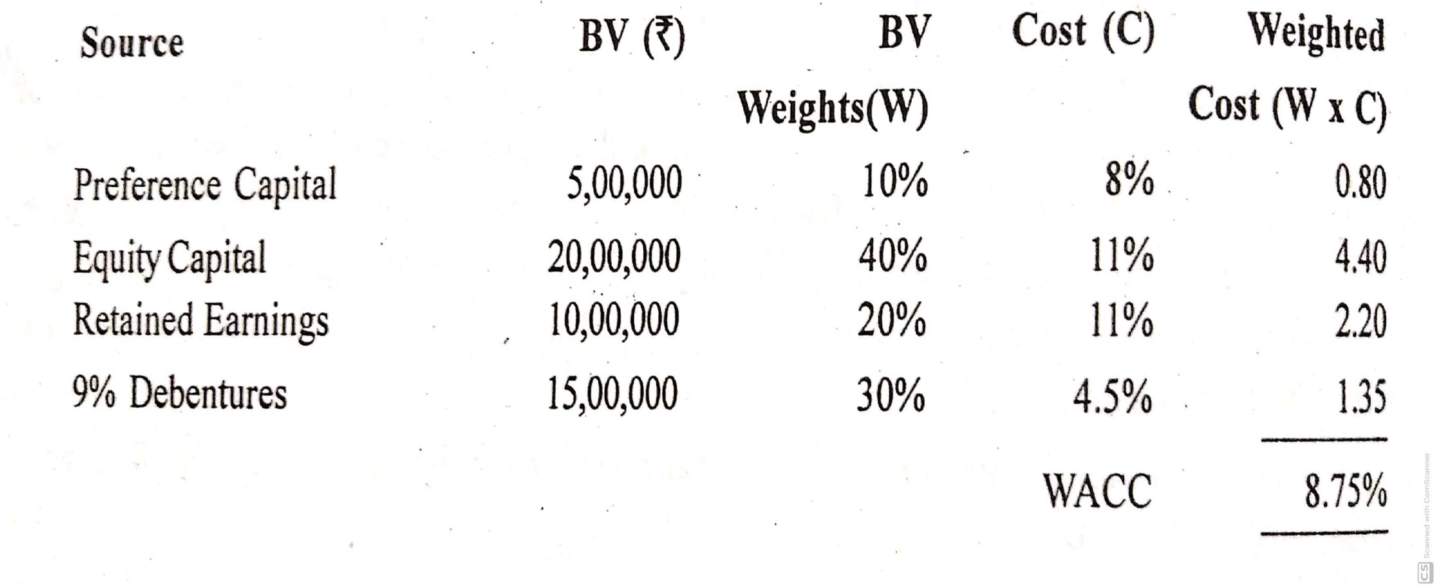

Slide 12
