Slide 1
Net Current Asset Forecasting Method
Prepared by
Dr. Muhammed Rafi.P
Assistant Professor
PG Department of Commerce & Management studies

Slide 2
Net Current Asset Forecasting Method
In this method, amount blocked in each item of current asset is determined first.
Then the value of current liabilities is arrived at.
The difference between the total estimated amount of current asset and current liabilities gives the networking capital requirement of the firm.
To this amount, some extra amount(safety margin) for providing for contingency is added.
The extra amount is calculated as a fixed percentage of the net working arrived at by deducting the total current liabilities from the total current assets.

Slide 3
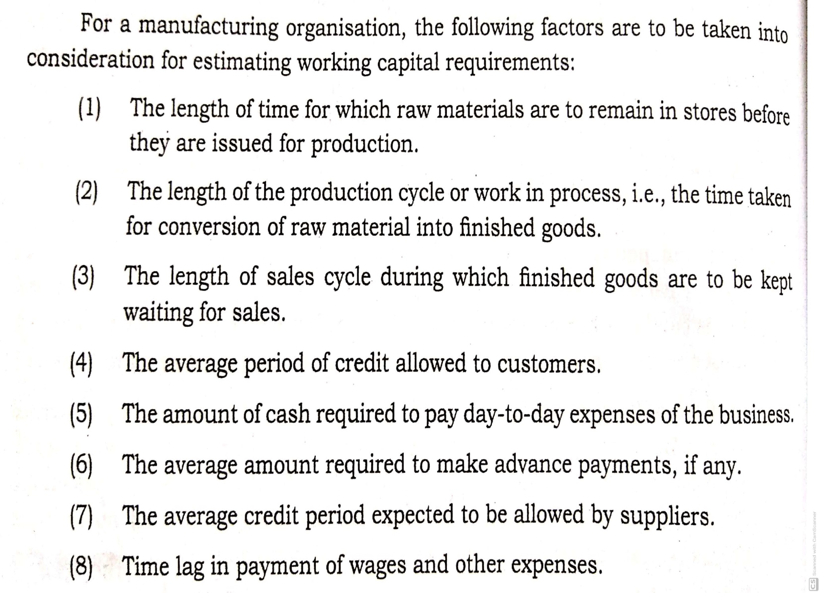

Slide 4
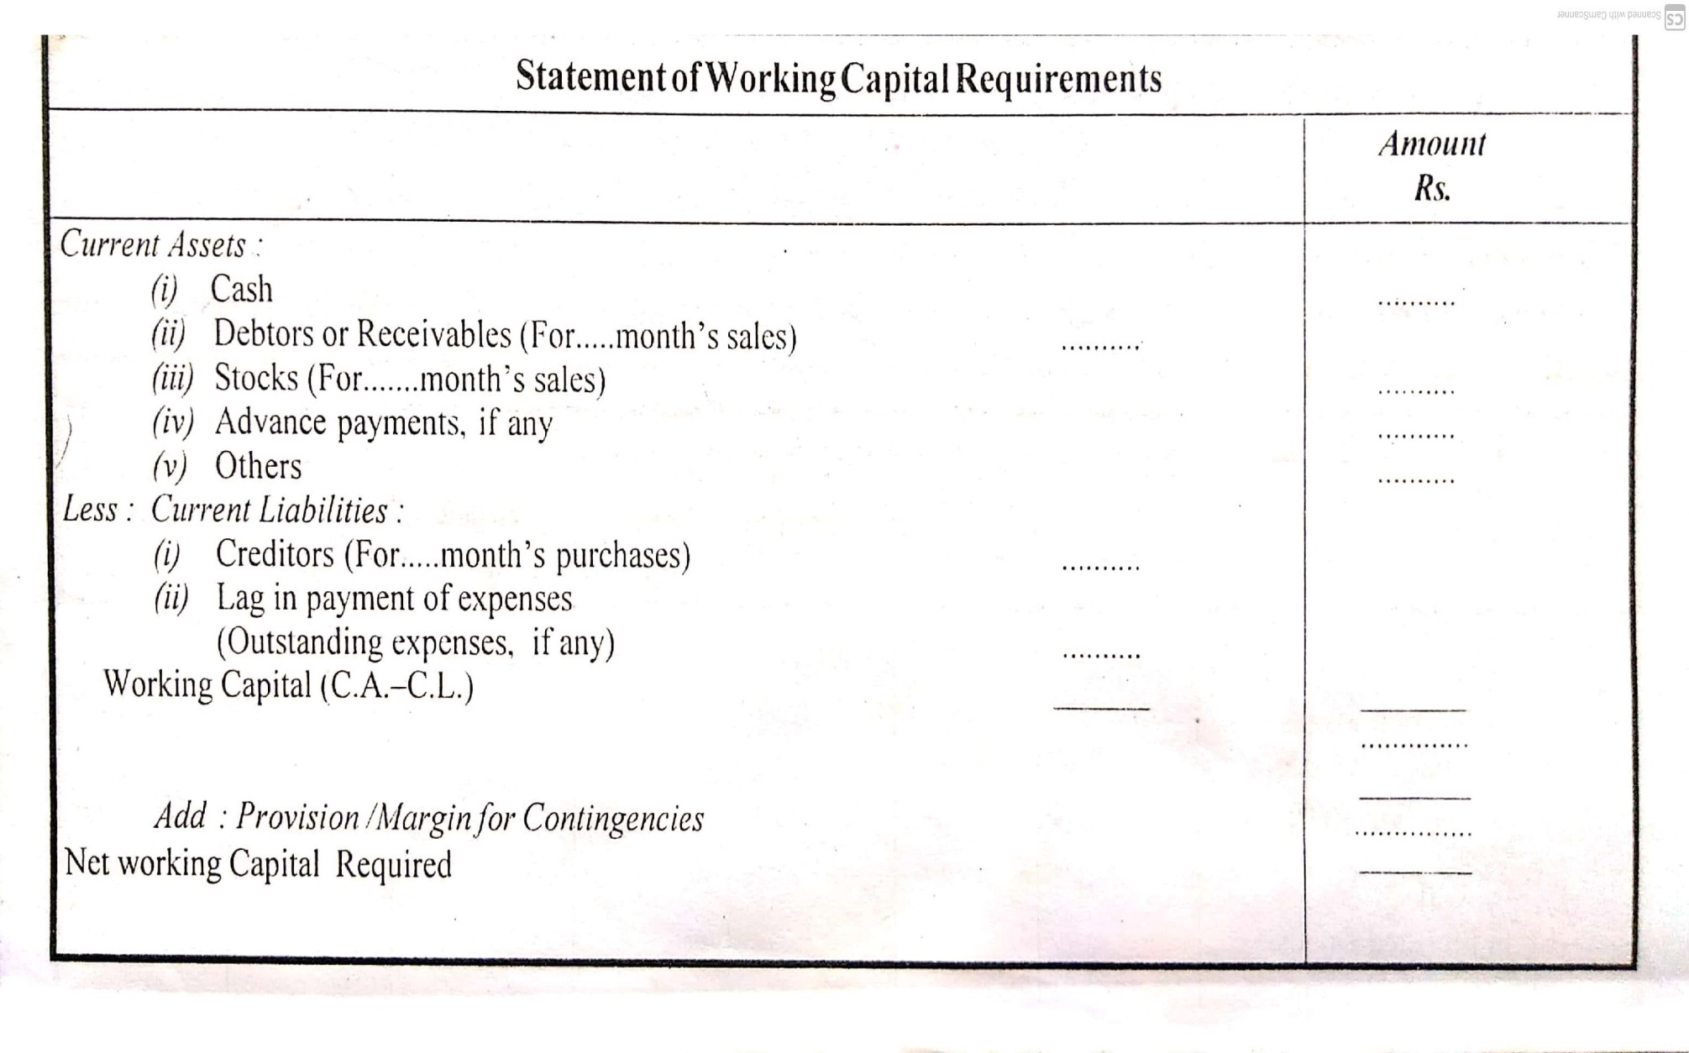
1.For a trading concern

Slide 5
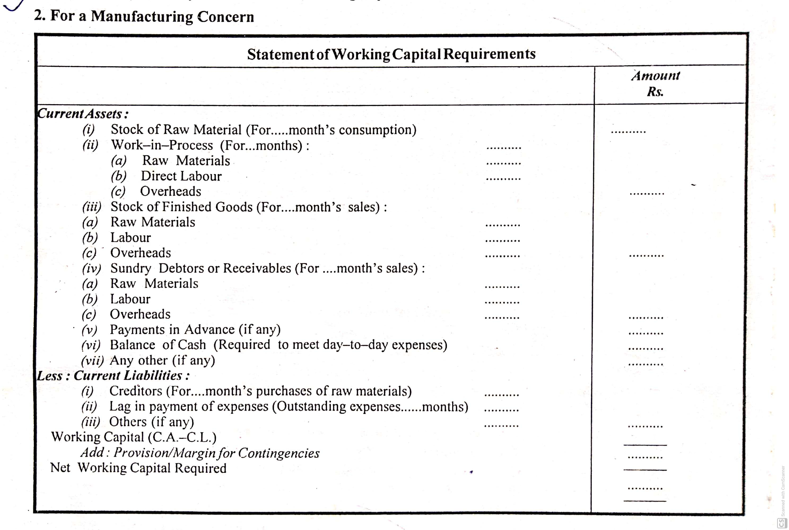

Slide 6
Problem 1
ABC Ltd. Gives the following information.
Expected level of production 1,20,000 units
Raw materials to remain in stock on an average 2months
Processing period for each unit of product 1 month
Finished goods remain in stock on an average 3 months
Credit allowed the customers from the
date of despatch 3 months
Expected ratios of cost to selling price
Raw material 60%
Direct wages 10%
Overhead 20%
Selling price per unit Rs.10
Expected margin on sale 10%
You are required to estimate the working capital requirements of ABC Ltd.

Slide 7
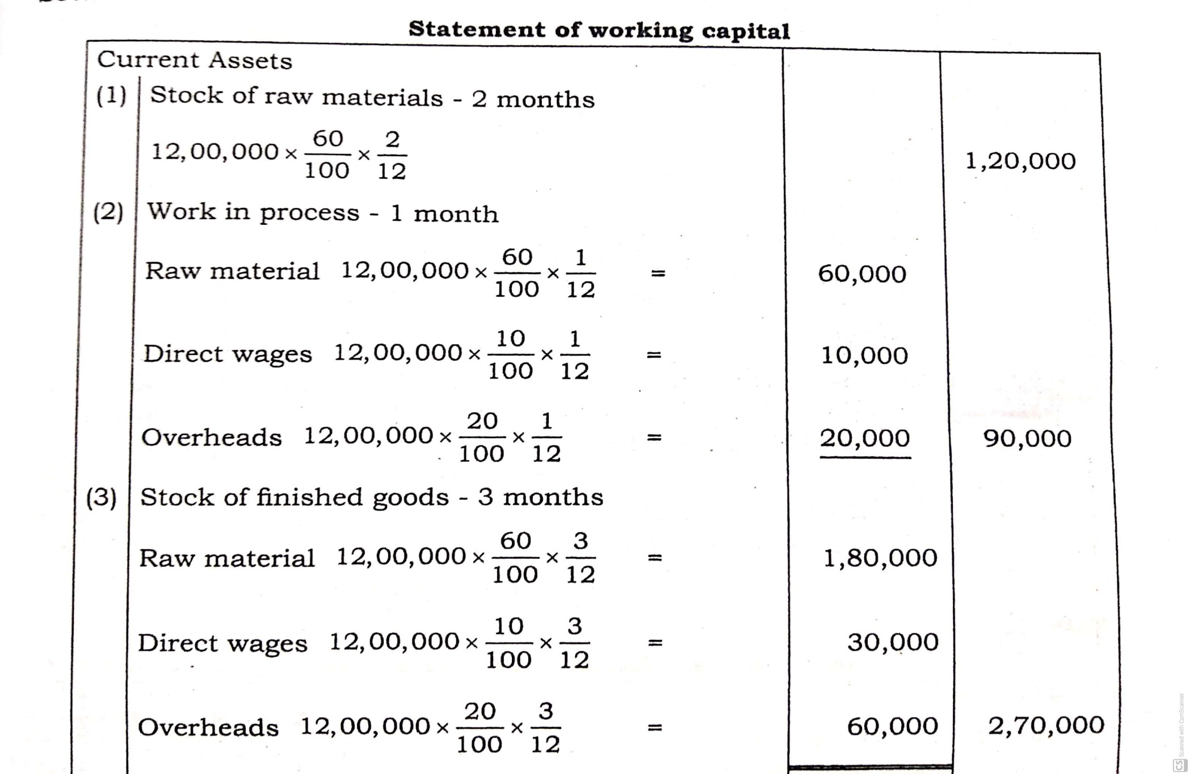
Solution

Slide 8
(4) | Sundry debtors: 3 Months Raw materials ( 12,00,000 x 60/100 x 3/12) Direct wages :( 12,00,000 x 10/100 x 3/12) Overheads : ( 12,00,000 x 20/100 x 3/12) | 1,80,000 30,000 60,000 | 2,70,000
 | Here profit may be included : If profit is not included, Total working capital. If profit is included, sundry debtors will be 3,00,000 instead of Rs.2,70,000 |  | 7,50,000 3,00,000
 | Then working capital will be |  | 7,80,000

Slide 9
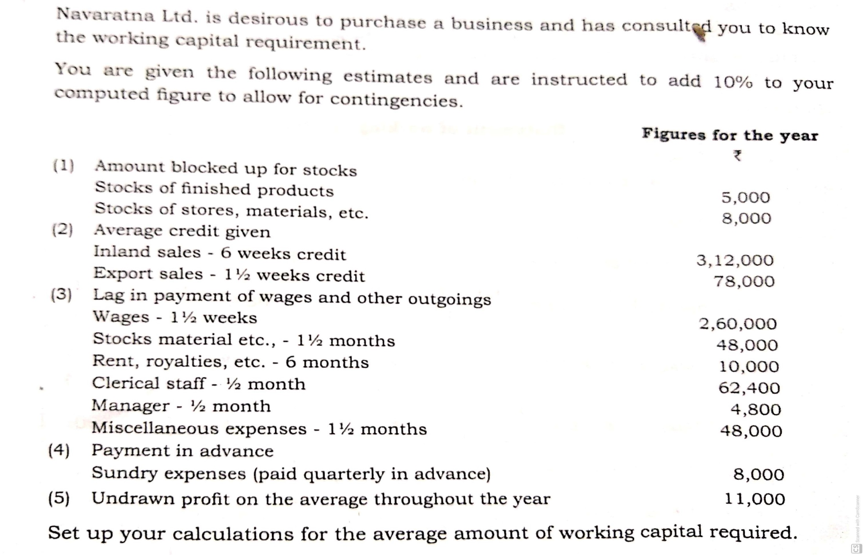
Problem 2

Slide 10
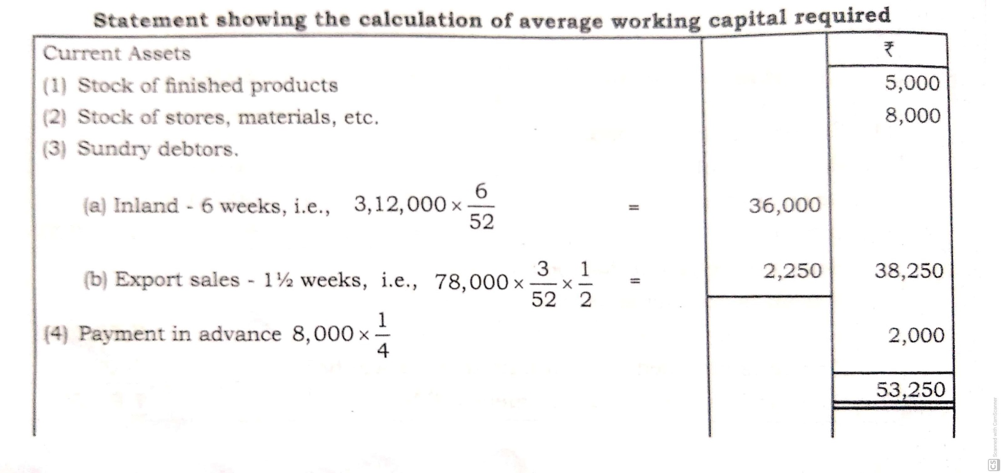
Solution

Slide 11
