Slide 1
Problems
Operating cycle method
Prepared by
Dr. Muhammed Rafi.P
Assistant Professor
PG Department of Commerce & Management studies

Slide 2
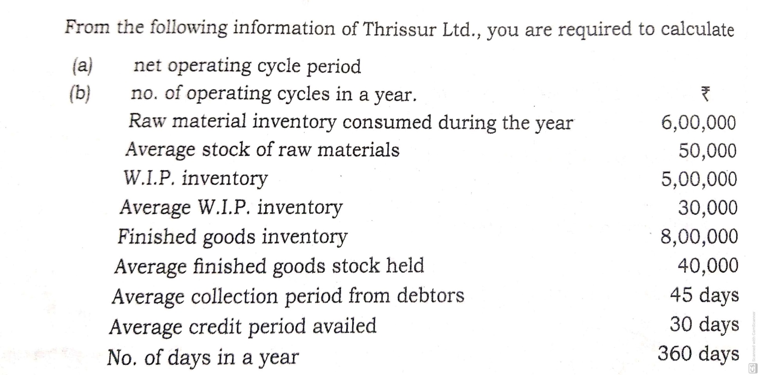
Problem. 1

Slide 3
Calculation of net operating cycle period of Trissur Ltd.
I. Raw material storage period (R) = Average stock of raw material
Average daily consumption
Average stock = 50,000
Average daily consumption = Material consumed during the year
360
= 6,00,000 = 1,667
360
Raw material storage period = 50,000 = 30
1,667

Slide 4
II. Average period of W.I.P (W) = Average W.I.P
Average daily production cost
Average W.I.P = 30,000
Average daily production cost = Total production cost
360
= 5,00,000 = 1389
360
Average period of W.I.P = 30,000 = 22
1,338

Slide 5
III. Finished goods average storage period (F):
= Average stock of finished goods
Daily average cost of goods sold
Average stock of finished goods = 40,000
Daily average stock of goods = Cost of goods sold
360
= 8,00,000 = 2,222
360
Finished goods average storage period = 40,000 = 18
2,222
IV. Debtors collection period (D) = 45 days

Slide 6
Gross operating cycle period = R + W + F + D = 115
Less :Average credit period availed(C) = 30
Net Operating cycle period = 85
Number of operating cycles in a year = 360 = 4.2
85

Slide 7
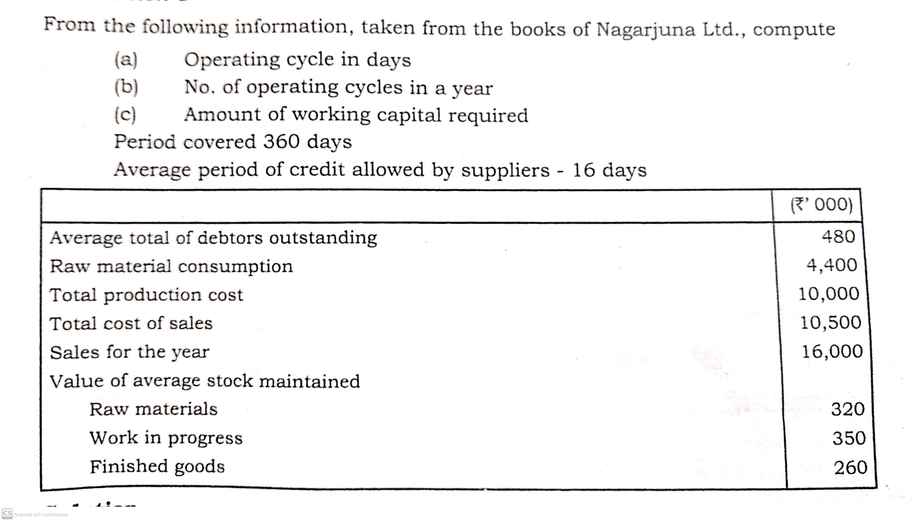
Problem.2

Slide 8
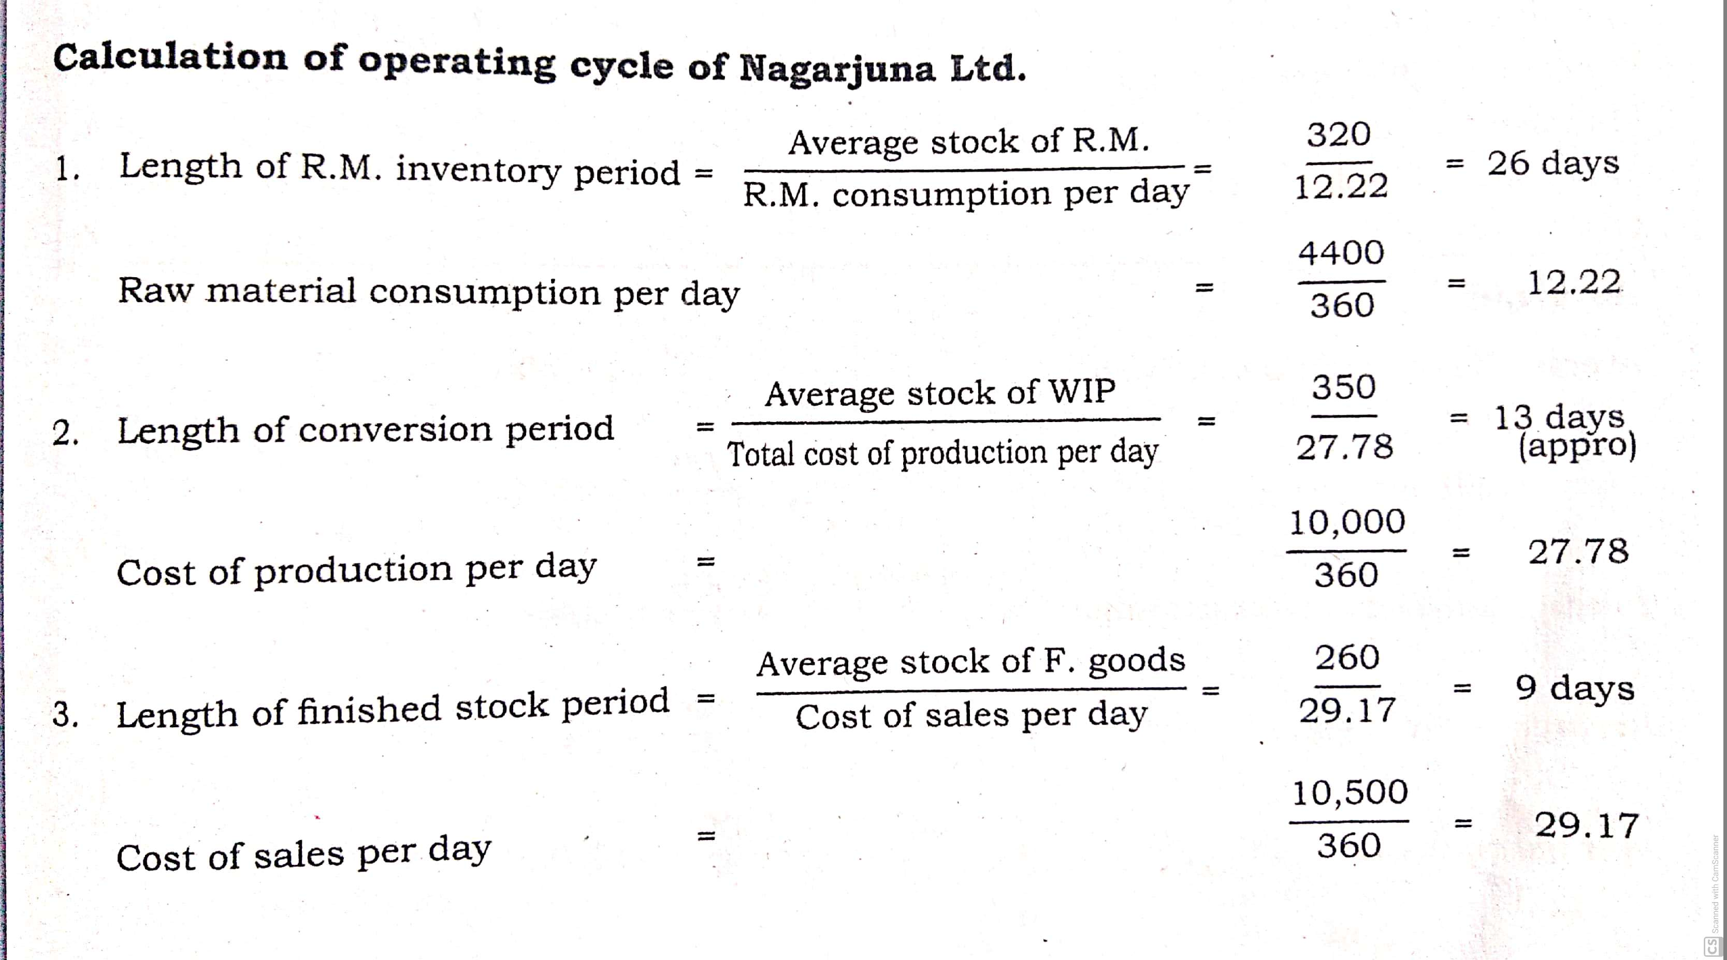

Slide 9
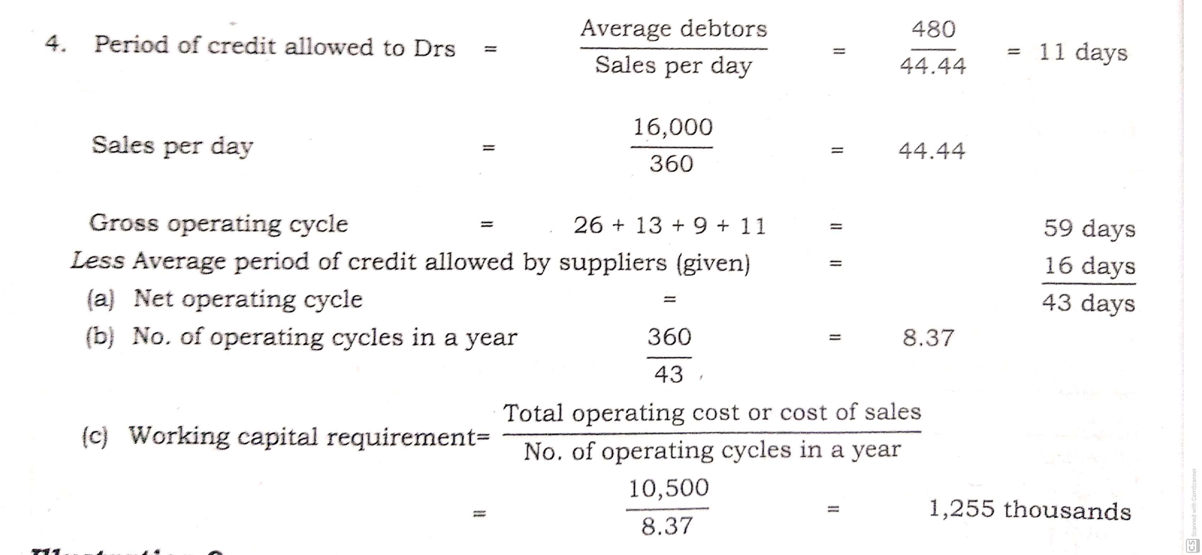

Slide 10
Problem.3
From the following information, calculate the working capital requirements of XYZ Ltd.
Rs. (in thousands)
Credit sales 5,000
Total cost of sales 4,000
Cost of production 3,000
Purchases 3,600
Total raw material consumed 700
Average material cost 90
Average work in progress 95
Average finished goods stock 200
Average debtors 360
Average creditors 760

Slide 11
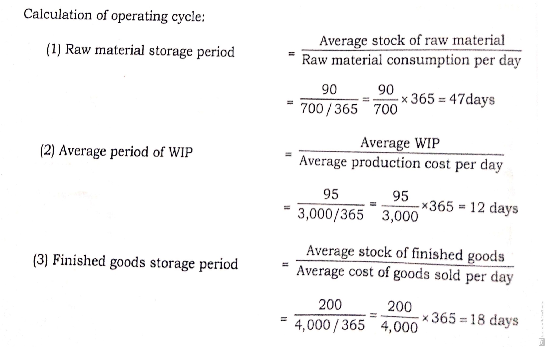

Slide 12
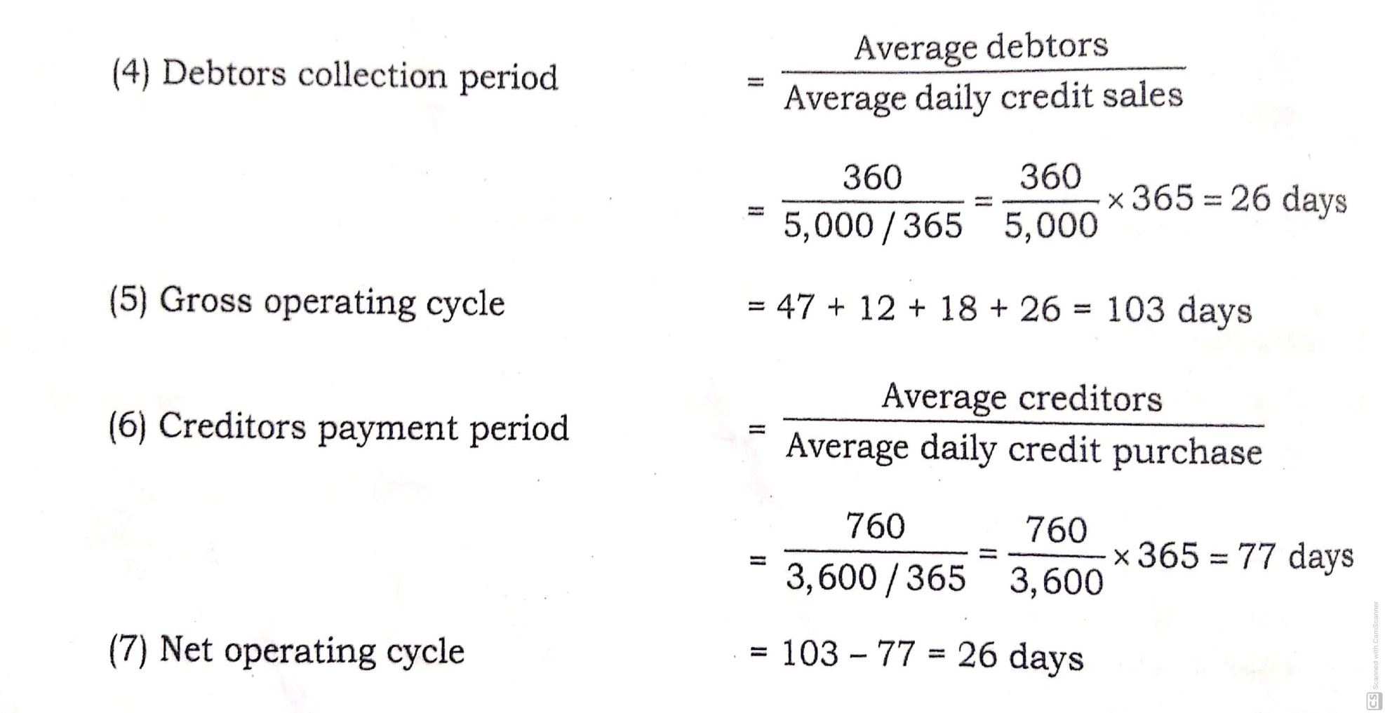

Slide 13
