Slide 1
3. Projected Balance Sheet Method
Estimation of working capital requirements
Prepared by
Dr. Muhammed Rafi.P
Assistant Professor
PG Department of Commerce & Management studies

Slide 2
Projected Balance Sheet Method
Under this method, various assets (excluding cash) and liabilities are totalled and a projected balance sheet is prepared for the coming year.
The difference between the total assets and liabilities of the projected balance sheet is treated as surplus or shortage of cash and it is considered as working capita requirements.

Slide 3
Problem.1

Slide 4
Total sales 192,000 units x 5 Current assets : Stock of raw materials 9,60,000 x 50 x 2 100 12 Stock of finished goods 9,60,000 x 90 x 3 100 12 Stock of work-in-process: Raw materials 9,60,000 x 50 x 1 100 24 Labour 9,60,000 x 20 x 1 x 1 100 24 2 Overheads 9,60,000 x 20 x 1 x 1 100 24 2 | 9,60,000 80,000 2,16,000 20,000 4000 4000

Slide 5
Debtors 9,60,000 x 2 12 | 1,60,000
Creditors 9,60,000 x 50 x 3 100 12 | 1,20,000

Slide 6
Projected Profit and Loss Account
 | Rs. |  | Rs.
To Raw materials 9,60,000 x 50% To Labour 9,60,000 x20% To Overheads 9,60,000 x 20% To Gross profit | 4,80,000 1,92,000 1,92,000 96,000 | By Sales | 9,60,000
 | 9,60,000 |  | 9,60,000
To Interest on Debentures 2,20,000 x 8% To Net profit | 17,600 78,400 | By Gross profit | 96,000
 | 96,000 |  | 96,000

Slide 7
Projected Balance sheet
Liabilities | Rs. | Assets | Rs.
Share capital 8% Debentures P &L A/c Creditors | 3,30,000 2,20,000 78,400 1,20,000 | Fixed assets at cost Current assets: Stock of raw materials Stock of work-in-progress Stock of finished goods Debtors Cash and bank balance (balancing figures) | 2,50,000 80,000 28,000 2,16,000 1,60,000 14,400
 | 7,48,400 |  | 7,48,400

Slide 8
Working capital requirements: = Current assets – Current liabilities = (4,98,400 – 1,20,000) Current Assets = (80,000+28,000+2,16,000+1,60,000+14,400) = 4,98,400 Current liabilities = 1,20,000 | 3,78,400

Slide 9
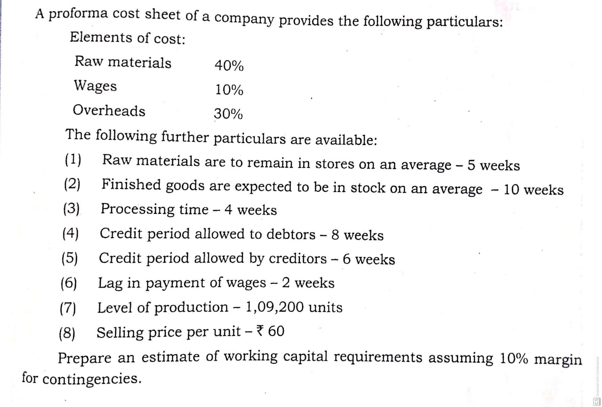
Problem 2

Slide 10
Total sales 1,09,200 units x 60 | 65,52,000
Current assets : Stock of raw materials 65,52,000 x 40 x 5 100 52 Stock of finished goods 65,52,000 x 80 x 10 100 52 Stock of work-in-process 65,52,000 x 80 x 4 100 52 Debtors 65,52,000 x 80 x 8 100 52 | 2,52,000 10,08,000 4,03,200 8,06,400
 | 24,69,600

Slide 11
Current liabilities: Creditors = 65,52,000 x 40 x 6 100 52 Wages outstanding = 65,52,000 x 10 x 2 100 52 | 3,02,400 25,200
 | 3,27,600
Working capital = Current assets – Current liabilities =(24,69,600 – 3,27,600) Add 10% contingencies (21,42,000 x 10%) | 21,42,000 2,14,200
Estimated working capital requirements | 23,56,200

