Slide 1
Factoring services
Prepared by
Dr. Muhammed Rafi.P
Assistant Professor
PG Department of Commerce & Management studies

Slide 2
Meaning
Factoring is an arrangement under which the factor purchases the account receivables (arising out of credit sale of goods/services) and makes immediate cash payment to the supplier or creditor.
Thus, the factor provides finance to the client (supplier) in respect of account receivables.
The factor undertakes the responsibility of collecting the account receivables.
The financial institution (factor) undertakes the risk.
For this type of service as well as for the interest, the factor charges a fee for the intervening period. This fee or charge is called factorage.

Slide 3
Definition
Factoring may broadly be defined as the relationship, created by an agreement, between the seller of goods/services and a financial institution called .the factor, whereby the later purchases the receivables of the former and also controls and administers the receivables of the former.

Slide 4
Types of factoring
1. Advance and Maturity Factoring
Under advance factoring arrangement, the factor pays only a certain percentage (between 75 % to 90 %) of the receivables in advance to the client, the balance being paid on the guaranteed payment date.
As soon as factored receivables are approved, the advance amount is made available to the client by the factor.
The factor charges discount/interest on the advance payment from the date of such payment to the date of actual collection of receivables by the factor.
The rate of discount/interest is determined on the basis of the creditworthiness of the client, volume of sales and prevailing short-term rate.

Slide 5
2. Maturity factoring:
In case of maturity factoring, no advance is paid to client and the payment is made to the client only on collection of receivables or the guaranteed payment data as the case may be agreed between the parties.
Thus, maturity factoring consists of the sale of accounts receivables to a factor with no payment of advance funds at the time of sale.

Slide 6
3. Disclosed or Notified Factoring
Here, the name of the factor is mentioned in the invoice by the supplier telling the buyer to make payment to the factor on due date. However, the supplier may continue to bear the risk of bad debts (i.e. non-payments) without passing to the factor.
The factor assumes the risk only under non-recourse factoring agreements.

Slide 7
4. Undisclosed or Non notified or Confidential factoring:
Under undisclosed factoring, the name of the factor is not disclosed in the invoice.
But still the control lies with the factor.
The factor maintain sales ledger of the seller of goods, provides short-term finance against the sales invoices but the entire transactions take place in the name of the supplier company (seller).

Slide 8
5. Recourse factoring:
Here, the factor only manages the receivables without taking any risk like bad debts etc.
Full risk is born by the firm itself.

Slide 9
6. Non-recourse factoring or full factoring:
Here, the firm gets total credit protection because complete risk of total receivables is borne by the factor.
The client gets 100% cash against the invoices even if bad debts occur.
For the factoring services, the client pays a commission to the factor. This is also called full factoring

Slide 10
7. Export Factoring:
There is usually the presence of two factors: an export factor and an import factor.
The former buys the invoices of a client exporter and assumes the risk in case of default by the overseas customers.
Because of distance, different condition or lake of information, the export factor usually forms out to an agent, known as the import factor, the administrative job of servicing the debts owed to its exporting clients.

Slide 11
8. Domestic Factoring:
When the three parties to factoring, i.e. customer, client, and factor, reside in the same country, then this is called as domestic factoring.

Slide 12
Functions of a Factor
1. Administration of sellers’ sales ledger.
2. Collection of receivables purchased.
3. Provision of finance.
4. Protection against risk of bad debts/credit control and credit protection.
5. Rendering advisory services by virtue of their experience in financial dealings with customers.

Slide 13
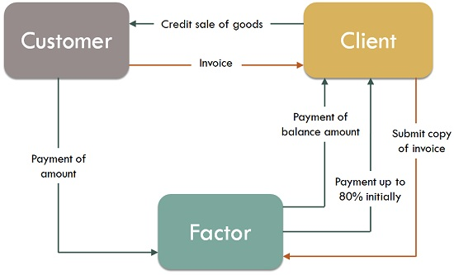
Mechanics of factoring

Slide 14
Steps for factoring:
The customer places an order with the seller (client).
The factor and the seller enter into a factoring agreement about the various terms of factoring.
Sale contract is entered into with the buyer and the goods are delivered. The invoice with the notice to pay the factor is sent along with.
The copy of invoice covering the above sale to the factor, who maintains the sale ledger.
The factor prepays 80% of the invoice value.
The monthly statements are sent by the factor to the buyer.
Follow up action is initiated if there are any unpaid invoices.
The buyer settles the invoices on the expiry of the credit period allowed.
The balance 20% less the cost of factoring is paid by the factor to the client.

