Slide 1

RESEARCH PROCESS
There is no rigid sequence of research process steps.
Depending on each situation, certain steps can be skipped, can be repeated or circumvented.
Each of these steps is the natural outcome of the previous steps, but these steps are not mutually exclusive.

Slide 2
Research Process
Prepared by
Dr. Muhammed Rafi.P
Assistant Professor
PG Department of Commerce & Management studies

Slide 3
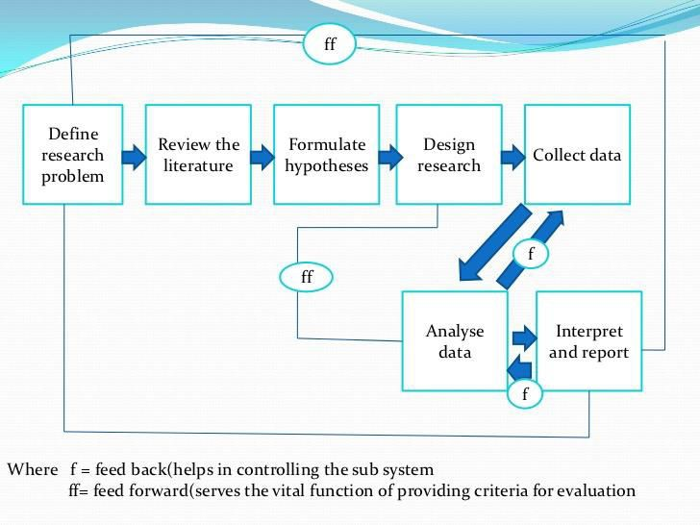

Slide 4





The various steps are:-
1)Discovering the problem area:-
We first of all need to discover the problem which demands solution.
The best way to identify a problem would be to look for an unresolved query, a gap in the existing knowledge, or an unfulfilled need within the chosen subject.

Slide 5
The researcher wisely choose the topic of research and show patience and thoroughness in finalizing the topic by considering following factors-
Availability of information.
Personal interest and aptitude in the field of study.
Accessibility.
Confidentiality.
cost of obtaining information

Slide 6




2) Literature survey:-
It involves comprehensive review of published and unpublished work from the secondary sources of data available in the relevant area of study.
It is of two types:-
Conceptual literature:- which deals with concepts and theories.
Empirical literature:- which contains studies made earlier and so it consists of many facts and figures observed in the earlier studies.

Slide 7


The researcher can either access:-
Bibliographic databases
Abstract databases
Full text databases

Slide 8
Literature review helps the researcher in two ways:-
It helps him in specifying his research problem in a meaningful context.
It would provide him an insight into the methods and techniques adopted for handling such problems.

Slide 9


3) Problem definition:-
Now researcher formulates his problem very clearly.
It should be clear, precise and concise statement of the matter that is to be investigated.
The objectives of the study at this stage are clearly developed.

Slide 10
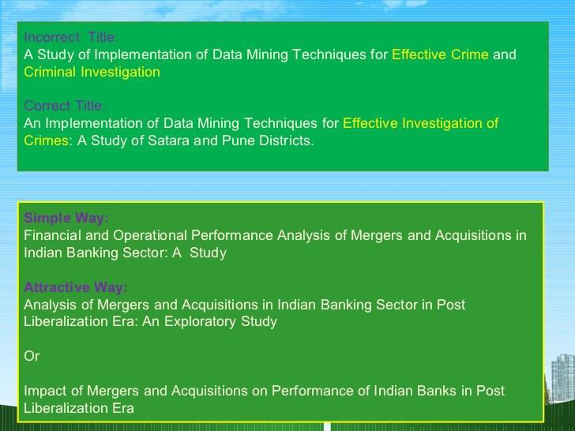

Slide 11
In the words of Albert Einstein “the formulation of a problem is far more essential than its solution, which may be merely a matter of mathematical or experimental skill”.
A problem well formulated will alone yield fruitful results.

Slide 12


4) Identifying and labeling variables:-
A researcher has to identify variables under study and label them.
In any research, the problems deal with relation between variables.
The variable which has the effect is called dependent variable.
The variable which has affected the other variable is called independent variable.

Slide 13
Eg:- Suppose we are studying the variables
‘achievement’,‘aggression’ or‘anxiety’.
Do the variables mean the same for people from different areas?

Slide 14



5) Developing a working hypothesis:-
It is a tentative assumption regarding the solution to the problem under study.
It is the focal point around which the future research efforts will be directed.
The kind of data to be collected, the tools of analysis are influenced by the hypothesis.

Slide 15
Eg:- A study conducted to find the amount of research investment being done by the companies will have the following hypothesis:
Ho: Companies invest 1% of their sales revenue in research activities.
Ha :The companies spend less than 1% of their sales revenue.

Slide 16
The Ho is called as the null hypothesis which assumes there is no difference between the population parameter and the sample mean and the Ha is called as the alternative hypothesis which presents the alternative solutions.
So a hypothesis presents a relationship between the different variables.

Slide 17


6) Research proposal:-
It is a brief summary outlining the objectives of study and the modus operandi of conducting the research.
It is like a road map to the researcher showing where he has to start and where to go and how to get there.

Slide 18
In case of thesis:-
These are in the form of a synopsis stating the research objectives, the proposed methodology of research, benefits of study along with a detailed bibliography.
In case of business or government organizations:-
The research proposal, in addition to the above information will contain information about the researcher’s qualification, the time and cost schedules, resources and special facilities required during research.
                Continue……

