Slide 1
Methods of Pricing material issues (Methods of valuing materials)

Slide 2
Stock consists of materials purchased in different quantities in different dates at different prices.
When materials are issued for production from the stock consisting of different lots at different prices, a problem arises as to which price should be used for pricing material issues.

Slide 3
The various methods of pricing material issues may be grouped under the following categories:
A: Cost price or Actual cost methods:
First In First Out (FIFO)
Last In First Out (LIFO)
Base Stock
Specific Price Highest In First Out (HIFO)
Next In First Out (NIFO)

Slide 4
B: Average Price (Cost) Methods:
Simple Average
Weighted Average
Periodic Simple Average
Periodic Weighted Average
Moving Simple Average
Moving Weighted Average

Slide 5
C: Notional Price Methods:
Standard Price
Inflated Price
Market Price
Re-use price

Slide 6
First-In First-Out method(FIFO)
Under this method materials are issued in the order in which they are received in the stores.
This means that materials received first are issued first. After completion of the first lot, the second lot is issued and so on.
Automatically, closing stock will be valued at the latest prices.
This method is also known as original cost method.
In times of falling prices, FIFO method is found to be useful.
This is because the cost of materials issued to different jobs will be high and profit will be lower. This reduces the tax liability.

Slide 7
Here we discuss only FIFO, LIFO, simple average and weighted average methods. First-In First-Out (FIFO) Method

Slide 8
Advantages of FIFO Method
It is simple and easy to operate.
2. Materials are issued at actual cost. Hence, there is no unrealised profit/loss.
3. Closing stock is valued at market price. Hence, the value of stock is realistic.
4. In conditions of falling prices, the method gives better results.

Slide 9
Disadvantages of FIFO Method
This method increases the possibility of clerical errors.
Issue price does not reflect the current market conditions.
Comparison of different jobs using the same materials becomes sometimes difficult.
This method is unsuitable in times of rising prices.

Slide 10
Example 1
Prepare the stores ledger account under FIFO method:
2021 Jan. 1 Opening stock 250 units @1 each
3 Purchased 100 units @ 1.05 each
5 Purchased 200 units @ 1.05 each
7 Issued 400 units
10 Purchased 400 units @1.20 each
12 Issued 150 units
15 Issued 100 units
16 Purchased 100 units @1 each
25 Purchased 200 units @1.25 each
31 Issued 300 units

Slide 13
Pricing of Returns to Stores under FIFO
Materials once issued may be returned from production department to stores for various reasons such as surplus, defective etc.
Materials returned to store is recorded in the 'Receipt Column' at the price at which they were originally issue These are issued according to the method of pricing used (here according to FIFO).
Thu returns are treated as new purchase for the purpose of next issue.

Slide 14
Pricing of Returns to Vendor under FIFO:
Sometimes materials may be returned to vendor being not upto specification or defective or substandard.
Such returns should be recorded the 'Issue Column'.

Slide 15
Treatment of shortage of materials under FIFO
At the time of verification of stock, some shortages may be found in materials.
Such shortage should be recorded in the 'Issue Colum at the price of the oldest consignment in stock.
If there is a surplus, it should be recorded the 'Receipt Column'.

Slide 16
It may also be noted that if receipt and issue are given on the same date (the time receipt and issue is not given), it is preferable to record receipt first.

Slide 17
Example2.
Prepare Stores Ledger Account using FIFO method
2021 June 1 Balance 500 units at 200 per unit
6 Issued 250 units
10 Purchased 200 units at * 190 per unit
15 Returned to stores 15 units issued on 6th June
18 Issued 180 units
22 Purchased 240 units at 190 per unit
23 Issued 300 units
24 Purchased 320 units at 190 per unit
25 Purchased 200 units at 170 per unit
26 Issued 115 units
27 Returned to vendor 50 units purchased on 24th June
30 Stock audit showed a shortage of 10 units

Slide 18
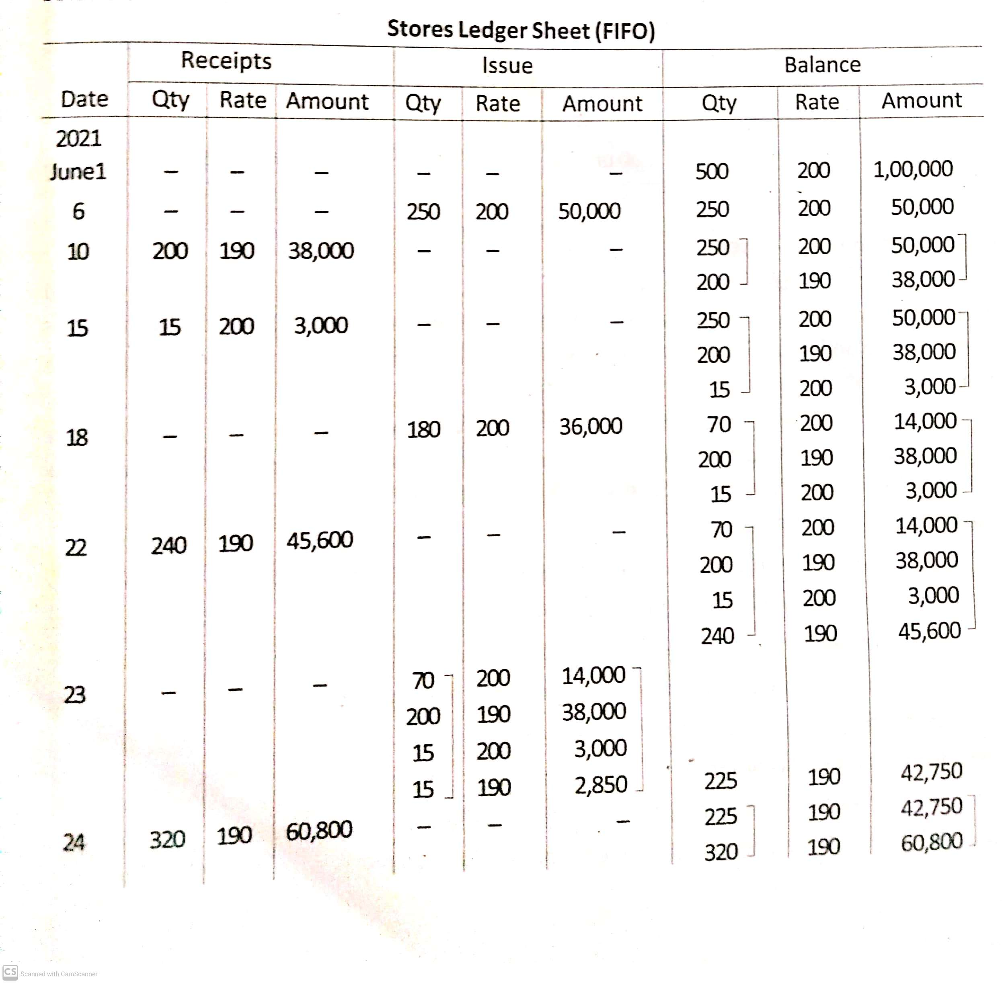

Slide 19
