Slide 1
Machine hour rate
Prepared by
Dr. Muhammed Rafi.P Assistant Professor PG Department of Commerce & Management studies

Slide 2
Machine Hour Rate
Machine hour rate is an important method of absorption of factory overhead.
It is used in those factories where machines are predominant.
Machine hour rate refers to the cost of running and operating a machine per hour.
In simple words, it is obtained by dividing the amount of overhead related to a machine by the number of machine hours (or working hours of the machine).
A separate machine hour rate is calculated for each machine.

Slide 3
Types of Machine Hour Rate
Simple or ordinary machine hour rate:
This machine hour rate does not take into account the wages. In this case only indirect expenses directly relating to running a machine are included.
Composite or comprehensive machine hour rate:
This machine hour rate takes into consideration both direct expenses (e.g., wages) and indirect expenses. Thus in a comprehensive machine hour rate, factory overhead and direct wages are absorbed in a single rate.
Group machine hour rate:
Where overhead rate is determined for a group of machines, it is known as group machine hour rate.

Slide 4
Advantages of Machine Hour Rate
It is a scientific, accurate and logical method of overhead absorption.
The relative efficiencies of various machines can be found out easily.
It helps in knowing idle time of machines.
It is useful for the estimation of cost of a job.
It helps to compare the operating cost of each machine.
It gives importance to the time factor.
It helps to quote more accurate selling price for jobs.

Slide 5
Calculation of M.H.R.
The following points should be borne in mind while calculating machine hour rate:
Divide overheads relating to the machine into two - standing charges (fixed) and machine expenses (variable).
Rent, rates, lighting, insurance, supervision, wages of operators, lubricating oil and consumable stores etc. may be treated as standing charges.
Depreciation, power, repairs, steam, water etc. may be treated as machine expenses.
Depreciation can be treated as standing charges also depending upon the convenience.

Slide 6
5. Estimate the total standing charges for the machine (one machine) for a period (day, or week or month or year) and divide this total by the working hours of the machine (effective working hours) for that period. This gives the standing charges per machine hour.
6. The machine expenses are to be estimated separately. These are divided by the normal working hours (effective working hours). It gives hourly rates for each item.
7. The total of standing charges per hour (as per 5) and the machine expenses per hour (separately calculated as under 6) will give the M.H.R.
8. If ordinary MHR is to be computed, direct wages (of operators, machine men, machine attendant etc.) should be excluded.

Slide 7
9. If comprehensive MHR is to be ascertained the direct wages should be included.
10. While calculating normal working hours idle time, maintenance time and setting up time should be deducted. This gives the effective working hours.
11. Sometimes working hours may not be given in the question. It can be ascertained from power cost. to the machine (whose rate is to be determined) on an equitable basis per hour.

Slide 8
The following bases are applied while calculating MHR.
Sl.No. | Expenses | Bases
1 | Standing charges: Rent and rates | Floor area occupied by each machine
2 | Lighting and heating | No. of light points used or on the basis of number of employees or on the basis of floor area
3 | Supervision | Time devoted by supervisor to each machine
4 | Oil, waste, consumable stores etc. | Past experience
5 | Insurance | Insurable value of each machine.

Slide 9
The following bases are applied while calculating MHR.
Sl.No. | Expenses | Bases
 | Machine expenses
1 | Depreciation | Cost +Installation charges - Scrap value Life in hours
2 | Power | Actual consumption
3 | Repairs | Actual machine-wise

Slide 10
Calculation of Depreciation per Machine Hour
If rate of depreciation is not given, depreciation is calculated as follows:
= Cost + Installation charges - Scrap value
Life (years)
This gives depreciation per year. Depreciation per hour is calculated as follows:
= Depreciation p.a
Machine Hours p.a
Alternatively, depreciation per machine hour can be directly calculated as follows:
= Cost + Installation charges - Scrap Value
Effective working life in hours

Slide 11
Example
Calculate machine hour rate from the following:
Cost of machine = 8,000
Cost of installation = 2,000
Scrap value after 10 years = 2,000
Rates and rent for a quarter for the shop = 300
General lighting = 20 p.m
Shop supervisor's salary = 600 per quarter
Insurance premium for a machine = 60 p.a
Estimated repairs = 100 p.a
Power 2 units per hour @Rs.5 per 100 units
Estimated working = 2,000 hours p.a.
The machine occupies 1/4 of the total area of the shop. The supervisor is expected to devote 1/6th of his time for supervising the machine. General expenses are to be apportioned on the basis of floor area.

Slide 12
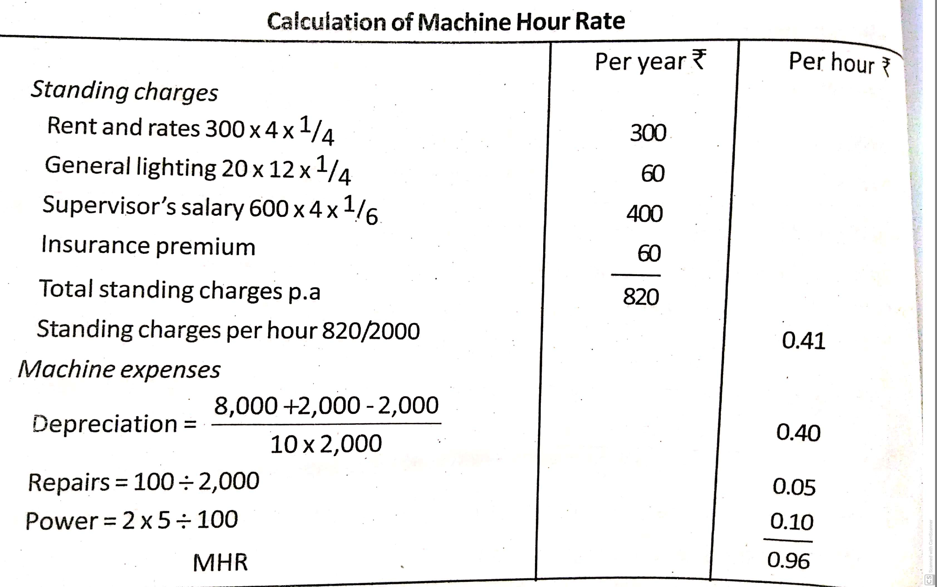
Calculation of Machine Hour Rate

Slide 13
Absorption of Office and Administrative Overheads
Office and administrative overheads are of a general nature.
These overheads include office rent, rates and insurance, office lighting, heating and cleaning, depreciation and repairs of office building, furniture and fitting.
Legal charges, printing and stationery used in office, bank charges and so on.

Slide 14
Methods of Absorption of Office and Administrative Overheads
The administrative overhead rate is computed by any one of the following methods:
Percentage of factory cost method:
This is determined by the following formula:
Admn. OH rate = Administrative OH x 100
Factory cost

Slide 16
Absorption of Selling and Distribution Overheads
Selling and distribution overheads may be classified into two - fixed and variable.
Advertising, samples, sales office rent, showroom expenses, market research expenses etc. are examples of fixed expenses.
Carriage outward, commission, bad debts, discounts etc. are examples of variable expenses.

Slide 17
Methods of Absorption of Selling and Distribution Overheads
There are four methods of absorption of selling & distribution overheads. They are as follows:
Rate per article: Under this method the total estimated selling overhead is divided by the total number of estimated units to be sold and thus selling and distribution rate per unit is determined.
A percentage of sales: In this method, on the basis of the previous year's figures a percentage of selling and distribution overhead on the total sales is calculated. This rate is applied to recover the overheads from the selling price.

Slide 18
3. A percentage of factory cost:
A percentage of selling and distribution overheads on factory cost is arrived at from past records. This percentage is applied to factory cost to add the selling and distribution overheads.
4. A percentage of cash collected:
This method is suitable for charging the credit and collection costs such as bad debts, legal expenses etc.

