Slide 1
Factor Analysis
Prepared by
Dr. Muhammed Rafi.P Assistant Professor PG Department of Commerce & Management studies

Slide 2
Factor Analysis
It is a data reduction method.
Its general purpose is to summarize the information contained in a large number of variables into a smaller number of factors.
It simplifies the data.
No distinction between dependent and independent variables.
all variables under investigation are analyzed together–to identify underlying factors.
It is a computational technique that reduce variables to a manageable number.

Slide 3
Example:-
A market researcher might have collected data on say, more than 50 attributes(items) of a product which may become very difficult to analyze.
Factor analysis could help to reduce the data on 50 odd attributes to a few manageable factors.
It helps in identifying the underlying structure of the data.

Slide 4
More examples:-
Height
Size
Weight
Occupation
Social Status
Education
Source of
Income

Slide 5
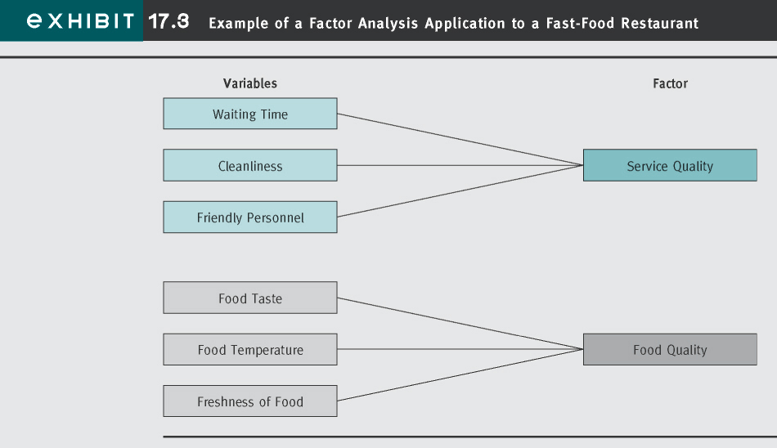

Slide 6
Examples:-
Factors determining buying behaviour of small cars.
Factors determining choice of an airlines.
Factors leading to cigarette smoking.
Underlying dimensions for willingness to donate regenerative & non regenerative body parts.
Factors determining choice of a bank.

Slide 7
Steps in factor analysis
Extraction of factors:-
The first and foremost step is to decide on how many factors are to be extracted from the given set of data. This could be accomplished by various methods like
the centroid method,
the principal component method and
the maximum likelihood method.

Slide 8
2) Factor loading:-
These are those values which explain how closely the variables are related to each one of the factors discovered. These are also known as factor-variable correlation.
Like correlations–vary from +1.0 to –1.0
3) Communality(h²):-
It shows how much of each variable is accounted for by the underlying factor taken together. A high value communality means that not much of the variable is left over after whatever the factors represent is taken into consideration.

Slide 9
4) Eagen value (or Latent root):-
It is the sum of squared values of factor loadings relating to a factor.
It indicates the relative importance of each factor in accounting for the particular set of variables being analyzed.
Since the eigen value represents the variance explained by a factor, hence using this rule all factors whose eigen value is 1 or above should be used.

Slide 10
5)Total sum of squares:-
It is the total of eigen values of all factors.
This value , when divided by the number of variables under study, results in an index.
This index shows how the particular solution accounts for what all the variables taken together represents.
If the variables are all very different from each other , this index will be low.

Slide 11
6) Factor scores:-
It represents the degree to which respondents gets high scores on the group of the items that load high each factor.
It helps to explain what the factors mean.

Slide 12
7) Rotation of factors:-
here, initial factors are rotated so as to yield a solution that can be interpreted easily.
It can be accomplished by:-
Orthogonal rotation
Varimax rotation, and
Oblique rotation

Slide 13
The basic idea of rotation is to get some factors that have a few variables that correlate high with that factor and some that correlate poorly with that factor.
This the rotation is carried out in such a way so that the factor loadings as in the first step are close to unity or zero.
This procedure helps to avoid problems of having factors with all variables having midrange correlations.

Slide 14
Once this is done, a cut off point on the factor loading is selected. Generally it is taken to be greater than 0.5.
Once the cut off point is decided , all those variables attached to a factor are used for naming the factors.
This is very subjective procedures and different researchers may name same factors differently.

Slide 15
Final Aspect of Factor Analysis
the number of factors to retain

Slide 16
FA Applications in Marketing Research
Advertising
to better understand media habits of various customers
Pricing
to identify the characteristics of price-sensitive and prestige-sensitive customers
Product
to identify brand attributes that influence consumer choice
Distribution
to better understand channel selection criteria among distribution channel members

Slide 17
Uses of Factor analysis
1) Scale construction:-
Factor analysis could be used to develop concise multiple item scales for measuring various constructs. This is done as a part of exploratory research.
FA can reduce the set of statements to a concise instrument and at the same time, ensure that the retained statements adequately represent the critical aspects of the constructs being measured.

Slide 18
2) Establish antecedents:-
This method reduces multiple input variables into grouped factors. Thus , the independent variables can be grouped into broad factors.
3) Psychographic profiling:-
Different independent variables are grouped to measure independent factors. These are then used for identifying personality types.

Slide 19
4) Segmentation analysis:-
FA could also be used for segmentation.
5) Marketing studies:-
FA can be successfully used for new product development, product acceptance research, developing of advertising copy, pricing studies and for branding studies.

Slide 20
Conditions for factor analysis:-
FA exercise requires metric data. The data should be either interval or ratio scale in nature.
The data or variables for FA are identified through exploratory research which may be conducted by:
Reviewing the literature conducted on the subject
Researches carried out already in this area
Informal interviews of knowledgeable persons
Focus group discussions
Analysis of case studies &
Judgment of the researcher

Slide 21
b) As the responses to different statements are obtained through different scales, all the responses need to be standardized for comparison of different responses fro such scale.
The standardization is carried out using the following formulae:-
Standardized score of ith respondent on a statement =
(Actual score of ith respondent on a statement -
Mean of all respondents on the statement)
S.D of all respondents on the statement

Slide 22
c)The size of the sample respondents should be at least four to five times more than the number of variables(number of statements).
d) The initial set of variables should be highly correlated. If the correlation coefficient between all the variables are small , FA may not be an appropriate technique.
e) Before a FA ,the value of KMO(Kaiser-Meyer- Olkin) statistics should be carried out which takes a value between 0 and 1.
A small value of KMO shows that correlation between variables cannot be explained by other variables.

Slide 23
Limitations of factor analysis
It is a complex method.
It requires thorough knowledge on part of the researcher.
The results obtained from the factor analysis are doubtful with regard to reliability.
Common factor analysis method does not offer a single unique solution.
A lot of relevant data is not considered and thus meaningful may be left out.
A lot of decisions taken with regard to factor analysis are based on the judgement of the researcher. Eg:-decision on no.of factors to be extracted.

