Slide 1
Steps in writing the report
Prepared by
Dr. Muhammed Rafi.P Assistant Professor PG Department of Commerce & Management studies

Slide 2
Steps in writing the report
1. Deciding on report format: (3 types )
Logical pattern:
In this type of format the report moves from specific to general or simple to complex gustures.it follows an inductive approach where associations are developed between one thing and another by means of analysis.
b) Psychological pattern:
This approach is the opposite of logical pattern where the most critical information is stated first and thereafter the finding s are stated in a manner that justifies the conclusion.

Slide 3
c) Chronological pattern:
The reporting of the events is done along the time dimension, i.e, the event which happened first are stated first and others are stated in the order of their occurrence . This format is least popular and finds its application in historical researches.

Slide 4
2. Preparing a report outline:
Topical outline:
This use, few key words on the assumption that the writer knows its significance and later while writing the detailed report will recall the entire argument.
b) Sentence outline:
This expresses the essential thoughts in a sentence form and is the preferred method for new inexperienced researchers. Since most of the thoughts are outlined initially and only elaboration and explanation is left for subsequent stages, there is a less chance of jumbling and error.

Slide 5
3. Preparation of rough draft.
4. Rewriting and refining the report
5. Preparing bibliography
6.Writing the final proof

Slide 6
Guidelines for writing a report
Typography
Written on good quality paper
One side should be used
Margines
Font size
Words
Quotations
Punctuation
Bibliographies

Slide 7
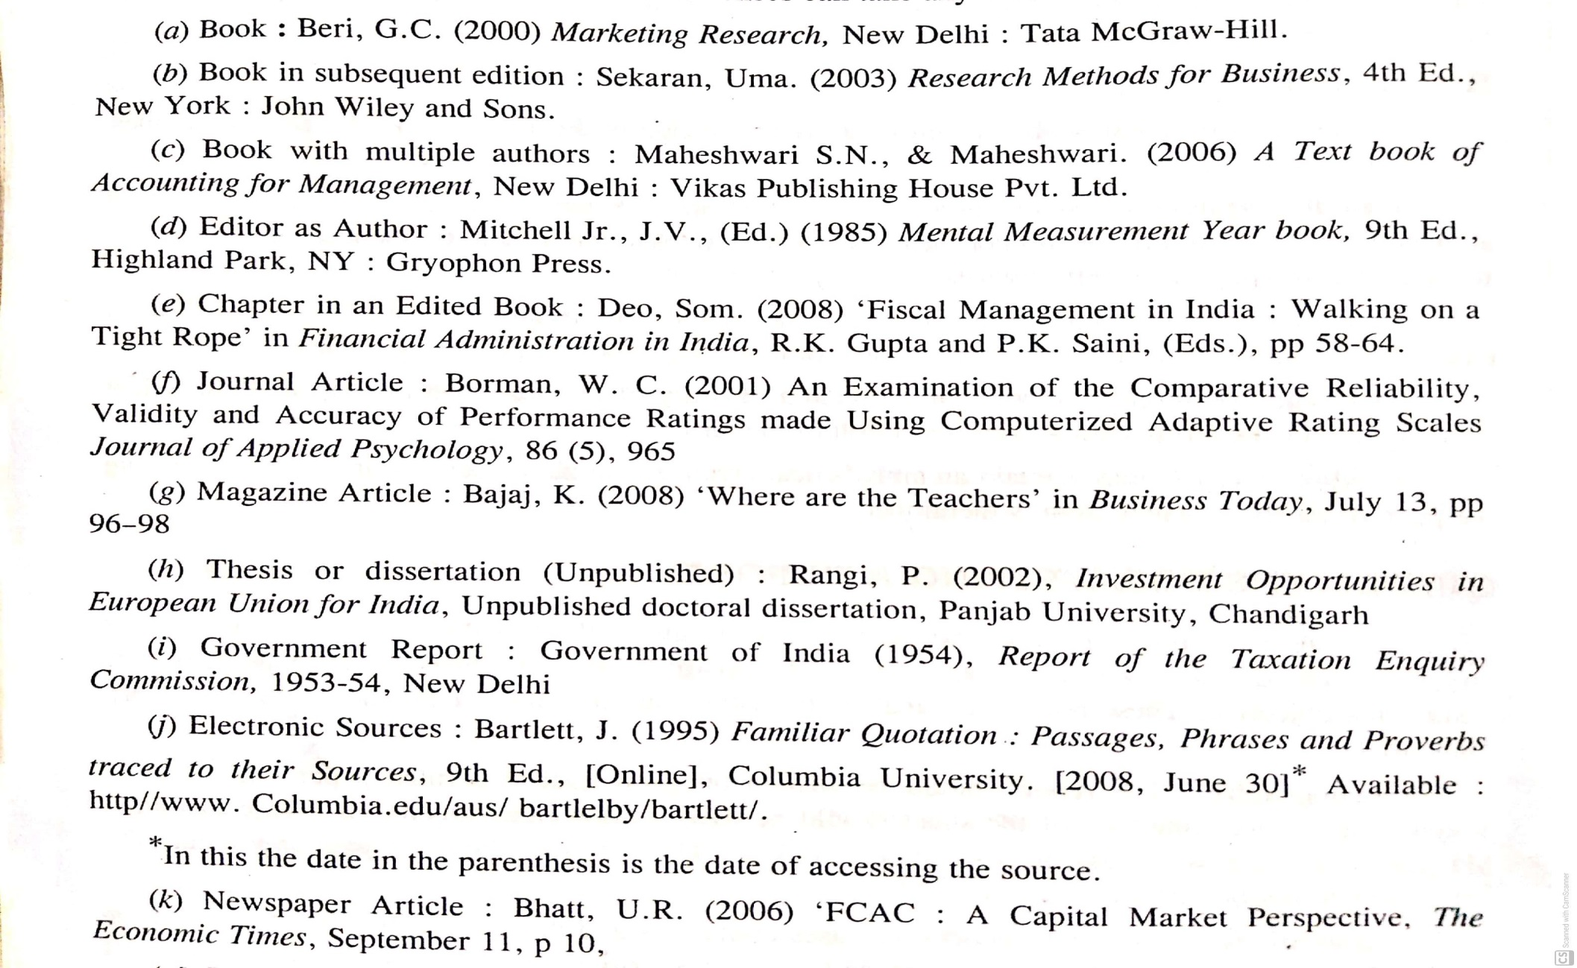
5. References

Slide 8
6. Footnotes
7. Pagination
8. Labelling tables and figures
9. Abbreviations

Slide 9
Tips to Follow While Writing
A document which bridge between the readers and the investigator.
70 to 80% of the people/professionals spend their time in reading/writing/listening/watching.
It is used as a guide to establish relationship/analysis/ interpretation/decision making to accept or reject or revise.
Avoid grammatical mistakes.
Follow simple language.
Keep sentences short and simple.
Should not use jargon words.
Use headings and subheadings with proper lay out.
For ex. Section, sub –section and sub –sub- section Section 1 Sub-section 1 (a) Sub-sub-section 1 (a) (i)

