Slide 1
MODULE 1
Importance, Benefits of e-commerce and limitations
Prepared by
Dr. Muhammed Rafi.P Assistant Professor PG Department of Commerce & Management studies

Slide 2
Importance of E-Commerce
Consumer sovereignty
Customization
New markets
Efficient use of resources
Employment opportunities
Quick and speedy disposal of customers
Managing competition

Slide 3
Benefits of E-commerce I. Benefits to business organization:
Global market.
A physical store will always be limited by a geographical area it can serve. An online store, or any other type of E-Commerce business for that matter, has the whole world as its market. Going from a local customer base to a global market at no additional cost is really one of the greatest advantages of trading online. In 2018, 11.9% of global retail sales came from online purchases and this is only set to increase year on year.
Around-the-clock availability.
Another great benefit of running an online business is that it is always open. For a merchant, it’s a dramatic increase in sales opportunities.

Slide 4
Reduced costs.
E-Commerce businesses benefit from significantly lower running costs. As there’s no need to hire sales staff or maintain a physical storefront, the major E-Commerce costs go to warehousing and product storage. As merchants are able to save on operational costs, they can offer better deals and discounts to their customers.
Inventory management.
E-Commerce businesses can automate their inventory management by using electronic tools to accelerate ordering, delivery and payment procedures. It’s saving businesses billions in operational and inventory costs.
Targeted marketing.
With access to such a wealth of customer data and an opportunity to keep an eye on customer buying habits as well as the emerging industry trends, E-Commerce businesses can stay agile and shape their marketing efforts to provide a better-tailored experience and find more new customers.

Slide 5
Serving niche markets.
Running a niche brick-and-mortar business can be tough. By tapping into a global market, E-Commerce retailers can build a highly profitable niche business without any further investment. Using online search capabilities, customers from any corner of the world can find and purchase your products.
Working from anywhere.
Often, running an E-Commerce business means that we don’t need to sit in an office from 9 to 5. A laptop and a good internet connection is all it takes to manage our business from anywhere in the world.

Slide 6
Lower telecommunication cost:
The internet is much cheaper than Value Added Network (VAN) which were based on leasing telephone lines for the exclusive use of the organization. It is also cheaper to send a fax or e-mail via the internet than direct dialing.
Digitisation of products and processes:
Digitisation of products and processes particularly in the cas of software and music/video products, which can be downloaded ore-mailed directly to customers via internet in digital format within 24 hour time.

Slide 7
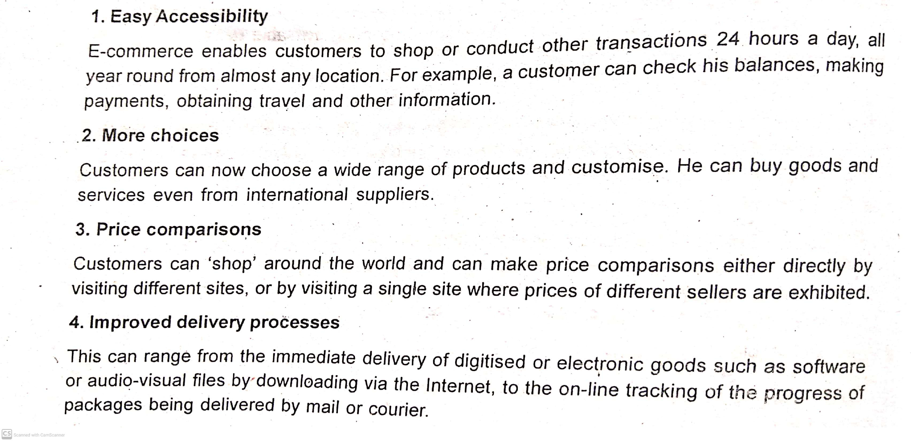
II.Benefits to Consumers:

Slide 8
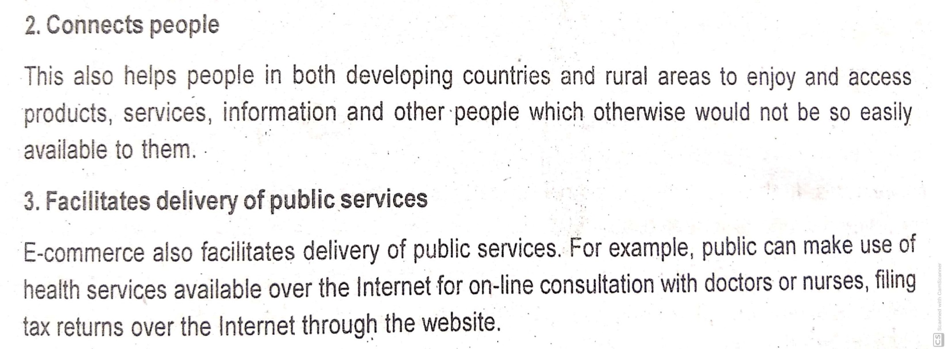
III. Benefits to Society:
1. Flexible working practices:
E-commerce enables more flexible working practices, which enhances the quality of life of people in society, enabling them to work from home. This more convenient and provides happiest and less working environment .it also reduces environmental pollution as few people have to travel to work regularly.

