Slide 1
Supply Chain Management
Prepared by
Dr. Muhammed Rafi.P Assistant Professor PG Department of Commerce & Management studies

Slide 2
Meaning of Supply Chain Management
A Supply chain is a network of supplier, manufacturing, assembly, distribution and logistics facilities that perform the functions of procurement of materials, transformation of these materials into intermediate and finished products, and the distribution of these products to customers.
Supply chains arise in both manufacturing and service organizations.

Slide 3
Supply Chain Management [SCM] is a systems approach to managing the entire flow of information, materials, and services from raw materials suppliers through factories and warehouses to the end customer.
Supply chain Management is utilized to facilitate the coordination with outside business entities.
SCM usually refers to the redesign of supply chain processes in order to achieve streamlining of supply chain collaboration. It is generally performed only by large corporations with large suppliers.

Slide 4
Definition
Ganeshan and Harrison defines supply chain as “It is a network of facilities and distribution options that performs the functions of procurement of materials, transformation of these materials into intermediate and finished products, and the distribution of these finished products to customers”.

Slide 5
Objectives of SCM
To reduce inventory cost.
To increase sales.
To improve the coordination and the collaboration with suppliers, manufacturers and distributors.

Slide 6
Pattern of Supply chain Management or Areas of SCM
Production
Inventory
Location
Transportation
Information

Slide 7
SCM Participants
Manufacturers
Distributors or wholesalers
Retailers
Customers
Services providers

Slide 8
Components of SCM System
SCM Software and Hardware
Business Processes
Business processes of supply chain include supply chain planning, execution and collaboration and operational control.
3. Users
The users of SCM system are workers of supply of participants at all levels.

Slide 9
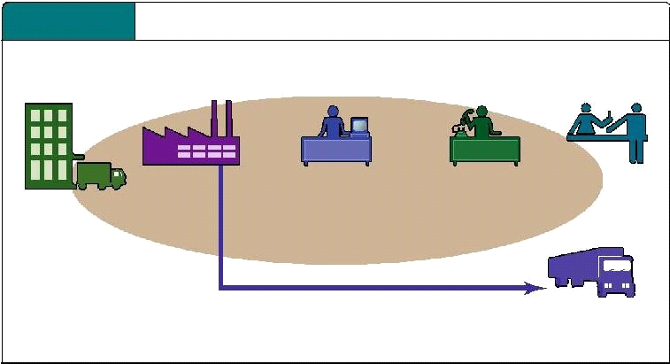
,
E
-
COMMERCE AND INDUSTRY VALUE
CHAINS
SUPPLIERS
RETAILERS

