Slide 1
E-commerce infrastructure
Prepared by
Dr. Muhammed Rafi.P
Assistant Professor
PG Department of Commerce & Management studies

Slide 2
Business infrastructure
Every business requires an infrastructure to support its customers and operations. This includes facilities, equipment, and processes for all functional areas. Choosing the correct infrastructure to match we business strategies enables our operations to run efficiently.

Slide 3
E-Commerce Infrastructure
E-Commerce Infrastructure identifies the functionalities of the Hardware and Software components, specifies the corresponding service level requirements, and describes the management and operations of the whole system.
Ecommerce infrastructure is a collection of hardware, software, network, facilities, etc. that we need to run an ecommerce business. When you have the right infrastructure, we will have an optimized business performance.

Slide 4
It may comprise briefly of the following components at a very abstract level:
  Software components used: Content management systems, Web analytics, Text analytics, Application Programming Interface (API), Database server, Middlewares etc. Object oriented (e.g. CORBA), Transaction processing, communication (https, messaging), data base (e.g. ODBC), application middleware (CGI).
  Hardware components used: Servers, proxy servers, load balancing systems. Firewalls, encryption devices and interactive voice response units etc.

Slide 5
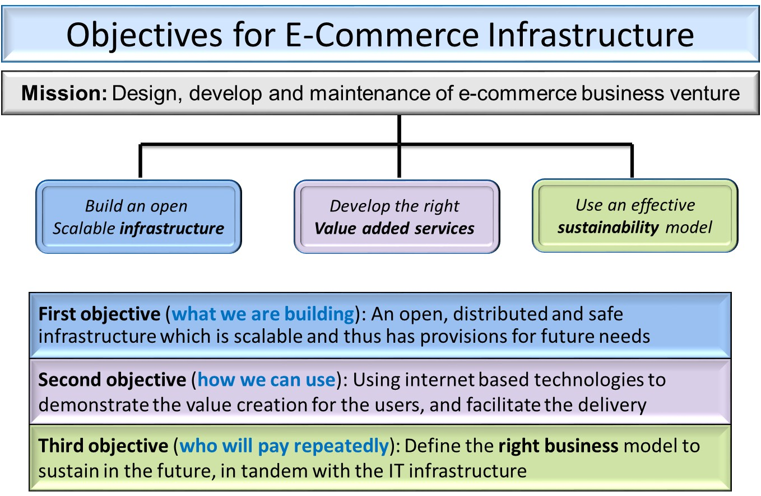

Slide 6
Key Ecommerce Infrastructure Decisions
Marketing.
Of all the infrastructure elements, marketing may be the most important. Once visitors are on our site, we need to keep them there and compel them to buy from us. Whether it’s website design, social media, search marketing, merchandising, email, or other forms of advertising, it’s all about marketing.
Facilities.
A word of advice is to keep our options flexible. Try to find an office park with a variety of spaces of different sizes. A key competitive advantage that ecommerce businesses have over brick-and-mortar stores is not having to invest in physical facilities.

Slide 7
Customer service.
There are many choices today for delivering high-quality customer service. Basic customer service for sales and post-sales activities can be handled using email and, for more extensive needs, phone support.
Information technology.
Choosing an ecommerce platform is one of the most important decisions we will make in your business. If we build and host our own system, we may need more cash upfront and skilled administrators and developers on our staff.

Slide 8
Fulfillment.
Another key decision is whether we will manage our own inventory or outsource those activities to a fulfillment house or through drop shipping arrangements with our suppliers. Select the best fulfillment option to meet our needs. Be sure to understand the costs involved and analyze the other options before moving forward.

Slide 9
Finance and administration.
If our ecommerce platform is tightly integrated into your accounting system, we may have very little need for an in-house bookkeeper. If you use separate systems for your website, order management, and accounting, you may need more help for data entry and making sure that the information is properly managed.
7. Human Resources:
Many small-business owners avoid the human resources function. Recruiting, setting up compensation, maintaining compliance, and other HR activities are specialized and time-consuming. We may choose to bring the resources in-house. But, should we outsource, there are many individuals and agencies well equipped to do the job.

