Slide 1
E-Commerce Infrastructure over view
Prepared by
Dr. Muhammed Rafi.P Assistant Professor PG Department of Commerce & Management studies

Slide 2
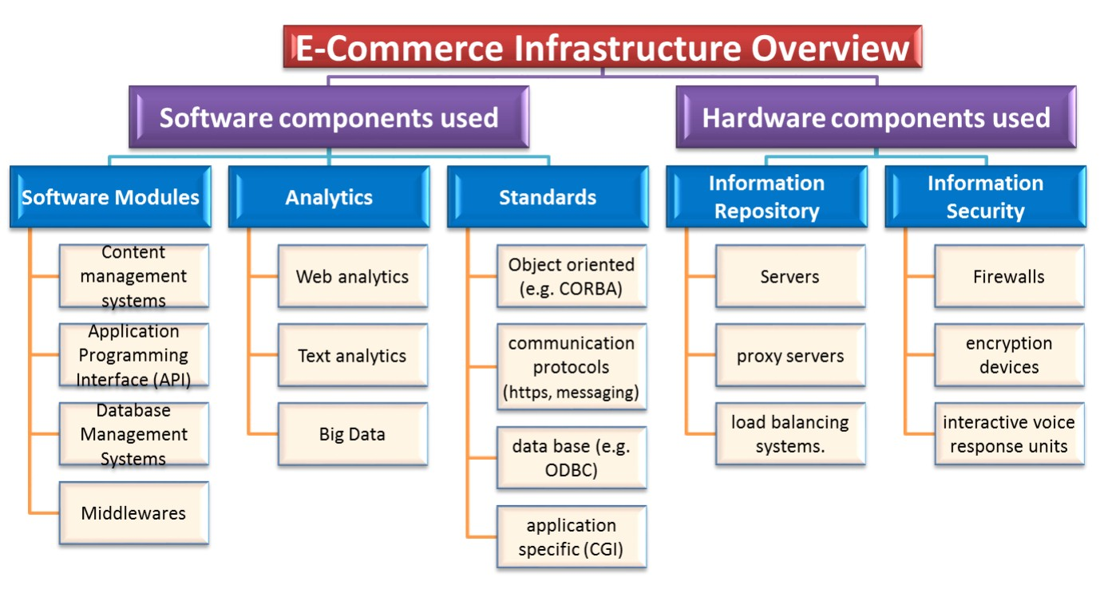

Slide 3
Content Management System [CMS]
A Content Management System [CMS] is a software platform that lets its users create, edit, archive, collaborate, report, publish, distribute and inform. Its Graphic User Interface (GUI) makes interacting with a website's database user friendly.
Websites use HTML (the Hypertext Markup Language) and CSS (Cascading Style Sheets) to create and design its pages.

Slide 4
Application Programming Interface
API is the acronym for Application Programming Interface, which is a software intermediary that allows two applications to talk to each other. Each time you use an app like Facebook, send an instant message, or check the weather on your phone, you're using an API.

Slide 5
Database Management System (DBMS)
It is a software for storing and retrieving users' data while considering appropriate security measures. It consists of a group of programs which manipulate the database. The DBMS accepts the request for data from an application and instructs the operating system to provide the specific data. In large systems, a DBMS helps users and other third-party software to store and retrieve data.

Slide 6
Middleware
Middleware is software which lies between an operating system and the applications running on it. Essentially functioning as hidden translation layer, middleware enables communication and data management for distributed applications.

Slide 7
Web analytics
Web analytics is the collection, reporting, and analysis of website data. The focus is on identifying measures based on your organizational and user goals and using the website data to determine the success or failure of those goals and to drive strategy and improve the user's experience.

Slide 8
Text Analytics
Text Analytics is the process of drawing meaning out of written communication. In a customer experience context, text analytics means examining text that was written by, or about, customers. You find patterns and topics of interest, and then take practical action based on what you learn.
Combined with data visualization tools, this technique enables companies to understand the story behind the numbers and make better decisions.

Slide 9
Big Data
Big Data is also data but with a huge size. Big Data is a term used to describe a collection of data that is huge in volume and yet growing exponentially with time. In short such data is so large and complex that none of the traditional data management tools are able to store it or process it efficiently.
Big data analytics is the use of advanced analytic techniques against very large, diverse data sets that include structured, semi-structured and unstructured data, from different sources, and in different sizes from terabytes to zettabytes.

Slide 10
Object-oriented programming
Object-oriented programming is a programming paradigm based on the concept of "objects", which can contain data, in the form of fields, and code, in the form of procedures. A feature of objects is that an object's own procedures can access and often modify the data fields of itself.

Slide 11
Communication protocols
Communication protocols are formal descriptions of digital message formats and rules. They are required to exchange messages in or between computing systems and are required in telecommunications. Communications protocols cover authentication, error detection and correction, and signalling. Communications protocols are implemented in hardware and software.

Slide 12
Database
A database is a collection of information that is organized so that it can be easily accessed, managed and updated. Computer databases typically contain aggregations of data records or files, containing information about sales transactions or interactions with specific customers.

Slide 13
Load balancing
Load balancing is the process of distributing network traffic across multiple servers. This ensures no single server bears too much demand. By spreading the work evenly, load balancing improves application responsiveness. It also increases availability of applications and websites for users.

Slide 14
Firewall
Firewall is a network security system that monitors and controls incoming and outgoing network traffic based on predetermined security rules. A firewall typically establishes a barrier between a trusted internal network and untrusted external network, such as the Internet.

Slide 15
Proxy server
Proxy server is a server application or appliance that acts as an intermediary for requests from clients seeking resources from servers that provide those resources.^{[1]} A proxy server thus functions on behalf of the client when requesting service, potentially masking the true origin of the request to the resource server.

Slide 16
Server
Server is a piece of computer hardware or software (computer program) that provides functionality for other programs or devices, called "clients".
This architecture is called the client–server model.
Servers can provide various functionalities, often called "services", such as sharing data or resources among multiple clients, or performing computation for a client.
A single server can serve multiple clients, and a single client can use multiple servers. A client process may run on the same device or may connect over a network to a server on a different device. Typical servers are database servers, file servers, mail servers, print servers, web servers, game servers, and application servers.

Slide 17
Encryption
Encryption is the process of converting data to an unrecognizable or "encrypted" form. It is commonly used to protect sensitive information so that only authorized parties can view it. This includes files and storage devices, as well as data transferred over wireless networks and the Internet.

Slide 18
Interactive Voice Response [IVR]
Interactive Voice Response is the telephony that allows an automated system to interact with callers and helps route calls to relevant recipients, via voice commands or touch-tone key selection.

