Slide 1
Prepared by Dr. Muhammed Rafi.P Assistant Professor PG Department of Commerce & Management studies
The Internet: Technology Background

Slide 2
The Internet: Technology Background
Internet
Interconnected network of thousands of networks and millions of computers
Links businesses, educational institutions, government agencies, and individuals
World Wide Web (Web)
One of the Internet’s most popular services
Provides access to around billions, possibly trillions, of Web pages

Slide 3
The Internet: Key Technology Concepts
Defined by Federal Networking Commission as network that:
Uses IP addressing
Supports TCP/IP
Provides services to users, in manner similar to telephone system
Three important concepts:
Packet switching
TCP/IP communications protocol
Client/server computing

Slide 4
Packet Switching
Slices digital messages into packets
Sends packets along different communication paths as they become available
Reassembles packets once they arrive at destination
Uses routers
Special purpose computers that interconnect the computer networks that make up the Internet and route packets
Routing algorithms ensure packets take the best available path toward their destination
Less expensive, wasteful than circuit-switching

Slide 5
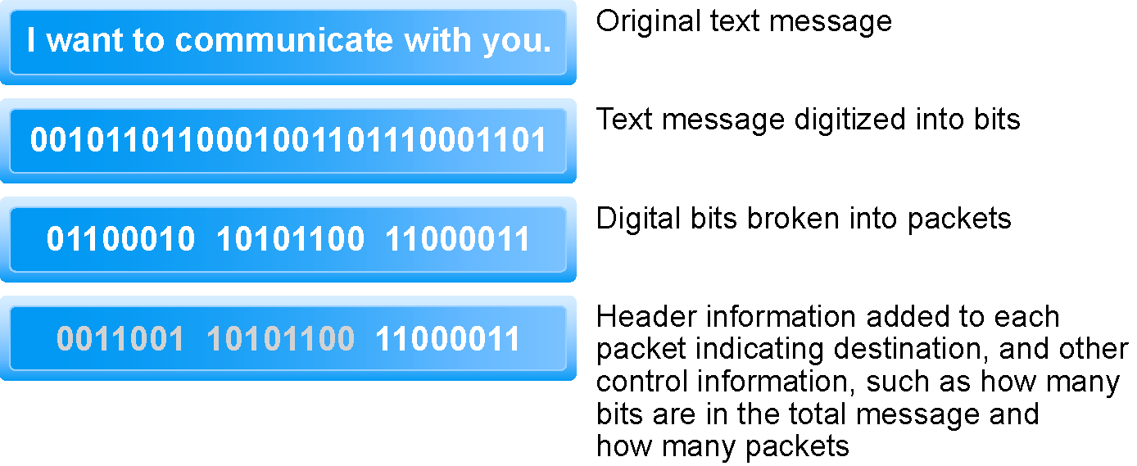
Packet Switching
Figure 3.3, Page 130

Slide 6
TCP/IP
Transmission Control Protocol (TCP):
Establishes connections between sending and receiving Web computers
Handles assembly of packets at point of transmission, and reassembly at receiving end
Internet Protocol (IP):
Provides the Internet’s addressing scheme
Four TCP/IP Layers
Network Interface Layer
Internet Layer
Transport Layer
Application Layer

Slide 7
Internet (IP) Addresses
IPv4:
32-bit number
Expressed as series of four sets of separate numbers marked off by periods
201.61.186.227
Class C address: Network identified by first three sets, computer identified by last set
New version: IPv6 has 128-bit addresses, able to handle up to 1 quadrillion addresses (IPv4 can only handle 4 billion)

Slide 8
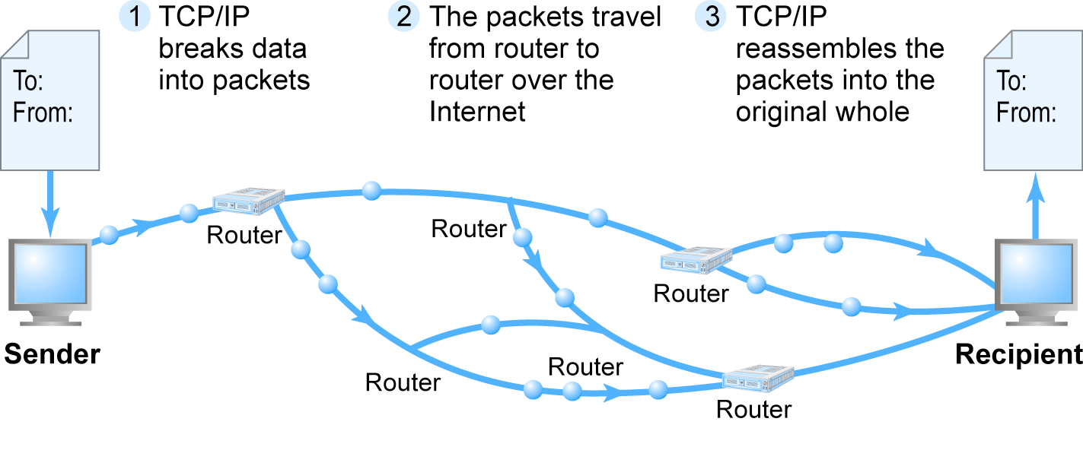
Routing Internet Messages: TCP/IP and Packet Switching
Figure 3.5, Page 133

Slide 9
Domain Names, DNS, and URLs
Domain Name
IP address expressed in natural language
Domain Name System (DNS)
Allows numeric IP addresses to be expressed in natural language
Uniform Resource Locator (URL)
Address used by Web browser to identify location of content on the Web
E.g., http://www.azimuth-interactive.com/flash_test

Slide 10
Client/Server Computing
Powerful personal computers (clients) connected in network with one or more servers
Servers perform common functions for the clients
Storing files, software applications, etc.

Slide 11
The New Client: The Emerging Mobile Platform
Within a few years, primary Internet access will be through:
Netbooks
Designed to connect to wireless Internet
Under 2 lbs, solid state memory, 8” displays
$200–400
Smartphones
Disruptive technology: Processors, operating systems

Slide 12
Cloud Computing
Firms and individuals obtain computing power and software over Internet
E.g., Google Apps
Fastest growing form of computing
Radically reduces costs of:
Building and operating Web sites
Infrastructure, IT support
Hardware, software

Slide 13
Internet Service Providers (ISPs)
Provide lowest level of service to individuals, small businesses, some institutions
Types of service
Narrowband (dial-up)
Broadband
Digital Subscriber Line (DSL)
Cable modem
T1 and T3
Satellite

Slide 14
Intranets and Extranets
Intranet
TCP/IP network located within a single organization for communications and processing
Extranet
Formed when firms permit outsiders to access their internal TCP/IP networks

Slide 15
The Last Mile: Mobile Wireless Internet Access
“Last mile”: From Internet backbone to user’s computer, cell phone, PDA, etc.
Two different basic types of wireless Internet access:
Telephone-based (mobile phones, smartphones)
Computer network-based

Slide 16
Telephone-based Wireless Internet Access
Competing 3G standards
GSM: Used primarily in Europe
CDMA: Used primarily in the United States
Evolution:
2G cellular networks: relatively slow, circuit-switched
2.5G cellular networks: interim networks
3G cellular networks: next generation, packet-switched
3.5G (3G+)
4G (WiMax, LTE)

Slide 17
Wireless Local Area Networks (WLANs)
Wi-Fi
High-speed, fixed broadband wireless LAN, different versions for home and business market, limited range
WiMax
High-speed, medium range broadband wireless metropolitan area network
Bluetooth
Low-speed, short range connection
Ultra-Wideband (UWB)
Low power, short-range high bandwidth network
Zigbee
Short-range, low-power wireless network technology for remotely controlling digital devices

Slide 18
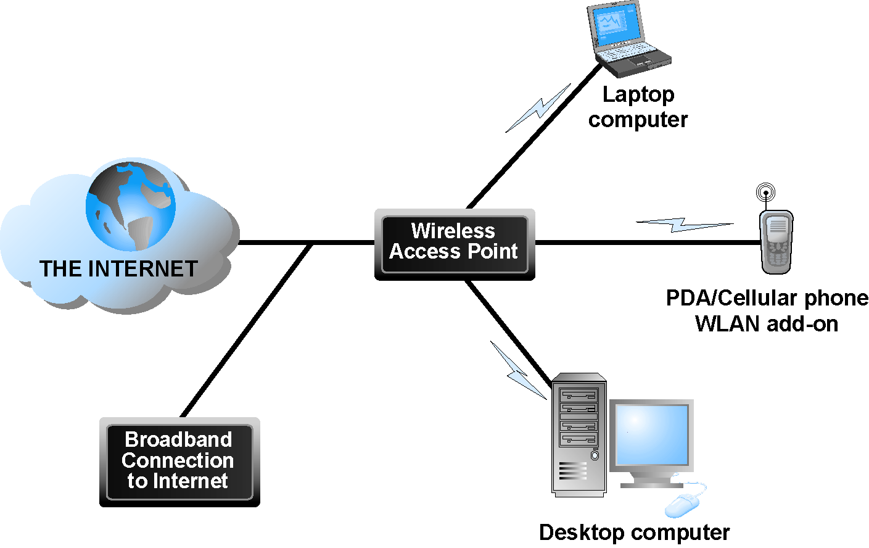
Wi-Fi Networks
Figure 3.16, Page 164

Slide 19
Hypertext
Text formatted with embedded links
Links connect documents to one another, and to other objects such as sound, video, or animation files
Uses Hypertext Transfer Protocol (HTTP) and URLs to locate resources on the Web
Example URL
http://megacorp.com/content/features/082602.html

Slide 20
Markup Languages
Generalized Markup Language (GML)—1960s
Standard Generalized Markup Language (SGML)—early GML,1986
Hypertext Markup Language (HTML)
Fixed set of predefined markup “tags” used to format text
Controls look and feel of Web pages
eXtensible Markup Language (XML)
New markup language specification developed by W3C
Designed to describe data and information
Tags used are defined by user

Slide 21
Web Servers and Web Clients
Web server software:
Enables a computer to deliver Web pages to clients on networks that request this service by sending an HTTP request
Apache and Microsoft IIS
Basic capabilities: security services, FTP, search engine, data capture
Web server
Can refer to Web server software or physical server
Specialized servers: database servers, ad servers, etc.
Web client:
Any computing device attached to the Internet that is capable of making HTTP requests and displaying HTML pages

Slide 22
Web Browsers
Primary purpose to display Web pages
Internet Explorer (67%) and Firefox (23%) dominate the market
Other browsers include:
Netscape
Opera
Safari (for Apple)
Google’s Chrome

Slide 23
The Internet and Web: Features
Internet and Web features on which the foundations of e-commerce are built include:
E-mail
Instant messaging
Search engines
Intelligent agents (bots)
Online forums and chat
Streaming media
Cookies

Slide 24
E-mail
Most used application of the Internet
Uses series of protocols for transferring messages with text and attachments (images, sound, video clips, etc.,) from one Internet user to another
Can be an effective marketing tool
Spam a worsening problem

Slide 25
Instant Messaging
Displays words typed on a computer almost instantly, and recipients can then respond immediately in the same way
Different proprietary systems offered by AOL, MSN, Yahoo, and Google
Meebo, Digsby: allow users to communicate across platforms

Slide 26
Search Engines
Identify Web pages that match queries based on one or more techniques
Keyword indexes, page ranking
Also serve as:
Shopping tools
Advertising vehicles (search engine marketing)
Tool within e-commerce sites
Outside of e-mail, most commonly used Internet activity

Slide 27
Streaming Media
Enables music, video, and other large files to be sent to users in chunks so that when received and played, file comes through uninterrupted
Allows users to begin playing media files before file is fully downloaded

Slide 28
Cookies
Small text files deposited by Web site on user’s computer to store information about user, accessed when user next visits Web site
Can help personalize Web site experience
Can pose privacy threat
Slide 3-

