Slide 1
Types of electronic payment system
Continue…..
Prepared by
Dr. Muhammed Rafi.P
Assistant Professor
PG Department of Commerce & Management studies

Slide 2
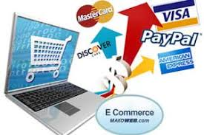
Electronic payment system

Slide 3
3.Credit Cards
They are the convenient method of making online payment.
The credit card is a financial instrument which can be used more than once to borrow money or buy products and services on credit.
It also contains a validity period and other important particulars.
Credit cards work around the globe regardless of the location of country of the issuing bank.
They also handle multiple currencies through a series of clearing houses.
The credit card holders can purchase goods and services either offline or online without making immediate payment.
Payment to the merchant’s will be made by the customer’s Bank.

Slide 4
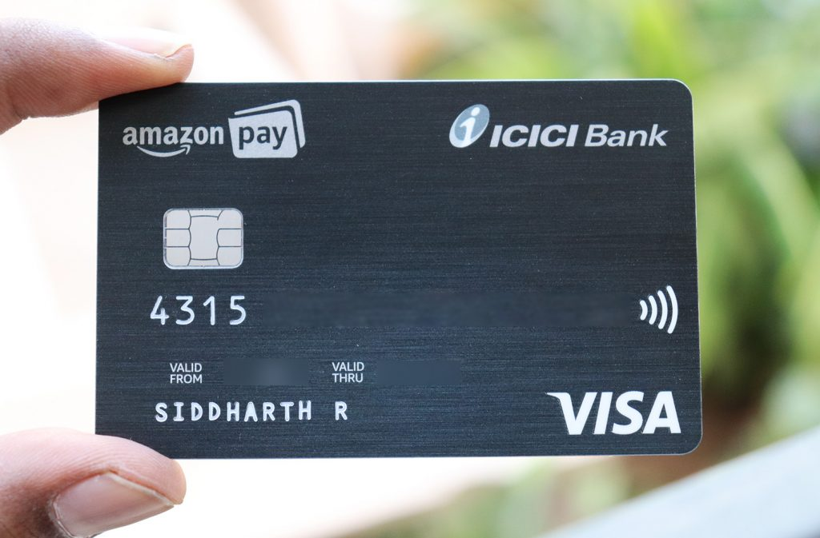
Credit card

Slide 5
4. Smart Card
These cards can be used to purchase goods and services.
A smart card is a plastic card about the size of a credit card, with an embedded microchip that can be loaded with data, used for telephone calling, electronic cash payments, and other applications and then periodically refreshed for additional use.
A smart card, chip card, or integrated circuit card [ICC] is any pocket sized card with embedded integrated circuits which can process data.

Slide 6
Smart cards are very useful to merchants and consumers to settle the transaction between them.
The card connects to a reader with direct physical contact or with a remote contactless radio frequency interface.
Smart card technology conforms to international standards and is available in a variety of form factors, including plastic cards, fobs, subscriber identification modules [SIMs] used in GSM Mobile phones and USB based tokens.

Slide 7
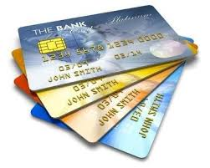
Smart card

Slide 8
Benefits of smart cards for the consumer
1. Security – unauthorized access is prevented by a lock function
2. Convenience
3. Flexibility
4. Control: Manage expenditure more effectively.
International use
Interest free loan
Ability to access multiple services such as health care, travel and financial data access.

Slide 9
5. Debit Cards
It is a popular method of making payment.
Banks issue debit cards to their customers who have maintained an account in the balance with sufficient credit balance.
Each time the customer makes a purchase, an equal amount of the purchase is debited in his account.

Slide 10
Process
The transaction works much like a credit card transaction.
A customer gives an ATM card to the seller for the purchase.
The merchant read the card through a transaction terminal and the customer enters his personal identification number.
Then the terminal route the transaction through the ATM networks back to the customer’s bank for authorization against customer’s deposit account.
The funds, are approved, are transferred from the customer’s bank to the sellers bank.

Slide 11
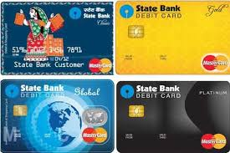
Debit card

Slide 12
5. Electronic Purse
Electronic Purse is a card with a microchip that can be used instead of cash and coins for everything from vending machines to public transportation.
The Electronic Purse would consist of micro‐ chip embedded in a credit card, debit card, or stand alone card to store value electronically.
It can be used for small ticket purchases such as gasoline stations, pay phones, road/bridge tolls, video games, school cafeterias, fast food restaurants, convenience stores, and cash lanes at supermarkets.
Cardholders can “reload” the microchip and control the amount of value stored in the card’s memory.
The Electronic Purse provides cardholders with the security and convenience of carrying less cash and coins, eliminating the need for exact change.

Slide 13
Process
To use the electronic purse, the user hands the card to the shop assistant who inserts the card in a terminal and keys in the amount of the transaction.
This is displayed visually to the customer.
Once again, the person must be able to read a display screen.
The customer confirms that the amount is correct, and the money is transferred from the card to the terminal.
In some systems the customer need to key in their PIN [Personal Identification Number] before the transaction can be completed.

Slide 14
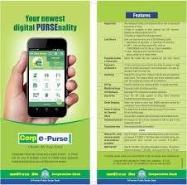
E-purse

Slide 15
Main security requirements for e-payment
1. Authorization
- A payment must always be authorized by the payer
- Needs payer authentication (physical, PIN, or digital signature)
- a payment may also need to be authorized by the bank data.
2. Confidentiality and authenticity
- Transaction data should be authentic
- External parties should not have access to data
- Some data need to be hidden even from participants o the transaction
- The merchant does not need to know customer account information
- The bank doesn’t need to know what the customer bought

Slide 16
3. Availability and reliability
  Payment infrastructure should always be available
  Centralized systems should be designed with care.
  High level of protection
4. Atomicity of transactions
  In practice, transactions can be interrupted (e.g., due to communication failure).
  It must be possible to detect and recover from interruptions (e.g., to undo already executed steps).

Slide 17
5. Privacy (anonymity and untraceability)
  Anonymity means that the customer hides her identity from the merchant.
  Untraceability means that not even the bank can keep track of which transactions the customer is engaged in.

