Slide 1
Biometrics
Prepared by
Dr. Muhammed Rafi.P
Assistant Professor
PG Department of Commerce & Management studies

Slide 2
Meaning of Biometrics
Biometrics comprises methods for uniquely recognizing human based upon one or more intrinsic physical or behavioral traits.
Biometrics is the science and technology of measuring and analyzing biological data. Biometrics is automated methods of recognizing a person based on a physiological or behavioral characteristic.
To verify an individual’s identity, biometric devices scan certain characteristics and compare them with a stored entry in a computer database.

Slide 3
In Information Technology biometrics refers to technologies for measuring and analyzing human physical and behavioral characteristics for authentication purposes.
The simplicity that biometrics lends to secure verification of an individual provides greater opportunities for e‐businesses to offer more products and services online.

Slide 4
Biometrics characteristics can be divided into two main classes:‐
  a) Physiological are related to the shape of the Body.
    E.g. Fingerprint, Face recognition, DNA, Hand and palm geometry, Iris recognition.
  b) Behavioral are related to the behavior of a person.
    E.g. Typing rhythm, Gait, and Voice.

Slide 5
A biometric system can operate in the following two modes:‐
1. Verification:
A one to one comparison of a captured biometric with a stored template to verify that the individual is who he claims to be. Can be done in conjunction with a smart card, username or ID number.
2. Identification:
A one too many comparison of the captured biometric against a biometric database in attempt to identify an unknown individual. The identification only succeeds in identifying the individual if the comparison of the biometric sample to a template in the database falls within a previously set threshold.

Slide 6
Types of Biometrics
There are two types of biometrics:
Behavioral and physical. Behavioral biometrics are generally used for verification while physical biometrics can be used for either identification or verification.

Slide 7
The different types of biometrics under these includes:‐
1. Signature
Signature recognition is a behavioural biometric. It can be operated in two different ways:
  Static:
  In this mode, users write their signature on paper, digitize it through an optical scanner or a camera, and the biometric system recognizes the signature analyzing its shape. This group is also known as "off-line".

Slide 8
  b) Dynamic:
  In this mode, users write their signature in a digitizing tablet, which acquires the signature in real time. Another possibility is the acquisition by means of stylus-operated PDAs. Some systems also operate on smart-phones or tablets with a capacitive screen, where users can sign using a finger or an appropriate pen. Dynamic recognition is also known as "on-line".
Computers can quantify, analyse and compare the different properties of signature to make signature recognition a viable biometric technology.

Slide 9
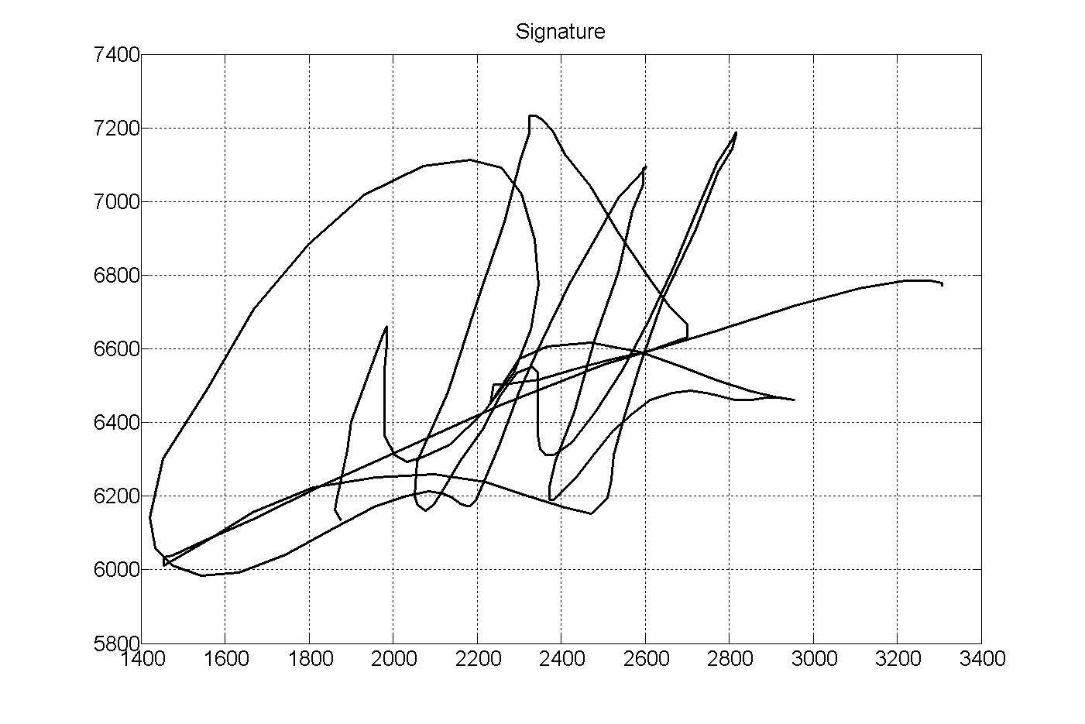
Offline biometrics

Slide 10

Online biometrics

Slide 11
2. Keystroke Dynamics:
The rhythms with which one types at a keyboard are sufficiently distinctive to form the basis of the biometric technology known as keystroke dynamics.
Key stroke dynamics unlike other biometric technologies is 100% software based, and it just requires a home computer to operate it.

Slide 12

Keystroke dynamics

Slide 13
