Slide 1
Types of biometrics
Continue….
Prepared by
Dr. Muhammed Rafi.P
Assistant Professor
PG Department of Commerce & Management studies

Slide 2
3. Hand geometry:
This system requires the subject to place his right hand on a plate where it is photographically captured and measured.
Made of 27 bones and a complex web of interconnected joints, muscles, and tendons, the human hand presents a sufficiently peculiar conformation of anatomical features to enable authentication.
Airports, prisons, and factories have successfully employed hand geometry system.

Slide 3
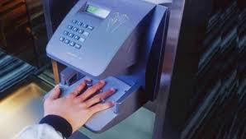
Hand geometry

Slide 4
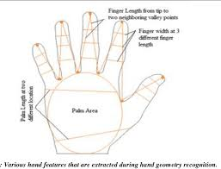

Slide 5
4. Finger Print:
It is a forensic criminological technique, used to identify perpetrators by the fingerprints they leave behind them at crime scenes.
In modern biometrics, the features of fingerprint called fingerprint minutiae, can be captured, analyzed, and compared electronically, with correlations drawn between a live sample and a reference sample, as with other biometric technologies.

Slide 6
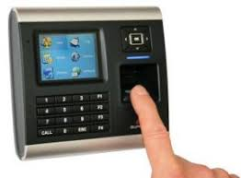
Finger print

Slide 7
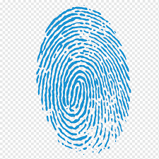

Slide 8
5. Facial Recognition:
With good cameras and good lighting, a facial recognition system can sample faces from tremendous distances without the subject’s knowledge or consent.
It works by two methods ; facial geometry or eigenface comparison. Facial geometry analysis works by taking a known reference point, say, and distance from eye to eye, and measuring the various features of the face in their distance and angles from this reference point.
Eigen face comparison uses a palette of about 150 facial abstractions, and compares the captured face with these abstract faces.

Slide 9
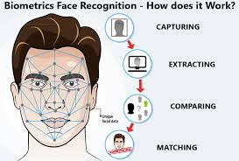
Facial Recognition

Slide 10
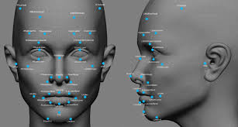

Slide 11
6. Eye biometrics [ Iris/ Retina]:
Both the iris and the veins of the retina provide patterns that can uniquely identify an individual.
The pattern of lines and colors on the eye are, as with other biometrics, analyzed, digitized, and compared against a reference sample for verification.

Slide 12
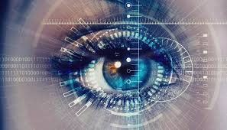
Eye biometrics

Slide 13
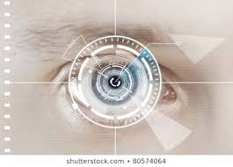

Slide 14
7. Voice Verification:
The identity of a person can also be verified with his voice. It is a difficult problem for computers to identify the voice of a person.
The prospect of accurate voice verification offers one great advantage.
It would allow a remote identification using the phone system without any additional cost.

Slide 15
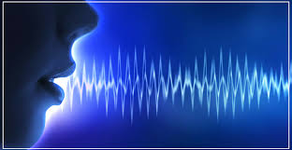
Voice recognition

