Slide 1
Exchange Rate
Prepared by
Dr. Muhammed Rafi.P Assistant Professor PG Department of Commerce & Management studies

Slide 2
Exchange Rate Behaviour
Exchange rates are highly volatile.
Exchange rate depends upon several factors such as inflation, interest rates and so on.
Whenever these factors change, the exchange rate also changes.
The behaviour exhibited by the exchange rates when the factors determining exchange rate change is known as exchange rate behaviour.

Slide 3
Equilibrium Exchange Rate (Foreign Exchange Rate Determination)
It is easy to measure the percentage change in the value of a currency.
But it is more difficult to explain why the value changed.
It is also difficult to forecast how it may change in the future.
For this the concept of equilibrium exchange rate and the factors affecting it must be understood.

Slide 4
An exchange rate represents the price of a currency.
Like the price of any commodity, the price of a foreign exchange (i.e., foreign exchange rate) also is determined by the demand for and the supply of foreign exchange of a particular country.
The exchange rate between, say, rupee and US dollar depends upon the demand for US dollar and the supply of US dollar in the Indian foreign exchange market and vice versa.
The prices are same in both these methods.

Slide 5
The equilibrium exchange rate is the rate at which demand for foreign exchange and the supply of foreign exchange are equal.

Slide 6
Demand for Foreign Exchange
Factors:
Domestic and foreign prices of goods and services.
Import of goods and services.
Investment in foreign countries (establishment of industries in foreign countries by Indians).
Other payments involved in international transactions like payments of Indian government to various foreign governments for settlement of their transactions.
Other types of outflow of foreign capital like giving donations etc.

Slide 7
Supply of Foreign Exchange
Factors:
Exports of goods and services.
Inflow of foreign capital.
Payments made by the foreign governments to Indian government for settling their transactions.
Other types of inflow of foreign capital like remittances by the NRIs, donations received etc.

Slide 8
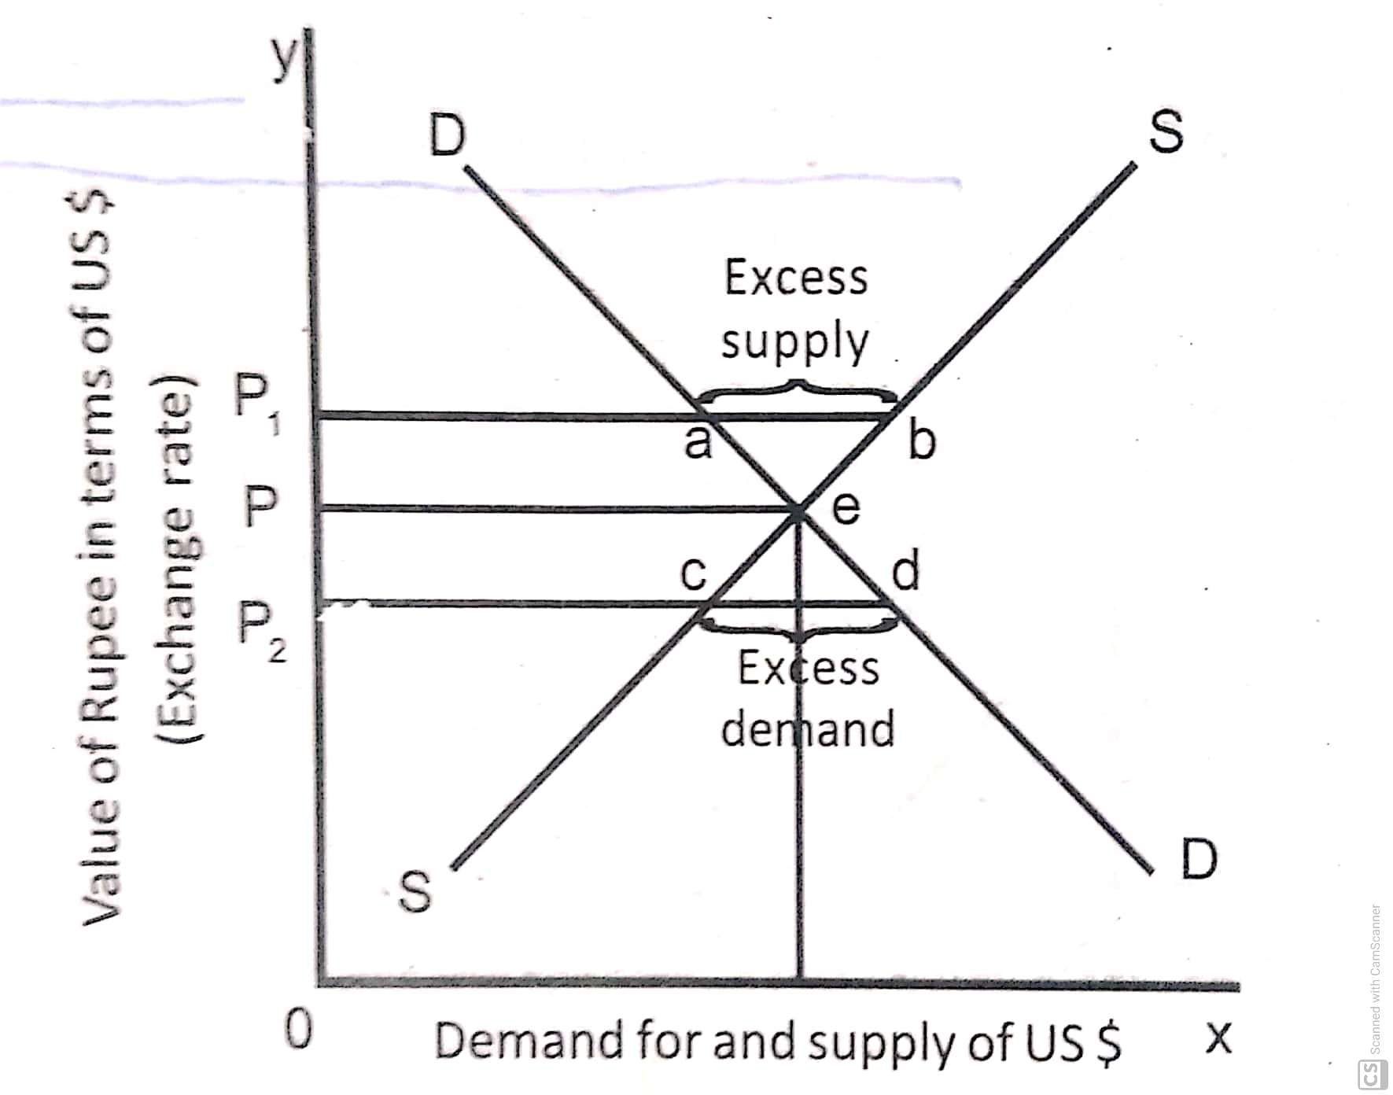

Slide 9
DD is the demand curve for US dollars and SS is the supply of US dollars. The equilibrium exchange rate is determined at point 'e' where demand and supply curves intersect each other i.e. demand and supply become equal. Thus OP is the equilibrium rate. If the demand for foreign exchange is less than the supply (demand is at point 'a' and supply is at point 'b'), the exchange rate is fixed at 'OP,' In contrast, if the demand is in excess of supply (demand is at point 'd' and supply in at point 'c'), the exchange rate is fixed at 'OP,'

Slide 10
In simple words, the equilibrium rate of exchange is the rate of exchange at which the par value of home currency with foreign currency is maintained at a stable level over a long period of time, which means it is neither undervalued nor overvalued.

Slide 11
Factors influencing or Determining Exchange Rate
Relative inflation rates:
Changes in relative inflation rates can affect international trade. This influences the demand for and supply of currencies. This in turn influences exchange rates.
Suppose inflation rate in India suddenly increased substantially while British inflation remained the same (assume that both British and Indian firms sell goods that can serve as substitutes for each other). The sudden jump in inflation in India should cause an increase in demand for British goods in India. Hence, this causes an increase in demand in India for British pounds.
In addition, the jump in inflation rate in India should reduce the British desire for Indian goods. Therefore, this reduces the supply of pounds for sale.

Slide 12
2. Relative Interest Rates:
Changes in relative interest rates affect investment in foreign securities. This influences the demand and supply of foreign currencies. This will in turn affect exchange rates.
Let us assume that US interest rates rise while Indian interest rates remain constant. In this case, US investors will likely reduce their demand for Indian rupees. This is so because the US rates are now more attractive in relation to Indian rates, and there is less desire for Indian bank deposits. Because US rates will now look more attractive to Indian investors with surplus cash, the supply of rupees for sale by Indian investors will increase as they establish more bank deposits in the US.
Due to a downward shift in the demand for rupees and an upward shift in the supply of rupees for sale, the equilibrium exchange rate will decrease.

Slide 13
3.Relative income levels:
Relative income levels is another factor affecting exchange rates. Since income can affect the amount of imports demanded, it can affect exchange rates.
Suppose the US income level rises substantially, while the Indian income level remains unchanged. Consider the impact of this scenario on (a) the demand schedule for rupees, (b) the supply schedule of rupees for sale, and (c) the equilibrium exchange rate.
First, the demand schedule for rupees will shift upward, reflecting the increase in US income and therefore increased demand for Indian goods. Second, the supply schedule of rupees for sale is not expected to change. Therefore, the equilibrium exchange rate rupees is expected to increase.

Slide 14
4. Government control and Government policy:
Another factor affecting exchange rates is government controls. The governments of foreign countries can influence the equilibrium exchange rate in many ways. These include :
imposing foreign exchange barriers, imposing foreign trade barriers,
intervening (buying and selling currencies) in the foreign exchange markets,
changing macro variables like inflation, interest rates, and income levels, etc.

Slide 15
5. Market expectations:
Another factor influencing exchange rates is market expectations about future exchange rates.
Like other financial markets, foreign exchange markets react to any news that may have a future effect.
Eg;- News of a potential surge in inflation in India may cause currency traders to sell rupees, anticipating a future decline in rupee value. This response puts immediate downward pressure on the rupee.
Many institutional investors such as commercial banks and insurance companies take currency positions based on anticipated interest rate movements.

Slide 16
6. Speculation:
The growth of speculative activities also influences the exchange rate.
Speculation causes short run fluctuations in the exchange rate.
If the speculators expect a fall in the value of currency and start buying the other currency they expect to appreciate in value. As a result, the supply of the former currency will increase and its exchange rate will fall. The demand for the other currency will increase and its exchange rate will go up.

Slide 17
7. Changes in bank rate:
The bank rate also influences the exchange rate.
If the bank rate rises relative to other countries, more funds will flow into the country from abroad to earn high interest rate.
It will tend to raise the demand for the domestic currency and the exchange rate will move in favour of the country.
When the bank rate falls, the opposite happens.

Slide 18
8. Structural influences:
Structural change is another important factor which influences the exchange rate of a country.
Structural changes are those which bring change in the consumer demand for commodities. They include technological change, innovations etc. These also affect the cost structure along with the demand for products. Such structural changes tend to increase the foreign demand for domestic products. It implies increase in exports, greater demand for domestic currency, appreciation of its value and rise in the exchange rate.

Slide 19
9. Political conditions:
Stable, political and industrial conditions and peace and security in the county have an important influence on the exchange rate. If there is political stability and the government is stable, strong and efficient, foreigners will have tendency to invest their funds into the country. With the inflow of capital, the demand for domestic currency will rise and the exchange rate will move in favour of the country.
On the contrary, if the government is weak, inefficient and dishonest and there is no safety to life and property capital will flow out of the country. Now the exchange rate will move against the country.

Slide 20
10. Banking operations:
The banking operations such as purchase and sale of bank drafts, letters of credit, arbitrage and dealing in bills of exchange have an impact on the demand for and supply of foreign exchange. Hence, these have an impact on the foreign exchange rate. A large issue of bank drafts or letters of credit on foreign banks causes an increase in the demand for foreign currency. As a result, foreign currency will appreciate. When foreign banks make large issue of bank drafts and letters of credit, then the currency of the home country will appreciate

Slide 21
11. Stock exchange activities:
The stock exchange activities such as sale and purchase of foreign securities, debentures, stocks, share etc. have influence upon the foreign exchange rate.
If there is a large sale of securities etc. to foreigners, the demand for home currency by the foreigners increases. This results in an increase in the exchange value of home currency relative to the foreign currency.
The purchase of foreign securities etc. by the people of home ﻿country raises the demand for foreign currency. As a result, the exchange value of foreign currency increases relative to home currency.

Slide 22
12. Currency and credit conditions:
If there is a steady increase in money circulation of a country that is not justified by the state of internal trade, it is assumed that the purchasing power of the currency is falling or the internal price level is rising. This will have an adverse effect on the export trade of the country. The demand for that country's currency will be reduced on account of decreased exports. This in turn will reduce the rate of exchange.

Slide 23
13. National budgetary influence:
The budgets of a country influence the rate of exchange. If the country prepares a balanced budget, there will be no need to have any additional taxation. This will, in turn, reduce the overhead costs of production and increase national savings.
On the other hand, if the country is spending more than its income, an additional taxation will have to be made. This will increase the overhead costs of production.
Under such circumstances, the speculators will anticipate an increase or decrease, as the case may be, in the exchange value of the currency. Their activity in the foreign exchange market will influence the exchange rate.

Slide 24
Exchange Rate Movements
Exchange rates are subject to wide fluctuations. When economic conditions change, exchange rates can change substantially.
The exchange rate may move upwards or downwards.

Slide 25
When there is upward movement of the exchange rate it may be either appreciation or revaluation.
i) Appreciation:
This describes an upward movement in a freely floating exchange rate. This may occur day by day or perhaps even minute by minute.
ii) Revaluation:
This also describes an upward movement in an exchange rate, but in a fixed exchange rate system. This will be a very infrequent event (if ever).

Slide 26
When there is downward movement of the exchange rate it may be either depreciation or revaluation.
i) Depreciation:
This describes a downward movement in a floating exchange rate.
ii) Devaluation: This means that the government has changed the fixed rate of a fixed exchange rate downwards.

Slide 27
Difference between Depreciation and Devaluation
Base | Devaluation of currency | Depreciation of currency
Meaning | It means to lower the value of a country's currency as compared to another country's value in fixed exchange rate system | The decrease in the value of a currency in floating exchange rate system is known as depreciation of currency
Circumstances | It is done by government | It is done by the forces of authority demand and supply in the international market.
Rate | It is done by using fixed exchange rate | It is done by using floating exchange rate
Effect on economy | It is just for short term. | It affects the economy for a long term.
Changes | There is no fixed time for it but it doesn't occur in regularly. | It occurs on a daily basis.

