Slide 1
International capital budgeting
Prepared by
Dr. Muhammed Rafi.P Assistant Professor PG Department of Commerce & Management studies

Slide 2
Capital budgeting
It refers to a process of analysing and selecting investment projects.
It can be defined as the process of analysing capital investment opportunities and deciding which project to undertake.

Slide 3
International capital budgeting
Capital budgeting is the process of analysing and selecting the most profitable investment project.
In the case of international capital budgeting , some additional complexities influence the computation of the cash flow and required rate of return.
The techniques are similar to domestic capital budgeting.

Slide 4
Problems associated with International capital budgeting
Conversion of currency
Taxes
Difficulty in anticipation of inflation rates
Foreign exchange risk
Restrictions on the remittance
Difficulty in recognising the exact remittances
Country risk or economic and political risk
Complexities due to type of financing
Sibsidized loans and cost of capital
Currency of evaluation
Incremental cash flows (Cannibalisation, sales reaction, transfer pricing, Royalties and fees)
Difficulties in estimating the terminal value.

Slide 5
Factors affecting Risk Evaluation
Economic conditions in the foreign country
Market conditions in the foreign country
Taxes
International conditions
Market risk
Blocked fund
Uncertain salvage value
Project risk
Host government incentives
Financial arrangement

Slide 6
Approaches to evaluate a Foreign project
There are two approaches to the cash flows of a MNC.
Foreign currency approach and
Home currency approach

Slide 7
Foreign Currency Approach (Appraisal from the Project's or Subsidiary's perspective)
The steps involved are :
Estimate the cash flows of a project in the foreign currency.
Identify the foreign currency discount rate and discount the cash flows.
Find the NPV in the foreign currency

Slide 9
Home Currency Approach (Appraisal from the Parent Company's perspective).
The steps involved are:
Estimate the cash flows of a project in the foreign currency
Estimate the expected future spot rate of exchange.
Convert foreign currency cash flows to INR (domestic currency) at the expected future spot rate.
Identify the domestic discount rate, discount the cash flows, and find NPV in the INR (domestic currency)

Slide 11
Example
An Indian firm wishes to invest in a US project. It is estimated that the project will initially cost USD 100 million. The firm expects to have a debt ratio of 52 per cent in the project funding. The expected free cash flows (net cash flows after tax) for the next five years are shown below:
Year : 1 2 3 4 5
Net cash flows: 20 35 40 40 50
(USD million)

Slide 12
The risk-free interest rate is 6% in India and 4% in the United States. The inflation rate is 5% in India and 3% in the United States. The tax rate is 35% in India and 30% in the United States. The risk premium is 10% in India and 8% in the United States. The estimated equity beta for United States investment is 0.90. The general interest rate is 12% in India and 9% in the United States. The current spot exchange rate is INR/USD 66.
Evaluate the project.

Slide 13
Solution
To evaluate the project in INR (i.e., the parent Co's perspective) the following steps can be observed :
Convert the initial cost of the project (USD 100 million) into INR at the current spot rate of INR 66, which comes to INR 6,600 million.
Forecast the forward exchange rate by using interest rate parity or inflation rate parity.

Slide 14
E(USD/INR) = So x (1+ ih)
(1+ if)
E(USD/INR) = Expected exchange rate between the Indian rupee and the US dollar
So = Current spot rate of exchange
ih = Inflation rate in home country (India)
if = Inflation rate in foreign country (United States)
Accordingly, the expected spot rate after one year is :
Rs. 66 x (1 +0.05)/(1+0.03) = Rs. 67.28

Slide 15
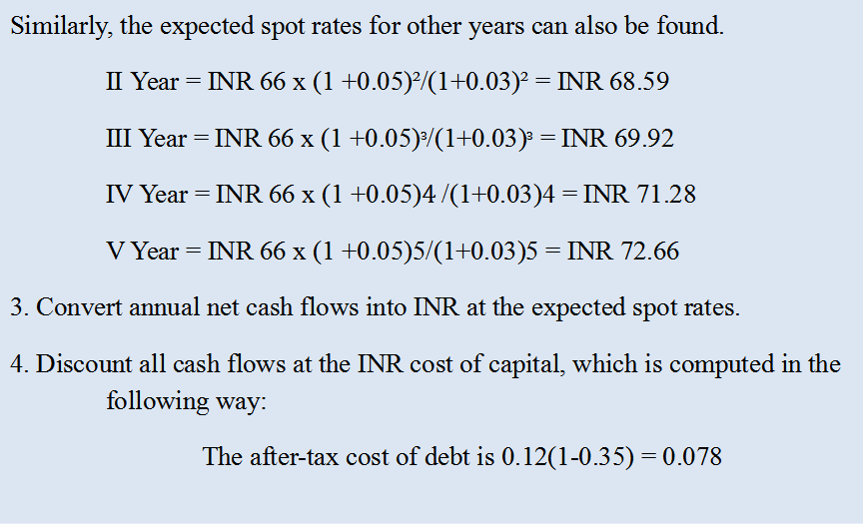
Similarly, the expected spot rates for other years can also be found.
II Year = INR 66 x (1 +0.05)²/(1+0.03)² = INR 68.59
III Year = INR 66 x (1 +0.05)ᵌ/(1+0.03)ᵌ = INR 69.92
IV Year = INR 66 x (1 +0.05)$4$/(1+0.03)4 = INR 71.28
V Year = INR 66 x (1 +0.05)5/(1+0.03)5 = INR 72.66
3. Convert annual net cash flows into INR at the expected spot rates.
4. Discount all cash flows at the INR cost of capital, which is computed in the following way:
The after-tax cost of debt is 0.12(1-0.35) = 0.078

Slide 16
The cost of equity is :
Ke = Nominal risk - free interest rate + Risk premium x β
= .12-.06+(0.10 x0.90) = 0.15
Weighted average cost of capital (WACC)
= (Cost of debt + Cost of equity)
= (0.078x0.52) + (0.15 x 0.48) = 0.11

Slide 17
Calculation of NPV
Year | Net cash flows(USD Million) | Estimated spot rate(USD/INR) | Net cash flows(INR million) | PV factor at 11% | Present value (INR million)
 | 1 | 2 | 3(1X2) | 4 | 5(3X4)
0 | -100 | 66 | -6600 | 1 | -6600
1 | 20 | 67.28 | 1345.6 | 0.901 | 1212
2 | 35 | 68.59 | 2400.65 | 0.812 | 1949
3 | 40 | 69.92 | 2796.8 | 0.731 | 2044
4 | 40 | 71.28 | 2851.2 | 0.659 | 1879
5 | 50 | 72.66 | 3633 | 0.593 | 2154
NPV = INR 2,638 (i.e., Total PV - Initial cost, 9,238 - 6600)

Slide 18
B. To evaluate the project in US dollars (i.e., subsidiary's perspective), the following calculations can be made:
The U.S. dollar cost of capital will be :
= (1 + INR cost of capital) x (1+rf) - 1
(1+rh)
U.S. cost of capital = 1 + 0.11 x (1 +0.09)/(1+0.12) - 1
= 0.08

Slide 19
Calculation of NPV
Year | Net cash flows(USD Million) | PV factor at 8% | Present value (USD million)
0 | -100 | 1 | -100
1 | 20 | 0.926 | 18.52
2 | 35 | 0.857 | 30.00
3 | 40 | 0.797 | 31.76
4 | 40 | 0.735 | 29.40
5 | 50 | 0.681 | 34.05
NPV = USD 43.73 million

Slide 20
Converting NPV in US dollars into NPV in INR at the current spot rate, the NPV comes to INR 2,886.18 million (i.e., 43.73 x 66)
Since the NPV is positive, the project can be taken up by the Indian firm.

Slide 21
Evaluation of Foreign Projects
Evaluating a foreign project is more complex than evaluating a local project due to multiple factors.
First, foreign projects are subject to foreign exchange risk.
Second, multiple tax jurisdictions are involved potentially subjecting the cash flows to double-taxation.
Further, foreign governments may place restrictions on repatriation of earnings back to the home country.

