Slide 1
Exploratory Research Design

Slide 2
Exploratory research is a preliminary study of a new problem about which the researcher has little or no knowledge.
Exploratory research is conducted into an issue or problem where there are few or no earlier studies to refer to.
The results of these research are not usually useful for decision-making by themselves, but they can provide significant insight in to a given Situation. Exlploratory research helps to determine the best research design, data collection method and selection of subjects.

Slide 3
Exploratory research, as the name implies, intends merely to explore the research questions and does not intend to offer final and conclusive solutions to existing problems. This type of research is usually conducted to study a problem that has not been clearly defined yet.

Slide 4
For example: Consider a scenario where a juice bar owner feels that increasing the variety of juices will enable increase in customers, however he is not sure and needs more information. The owner intends to carry out an exploratory research to find out if expanding their juices selection will enable him to get more customers if there is a better idea.

Slide 5
Initial research conducted to clarify and define the nature of a problem
Does not provide conclusive evidence
Subsequent research expected.
–Exploratory Research is used to clarify/define a problem

Slide 6
USES OF EXPLORATORY RESEARCH
This method is adopted when the results are not obtained on observation basis. In this connection certain hypothesis are formulated and it is tested through exploratory research.
Exploratory research helps to determine the best research design, data collection method and selection of subjects.
Exploratory research is used to finalize the questionnaire or format/schedule to ensure coverage of all possibilities that could arise while filling up of a questionnaire or schedule during conduct of full fledged research.

Slide 7

Experience/Expert surveys
Secondary data analysis
Case studies/Analysis
Pilot studies
Literature review
Depth interviews
Focus group

Slide 8




Ask knowledgeable individuals about a particular research problem- most are quite willing experience survey is to be conducted among the people who have had practical experience with the problem to be studied.
The main object of such a survey is to obtain new sights to the problem . The experience surveys involve talking with knowledgeable individuals, both inside and outside the organization, who may provide insights into the problem.

Slide 9


Experience survey rarely include a formal questionnaire .instead, the researcher may simply have a list of topics to be discussed. The experienced people can contribute new ideas.
Expert surveys allow us to gain information from specialists in a field that we are less qualified or knowledgeable in.

Slide 10


The secondary data reveal a lot of historical data. The secondary data are those data ,which have already been collected ,tabulated and presented in some form by someone else for some other purpose. It means data that are already available.
Economic surveys of the government of India, economic reviews published by various state governments, census data, and data relating to agriculture, industry, forestry, education etc by the government are the examples of secondary data.

Slide 11


The secondary sources may be both internal and external in character.
Internal secondary data- this refers the information that already exists within the company or unit studied.
Eg- the record of sales, budget, advertising expenses, previous market research studies etc
External secondary data- External secondary sources consist of both public and private documents.These are in both published and unpublished in nature. And these data comprise govt publications, busines reference sources, and commercial agencies. Private document consist of life history, diaries, letter, memories etc.

Slide 12


External secondary research can also help you perfect your research design.
Beyond reviewing other organizations’ research projects, social media like blogs and forums can give you a better sense of the issues, opinions and behaviors that go along with your research’s subject matter.

Slide 13
CHOICE BETWEEN PRIMARY DATA AND SECONDARY DATA
1 ) Nature and scope of study or enquiry
Accessibility of financial resource
Availability of time
4 ) Degree of accuracy necessary for the study.
5 ) The status of the investigator or researcher
6 ) Availability of trained investigators.

Slide 14
PRECAUTIONS TO BE TAKEN BY THE RESEARCHER WHILE USING SECONDARY DATA
1 RELIABILIT Y- He should find the person or organization or agencies collected the data. He should also verify from where data is collected, on what methods, at what time, whether any bias in compilation, the level of accuracy desired etc
2. SUITABILITY
3 .ADEQUACY-

Slide 15
Case study is a method or an approach of exploring or analyzing the life of a social unit.The social unit may be a person or a family or an institution or an organization or a community.
A case study is best defined as an in-depth study of a single unit. It is a comprehensive study through which one can know precisely the factors and causes of a particular phenomenon.
Researchers can understand a lot in regards to a problem by studying carefully selected examples or cases of the phenomenon.
case studies are suitable to undertake exploratory research.
A researcher must examine carefully the previously published case studies with regard to variables like price, advertisement, changes in the trend, etc.

Slide 16



Intensely investigates one or a few situations s i mi la r to the problem
Investigate in depth
Careful study
May require cooperation

Slide 17
PILOT STUDY /PILOT SURVEY
A pilot experiment ,also called pilot study , is a small scale preliminary study conducted before the main research, in order to check the feasibility or to improve the design of the research.
pilot studies are frequently carried out before large scale quantitative research, is an attempt to avoid time and money being wasted on an inadequately designed project.

Slide 18
Pilot experiments are also used to reduce cost, as they are less expensive than full experiments. The pilot study enables the researcher to gain some systematic knowledge of the universe and its population under study. The researcher is able to frame schedule or questionnaire on the basis of information gathered through pilot study.

Slide 19
So pilot study is-
Any small scale exploratory study that uses sampling
But does not apply rigorous standards
To promote efficiency in conducting surveys, researchers usually perform a pilot survey.
Applied on a smaller sample compared to the planned sample size.
In this phase of conducting a survey, the questionnaire is administered to a percentage of the total sample population, or in more informal cases just to a convenience sample.

Slide 20

· Conducting a pilot survey prior to the a c t u al, large-scale survey presents many benefits and advantages for the researcher.
1 Helps in selection of the respondents
2 It helps to know the non response rate, reasons for it, desirable time for interviewing etc.
3 tests the correctness of the instructions to be measured by whether all the respondents in the pilot sample are able to follow the directions as indicated

Slide 21
4. Provides better information on whether the type of survey is effective in fulfilling the purpose of the study.
5. Practically speaking, it save financial resources because if errors are found in the questionnaire or interview early on, there would be a lesser chance of unreliable results or worse, that you would need to start over again after conducting the survey.
6. Main objective of a pilot study is to determine whether conducting a large-scale survey is worth the effort.

Slide 22

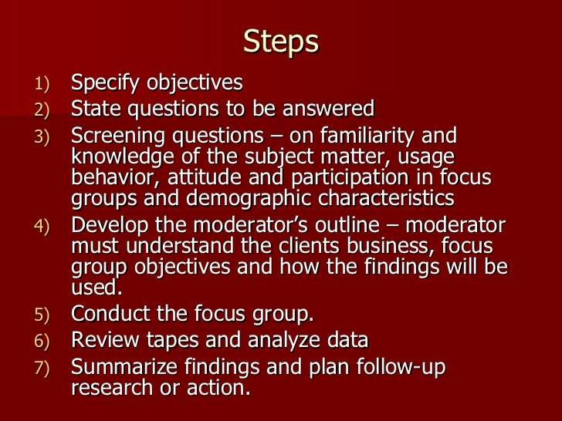

·

Slide 23

A focus group interview is an unsructured ,free flowing interview with small group of people.It has a flexible format that encourages discussion.
In a focus group, only a few people are brought together to study and talk over some theme of interest.
The discussion is directed by a moderator who is in
the room with the focus group participants.
The group usually is of 8-12 persons. While choosing these individuals, care must be taken to see that they should have a common background and have comparable experiences in buying.
This is certainly needed since there should not be a conflict among the group members on the common problems that are being talked about.
A focus group is a form of qualitative research in which a group of people are asked about their perceptions,opinions,beliefs and attitude towards a product,service,concept,advertisement,idea,or packaging.questions are asked in an interactive group setting where participants are free to talk with other group

Slide 24

TWO-WAY FOCUS GROUP
one focus group watches another focus group and discusses the observed interactions and conclusion
DUAL MODERATOR FOCUS GROUP
one moderator ensures the session progresses smoothly, while another ensures that all the topics are covered
DUELING MODERATOR FOCUS GROUP (FENCING- MODERATOR):
two moderators deliberately take opposite sides on the issue under discussion
RESPONDENT MODERATOR FOCUS GROUP
one and only one of the respondents is asked to act as the moderator temporarily

Slide 25


CLIENT PARTICIPANT FOCUS GROUPS
one or more client representatives participate in the discussion, either covertly or overtly
MINI FOCUS GROUPS
groups are composed of four or five members rather than 6 to 12
TELECONFERENCE FOCUS GROUPS
telephone network is used
Creativity groups
Band obsessive group
Online focus groups - computers connected via the internet are used

Slide 26
INTERNET-BASED FOCUS GROUPS
Such “groups,” in which multiple respondents can “meet” electronically via chat rooms, instant mes- saging, Web cameras, and the like, offer tremendous speed and cost benefits, particularly when using an established online panel of respondents.
There are other advantages of online focus groups, groups composed of people from far- flung locations, to deal with sensitive topics.
less expensive - multiple respondents are handled simulta- neously.
That’s not to say that they are inexpensive, however. By the time the facility has been rented, an experienced moderator has been hired to conduct the session and write the report, and incentives paid to participants, a focus group has become costly.
And that’s just one focus group; add a series of focus groups and the costs can really rise.

