Slide 1


 Brief Introduction to Research as a Methodology
✓✓ Key Components of research methodology
✓✓ Research process flow
✓✓ Importance of a research problem
 Research Problem
?
✓✓ What is a Research Problem
✓✓ When is a problem researchable
✓✓ Identifying a Research Problem
✓✓ Sources of a Research problem
✓✓ Problem statement
 Research Question
 Steps to Defining a Research Problem
 The Crux and an Analogy

Slide 2


I’m a Genius !!!!
Every human being, from the time of birth, has natural instincts and interest for exploring, understanding and discovering the world unknown to him/her.
‘Every newborn is a researcher in its own capacity.’ However a few with pertinence
continue the pursuit
exploring the unknown and
eventually adopt a structured way for exploring the unknown
termed as ‘Researchers’
Research therefore .. is a methodical, unbiased and complete investigation of any subject matter to establish principles or to discover pertinent information to solve a specific problem
Research Methodology is a scientific way to solve a research problem
2

Slide 3

























COMPONENTS OF RESEARCH METHODOLOGY
Identify & Define Research Problem
Defining the research problem
(Identification of Problem / Review of Literature / Formulation of hypothesis)
50
Review of Literarture
Formulation of hypothesis
Designing the study
(Research design / Sample design / Data Collection)
25
Design Research Study
Interpretation of results
(Data Analysis / Interpretation)
Data Collection
15
Data Analysis & Interpretation
Discussing and presenting the conclusions
(Preparation of report)
10
Reporting
A good impact research outcome depends on
how well the Research Problem is
defined
3
AI

Slide 4







WHAT IS A RESEARCH PROBLEM
That was easy la !!!
A problem is a situation or a condition that is difficult to resolve
We look for ways and means to resolve the situation by reducing/removing the difficulty
A research problem therefore is a statement about
✓✓ an area of concern,
✓✓ a condition to be improved,
✓✓ a difficulty to be eliminated,
✓✓ or a troubling question
that point to the need for meaningful understanding and deliberate investigation.
A research problem is usually expressed as a question or statement, which inquires on a subject
5
I,

Slide 5


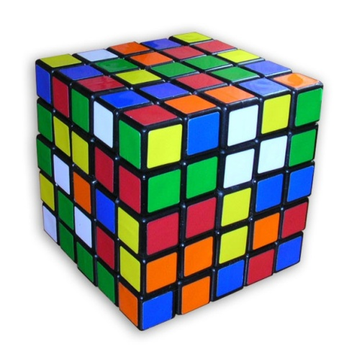

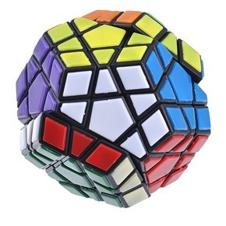
WHEN IS A PROBLEM RESEARCHABLE ?
A problem is a situation or a condition that is difficult to resolve
✓✓ When there is no known answers or solution to a problem and that a gap in knowledge exists
✓✓ When there are possible solutions however the effectiveness of which is unknown
✓✓ When there are answers or solutions the possible result of which maybe seen or factually contradicting
✓✓ there are several possible and plausible explanations for an undesirable condition (problem), and when the existence of a phenomenon requires a solution.

Slide 6
IDENTIFYING A RESEARCH PROBLEM
Problem identification - process of finding or determining what research area is to be studied.
Identify using the following features
✓✓ Interest to the researcher
✓✓ The problem should be significant
✓✓ The problem should be delineated (describe- or explain)
✓✓ The information required should be accessible, obtainable
✓✓ Conclusions related to the problem should be derivable
✓✓ It should be possible to state the problem clearly and concisely

Slide 7
Tips to identifying a problem with significance
Think of the BIG PICTURE
▪▪ What is the problem you are trying to solve?
▪▪ Think of something you like to learn more about
▪▪ Consult text books, journal or your supervisor
Pick one based on:
▪▪ Interest and relevance
▪▪ Magnitude of work involved
▪▪ Level of expertise (yours and your advisors)
When narrowing down on a topic think how it can contribute towards
solving the BIG PROBLEM !

Slide 8
Unskilled Labor
Inefficient Irrigation
Low Labor Productivity
Unsuitable Climate
Inefficient Water harvesting
Water Scarcity
Lack of crop varieties adapted to climate
Food Insecurity
Unsuitable Crops
Farming Patterns do not Return nutrients
Low Land Productivity
Farmers canʼt afford fertilizer
Poor Soil
Farmers unaware of best practices
To narrow down on a topic from a broad area understand the
‘cause and effect’ phenomenon
9

Slide 9
RESEARCH QUESTION
✓✓ A research question is a way of expressing interest in a problem or phenomenon.
✓✓ There may be more than one research question for a study, depending on the complexity and breadth of the proposed work.
✓✓ a well-written research question will also sheds light on appropriate research methods
A ‘5 Why Analysis’ pattern of questioning can get you to the root cause, your actual narrowed area
of work.
10

Slide 10
SOURCES OF RESEARCH PROBLEMS
Broad sources of inspiration for beginners
✓✓ Deductions from Theory
deductions made from social philosophy or generalization
✓✓ Interdisciplinary Perspectives
examining research from related disciplines, which can expose one to new avenues of exploration and analysis
✓✓ Interviewing Practitioners
Discussions with experts in the field, such as, teachers, practitioners etc.
✓✓ Personal Experience
Critical thinking about personal experiences with an issue facing society, community, or in the neighborhood can give rise to a researchable problem
✓✓ Relevant Literature
extensive and thorough review of pertinent research associated with the overall area of interest
11

Slide 11
PROBLEM STATEMENT
The statement need not be lengthy but a good research problem should incorporate the following features:
✓✓ Compelling topic.
The problem chosen to explore must be important to the researcher and to a larger community. The problem chosen must be one that motivates the researcher to address.
✓✓ Supports multiple perspectives.
A general rule of thumb is that a good research problem is one that would generate a variety of viewpoints from a composite audience made up of reasonable people.
✓✓ Researchable.
Research problems that can be supported by the resources available must be the ones that are chosen
A good problem statement begins by introducing the broad area in which the research is centered and then gradually leads the reader to the more narrow
12
questions that are posing.

Slide 12




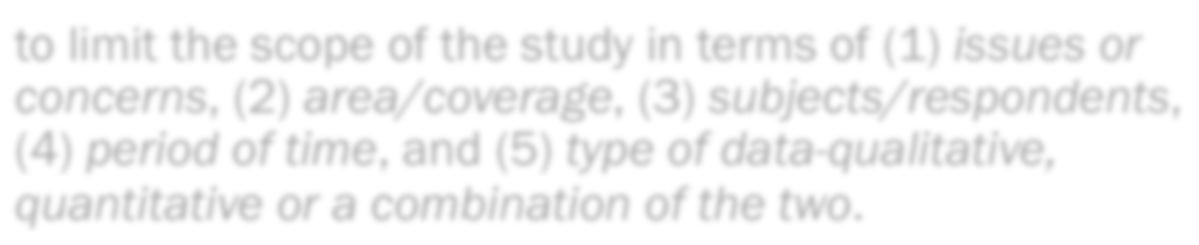




‘3’ STEPS TO DEFINING A RESEARCH PROBLEM
narrow it down so as to make it manageable rather than formidable
The first step is to see to it that the major concepts or terms are clearly defined
to limit the scope of the study in terms of (1) issues or concerns, (2) area/coverage, (3) subjects/respondents,
(4) period of time, and (5) type of data-qualitative,
quantitative or a combination of the two.
be resourceful in looking for other means that will help him/her refine further and make more explicit his research problem
12

Slide 13
THE ‘CRUX’
A research problem must be justifiable, in terms of its feasibility and worthiness as a proposal.
✓✓ Why the “problem” is actually a problem at all.
✓✓ What are the ways that the study will add to the scholarly research/literature in the field?
✓✓ How does the study improve (current) practice?
✓✓ How might the study improve policy?
13

Slide 14
RESEARCH PROBLEM – AN ANALOGY
Defining a research problem is like giving birth to a baby, defining period is like gestation.
The mother (researcher) needs intake of assimilable sumptuous wholesome nourishment (background study &
literature review).
The baby born then can be groomed (studied) well.
That is why research outcomes are referred to as
Brain-child !!!!!!!
15

Slide 15


Pssst !!!!!!
…..and anybody who goes by all of that gets to be…..
*
* Conditions apply
PREM SARAN TIRUMALAI, DEPTT OF ZOOLOGY, DEI
16

