Slide 1
SAMPLING DESIGN
Sampling design is a design, or a working plan, that specifies the population frame, sample size, sample selection, and estimation method in detail. Objective of the sampling design is to know the characteristic of the population. A sample design is a definit plan for obtaining a sample from a given population.

Slide 2
Steps in sampling design
1.Define the population or universe
2.State the sampling frame
3.Identify the sampling unit
4.State sampling method
5.Determine the sample size.
6.Spell out the sampling plan
7.Select the sample.

Slide 3
1.Define Target Population or Universe
The population to which the investigator wants to generalize his results.
2.Sampling frame
The sampling frame is the list from which the potential respondents are drawn(is the source material or device from which a sample is drawn.OR sampling frame is a list of all the items in your population.)
Eg –population-commerce students under university of calicut.
S frame-mes kalladi,gvc palakkad,mercy,najath,gc malprm,farook,ptm gc,mankada gc etc.
3.Sampling Unit:
smallest unit from which sample can be selected(state or village etc)
4.State sampling method-it includes probability-sampling methods, non probability sampling methods.researcher should select one method among this.

Slide 4
5.Determine the sample size-this refers to the number of items to be selected from the universe.
6.Spell out the sampling plan-he should decide the techniques, which are used in selecting of the item of sample.
7.Select sample.

Slide 5





Types of Sampling
Probability sample – a method of sampling that uses of random selection so that all units/ cases in the population have an equal probability of being chosen.
Non-probability sample – does not involve random selection and methods are not based on the rationale of
probability theory.
Sampling Techniques
Non- Probability
Probability

Slide 6










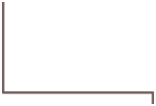


Probability (Random) Samples-types
  Simple random sample
Systematic random sample
Stratified random sample
Cluster sample
Probability Sampling
Simple Random Sampling
Systematic Sampling
Stratified Random Sampling
Cluster Sampling
Proportionate
Dis Proportionate
One- Stage
Two Stage
Multi- Stage

Slide 7

SIMPLE RANDOM SAMPLING
Applicable when population is small, homogeneous & readily available
All subsets of the frame are given an equal probability. Each element of the frame thus has an equal probability of selection. A table of random number or lottery system is used to determine which units are to be selected.
Advantage
Easy method to use
No need of prior information of population
Equal and independent chance of selection to every element
Disadvantages
If sampling frame large, this method impracticable.

Slide 8

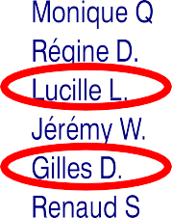
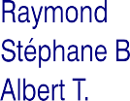

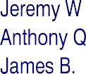

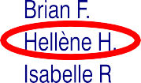
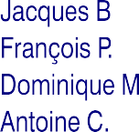
Simple random sampling
Every subset of a specified size n from the population has an equal chance of being s^{S}e^{un}le^{il K}c^{u}t^{m}eªd^{r}

Slide 9
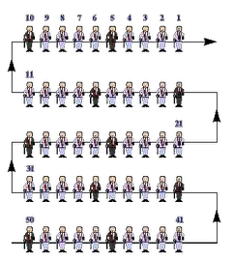

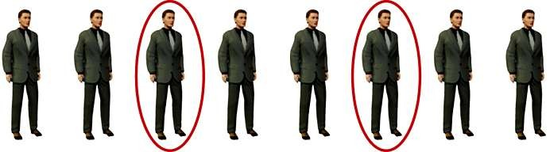






Systematic Sampling
Similar to simple random sample. – select directly from sampling frame. Ratio between sample size and population size
First unit select by random numbers then every nth unit selected (e.g. every 10th)
Work out what fraction of the frame the sample size represents
Sunil Kumar
Select according to fraction (100 sample from 1,000 frame then
10% so every
10th unit)
Define
population
Develop sampling frame
Decide the
sample size

Slide 10
Stratified sampling
If a population from which a sample is to be drawn does not constitute a homogeneous group,stratified sampling technique is genarally applied inorder to obtain a representative sample.
under stratified sampling the population is divided into several sub –populations that are individually more homogeneous than the total population(the different sub populations are called ‘strata’.)and then we select items from each stratum to constitute a sample.

Slide 11

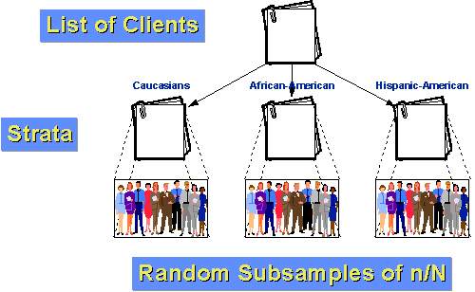
The population is divided into two or more groups called strata, according to some criterion, such as geographic location, grade level, age, or income, and subsamples are randomly selected from each strata.

Slide 12

Advantage :
Enhancement of representativeness to each sample
Higher statistical efficiency
Easy to carry out Disadvantage:
Classification error
Time consuming and expensive
Prior knowledge of composition and of distribution of population

Slide 13



Cluster/ multi-stage random sample
Cluster sampling: selecting a sample based on specific, naturally occurring groups (clusters) within a population.
Definition: The Multistage Sampling is the probability sampling technique wherein the sampling is carried out in several stages such that the sample size gets reduced at each stage.
For example, If the government wants to take a sample of 10,000 households residing in Gujarat state. At the first stage, the state can be divided into the number districts, and then few districts can be selected randomly. At the second-stage, the chosen districts can be further sub-divided into the number of villages and then the sample of few villages can be taken at random. Now at the third-stage, the desired number of households can be selected from the villages chosen at the second stage. Thus, at each stage the size of the sample has become smaller and the research study has become more precise
.

Slide 14
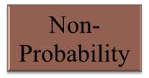
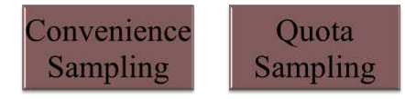
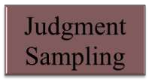
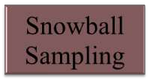
Non-Probability Samples
Convenience samples (ease of access)
sample is selected from elements of a population that are easily accessible
Purposive sample (Judgmental Sampling)
You chose who you think should be in the study
Quota Sampling
Snowball Sampling (friend of friend….etc.)

Slide 15

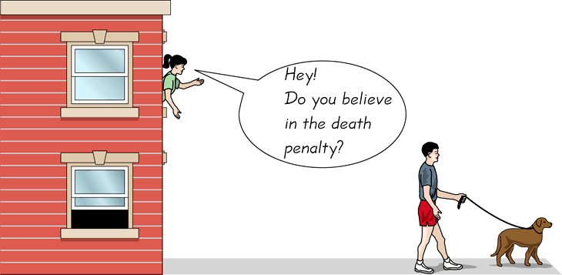
Convenience Sampling
Advantage: A sample selected for ease of access, immediately known population group and good response rate.
Disadvantage: cannot generalise findings (do not know what population group the sample is representative of) so cannot move beyond describing the sample.
Problems of reliability
Do respondents represent the target population
Results are not generalizable
S
unil Kumar

Slide 16
Judgmental sampling or Purposive sampling
- The researcher chooses the sample based on who they think would be appropriate for the study. This is used primarily when there is a limited number of people that have expertise in the area being researched
Selected based on an experienced individual's belief
Advantages
  Based on the experienced person's judgment
Disadvantages
  Cannot measure the respresentativeness of t h e sample

Slide 17

QUOTA SAMPLING
The population is first segmented into mutually exclusive sub- groups, just as in stratified sampling.
Then judgment used to select subjects or units from each segment
based on a specified proportion.
The main difference between these tQuota Sampling is a non-probability sampling method in which researchers can form a sample involving individuals that represent a population and are chosen according to traits or qualities.
The main difference between these two techniques is that, in quota sampling, the elements of the sample are not chosen randomly from each stratum like it is done in stratified random sampling.

Slide 18
Snowball Sampling
Useful when a population is hidden or difficult to gain access to. The contact with an initial group is used to make contact with others.
  Respondents identify additional people to included in the study
    The defined target market is small and unique
    Compiling a list of sampling units is very difficult
Advantages
  Identifying small, hard-to reach uniquely defined target population
  Useful in qualitative research
  access to difficult to reach populations (other methods may not yield any results).
Disadvantages
  Bias can be present
  Limited generalizability
  not representative of the population and will result in a biased sample as it is self-selecting.

Slide 19

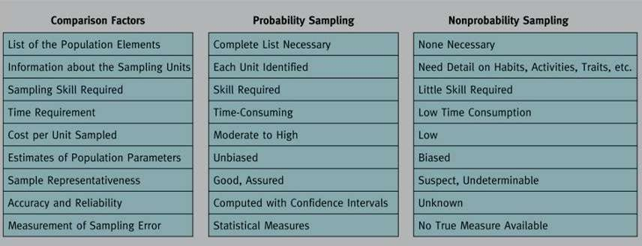

Slide 20



Sunil Kumar

