Slide 1
Methods of Collecting primary data
The following are the important primary sources of collecting data.
Observation.
Experimentation
Simulation
Interview
Use of telephone
Panel method
Mail survey
Projective techniques: these are many ways to assess a person’s personality. Psychologists have developed projective tests technique, which are indirect and unstructured ways to find out about people.
Exploring the unconscious
Understanding emotions and attitudes
Overcoming social desirability bias
Enhancing quality research
( word association tests, completion test, thematic appreciation test, expression techniques)

Slide 2
9. Sociometry : a sociometric measure assess the attractions (or repulsions) within a given group. The basic technique involves asking all group members to identify specific persons within the group they would prefer ( or would not prefer) to have as partners in a given activity.
10. Focus group discussion
11. Content analysis.

Slide 3

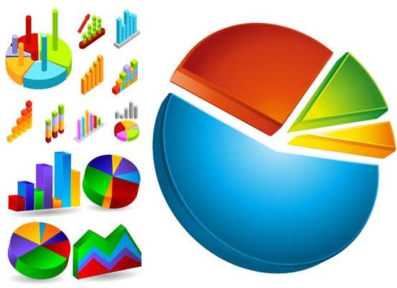
PROCESSING AND ANALYSIS OF DATA

Slide 4
After collecting data ,it has to be processed. Data processing involves classification and summarization of data in order to make them amenable for analysis.
THERE ARE FOUR IMPORTANT STAGES IN THE PROCESSING OF DATA
EDITING
CODING
CLASSIFICATION
TABULATION

Slide 5
EDITING
It is the process of examining the data collected in questionnaires or schedules to detect the errors and omissions and to correct these as far as possible.
There are two stages in editing
1 field editing
2 central editing

Slide 6
FIELD EDITING
Field editing consists in the review of the reporting forms by the investigator for completing (translating or rewriting) what the latter has written in abbreviated and/or in illegible form at the time of recording the respondents’ responses.
This type of editing is necessary in view of the fact that individual writing styles often can be difficult for others to decipher.
CENTRAL EDITING
Central editing should take place when all forms or schedules have been completed and returned to the office.
This type of editing implies that all forms should get a thorough editing by a single editor in a small study and by a team of editors in case of a large inquiry.

Slide 7
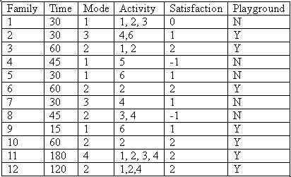
2) CODING
Coding refers to the process of assigning numerals or other symbols to answers so that responses can be put into a limited number of categories or classes.
Coding is necessary for efficient analysis and through it the several replies may be reduced to a small number of classes which contain the critical information required for analysis.
Coding decisions should usually be taken at the designing stage of the questionnaire.
It makes it possible to precode the quesistionnaire choices and which in turn is helpful for computer tabulation as one can straight forward key punch from the original questionnaires.

Slide 8
3) CLASSIFICATION
Classification of data which happens to be the process of arranging data in groups or classes on the basis of common characteristics.
Data having a common characteristic are placed in one class and in this way the entire data get divided into a number of groups or classes.
TYPES OF CLASSIFICATION
ACC. TO ATTRIBUTES
ACC. TO CLASS INTERVAL
ACC. TO ATTRIBUTES
data are classified on the basis of common characteristics which can either be descriptive (such as literacy, sex, honesty, etc.) or numerical (such as weight, height, income, etc.)
ACC. TO CLASS INTERVAL EXCLUSIVE TYPE
INCLUSIVE TYPE

Slide 9
EXCLUSIVE TYPE CLASS INTERVALS: They are usually stated as follows:
10–20
20–30
30–40
40–50
The above intervals should be read as under:
10 and under 20
20 and under 30
30 and under 40
40 and under 50
An item whose value is exactly 30 would be put in 30–40 class interval and not in 20–30 class interval.
INCLUSIVE TYPE CLASS INTERVALS: They are usually stated as follows:
11–20
21–30
31–40
41–50
Thus, an item whose value is 20 will be put in 11–20 class interval.

Slide 10
3) TABULATION
Tabulation is the process of summarizing raw data and displaying the same in compact form (i.e., In the form of statistical tables) for further analysis.
In A broader sense, tabulation is an orderly
arrangement of data in columns and rows.
Tabulation is essential because of the following reasons
It conserves space and reduces explanatory and
descriptive statement to a minimum.
It facilitates the process of comparison.
It facilitates the summation of items and the detection of errors and omissions.
It provides a basis for various statistical computations.
.

Slide 11
GENERALLY ACCEPTED PRINCIPLES OF TABULATION:
Every table should have a clear, concise and adequate title and this title
should always be placed just above the body of the table.
Every table should be given a distinct number to facilitate easy reference.
The column headings (captions) and the row headings (stubs) of the table
should be clear and brief.
The units of measurement under each heading or sub-heading must
always be indicated.
Explanatory footnotes, if any, concerning the table should be placed directly beneath the table, along with the reference symbols used in the table.
Source or sources from where the data in the table have been obtained must be indicated just below the table.
Usually the columns are separated from one another by lines which make
the table more readable and attractive.

Slide 12
Those columns whose data are to be compared should be kept side by side. Similarly, percentages and/or averages must also be kept close to the data.
It is generally considered better to approximate figures before tabulation
as the same would reduce unnecessary details in the table itself.
It is important that all column figures be properly aligned. Decimal points and (+) or (–) signs should be in perfect alignment.
Abbreviations should be avoided to the extent possible and ditto marks should not be used in the table.
Miscellaneous and exceptional items, if any, should be usually placed in
the last row of the table.
The arrangement of the categories in a table may be chronological, geographical, alphabetical or according to magnitude to facilitate comparison.

Slide 13




Slide 14
Analysis can be classified into two
1 Descriptive analysis.
2 Inferential analysis.
Descriptive analysis- in descriptive analysis we tries to workout various measures that illustrates the size and shape of distribution along with the study of measuring relationship between two or more variables. It consists of two type s of analysis.
1 Uni dimensional analysis- averages, dispersion, skewness and kurtosis.
Bi variate analysis
i correlation analysis
ii regression analysis
iii multivariate analysis
1 multiple regression analysis
2 multiple discriminate analysis
3 multivariate analysis of variance
iv factor analysis
v canonical analysis
vi other methods – proportions, ratios, and percentages

Slide 15
Inferential analysis
The purpose of sampling is to estimate some characteristics of the population from which the sample is selected. All most all field s the statistical enquiry deals with drawing of conclusions related with a population from a sample selected from it.
Statistical inference is the process by which we draw a conclusion about some measure of population on the basis of sample value.
1 test of hypothesis
2 estimation of population parameters

Slide 16
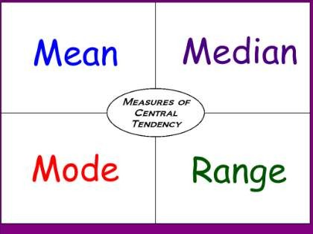
MEASURES OF CENTRAL TENDENCY
What is a measure of central tendency?
Measures of Central Tendency
  Mode
  Median
  Mean
Shape of the Distribution
Considerations for Choosing an Appropriate Measure of Central Tendency

Slide 17
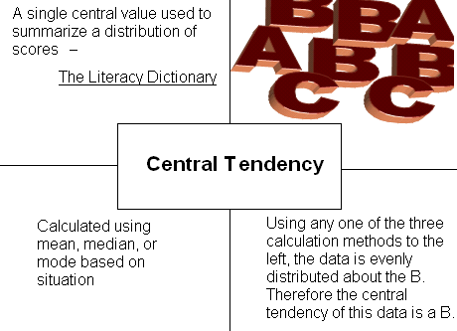
What is a measure of Central Tendency?

Slide 18
∑Y
MEAN The arithmetic average obtained by adding up all the scores and dividing by the total number of scores.
Y =
N
Y bar” equals the sum of all the scores, Y, divided by the number of scores, N.
MEDIAN is the value of the middle item of series when it is arranged in ascending or descending order of magnitude. It divides the series into two halves; in one half all items are less than median, whereas in the other half all items have values higher than median.
THE MODE- Mode is the most commonly or frequently occurring value in a series. The mode in a distribution is that item around which there is maximum concentration.
Mode is a positional average and is not affected by the values of extreme items

Slide 19
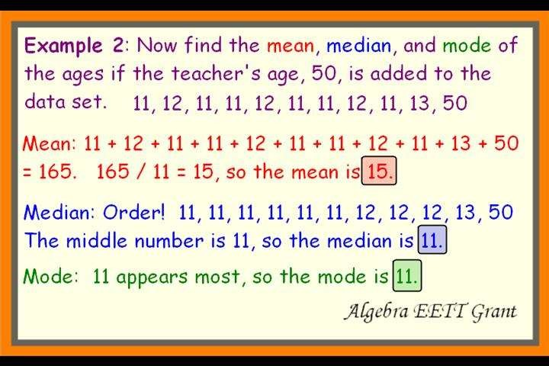

Slide 20
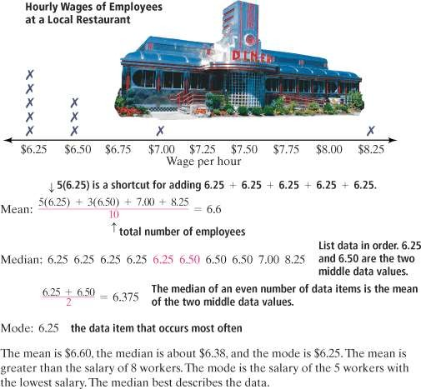

Slide 21
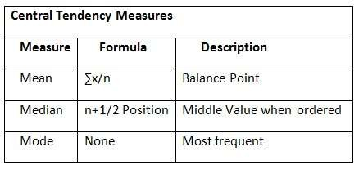

Slide 22
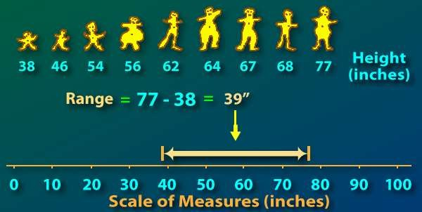
MEASURES OF DISPERSION
Important measures of dispersion are
Range
Mean Deviation
Standard Deviation.
RANGE is the simplest possible measure of dispersion and is defined as the difference between the values of the extreme items of a series.
Thus,
Range=Highest value of an item in a series - Lowest value of an item in a series.

Slide 23
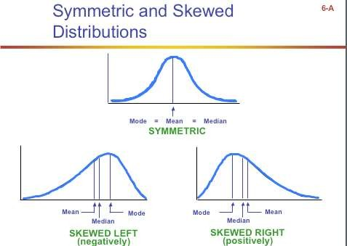
MEASURE OF SKEWNESS

Slide 24





