Slide 1







Slide 2

What is a Research Report?
A research report is a completed study that reports an investigation or exploration of a problem, identifies questions to be addressed, and includes data collected, analyzed, and interpreted by the researcher.

Slide 3
Research Report - definition
A research report is an oral presentation or a written statement that has the purpose of communicating research findings, recommendations for courses of action, other findings to management or other specific audiences.

Slide 4
Types of research report
Oral report : Reporting may be done to an administrator either orally or in written form.
The written report : may be three types
Popular report :
popular report is a report prepared for a layman. It is prepared to those persons who are not interested in technical aspects of the study.
Report submitted to an administrator: the administrator require only the essence of the research study. So in this type of report, some technical details and supporting data are included.
Technical report:
It is prepared for specialists who are interested in understanding the technical aspects of research methodology and research findings.

Slide 5

Structure Of A Research Report
The research report format mainly consists of three main sections:
The Introductory Section
The Main Body Of The Report
The Reference Section

Slide 6
1) The Introductory Section
Title Page
Acknowledgments (if any)
Table of Contents
List of Tables (if any)
List of Figures (if any)
Abstract

Slide 7
2) The Body Of The Report
  Introduction
    Statement of the Problem
    Significance of the Problem
    Purpose
    Statement of Hypothesis
    Assumptions
    Limitations
    Definition of important Terms

Slide 8
2. Review of Related Literature (analysis of previous research)
  Design of the Study
    Description of Research Design and Sources
of Data
    Sampling Procedures
    Methods and Instruments of Data Gathering
    Statistical Treatment

Slide 9
4. Analysis of Data
text with appropriate
Tables
Figures
  Results And Discussion
    Major Findings (reject or fail to reject Ho)
  Summary and Conclusions
    Conclusions
    Recommendations for Further Investigation

Slide 10
3) The Reference Section
References/ Bibliography
Appendices

Slide 11
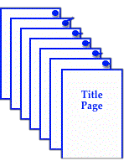
1) The Introductory Section
a) Title Page:
Title Page identifies the title of the report, the name of the researcher, the name of the guide, institution, month and year of submission.
The title should communicate what the study is about. A well constructed title makes it easy for the reader to understand and determine the nature of the topic .

Slide 12

b) Acknowledgments:
This page permits the writer to express appreciation to persons who have contributed significantly to the research.
Table of Contents:
The table of contents is an outline of the report that indicates the page number on which each major section and subsection begins.
List of Tables:
A list of all the tables included in the report along with the page numbers should be provided.

Slide 13
e) List of Figures:
A list of all the figure included in the report along with the page numbers should be provided.
f) Abstract:
The abstract is a brief but comprehensive summary of the research report. It includes a concise statement of the goal of the research, the type of participants and instruments, outlines the methods, major results and conclusions.
Abstract must be limited to a specific number of words, usually between 100 and 500 words.

Slide 14
2) The Body Of The Report
Introduction:
The Introduction section provides the theoretical framework of the study within which the research has been conducted, background information of the topic as well as the need for and rationale for the research, to make the material more logical, useful and interesting for readers.

Slide 15

The introduction begins with a description of the research problem or topic and includes objectives, significance of the problem, research questions, statement of hypothesis(if any).
It also includes the assumptions of the study(if any), definition of important terms, limitations and delimitations of the study.

Slide 16

2) Review of Related Literature
The Review of Related Literature indicates what is known about the problem or topic.
Its function is to educate the reader about the area under study.

Slide 17
3) Design of the Study
This section provides a detailed description of the methodology used in the study. e.g. population, sample size and sampling techniques and tools used in the study.
The purpose of this section is to describe in detail how a researcher performed the study so that someone should be able to replicate the study based on the information that a researcher provide in this section.

Slide 18
For a qualitative study, this section may also include a detailed description of the nature and length of interactions with the participants. The description of participants includes information about how they were selected and mainly representative of the population.
The description indicate the purpose of the
instrument and the validity and reliability of
the instrument.

Slide 19
4) Analysis of Data
This section describes the statistical techniques or the inferential interpretations that were applied to the data and the result of these analyses.
Tables and figures are used to present findings or graphic form which add clarity in findings
for a reader.

Slide 20
5) Results And Discussion
The Results section is to tell the reader what
was found in the study.
it includes the descriptive statistics for the relevant variables (e.g mean, standard deviation).Then tell the reader what statistical test you used to test your hypothesis and what you found.

Slide 21
The Discussion section is where the researcher interprets and evaluates the results.
The discussion of a research report section presents the theoretical and practical implications of the findings and make recommendation for the future research.

Slide 22
Discuss the results of the current study, explaining exactly what was found.
Account for the research findings, relate back to the previous research and theories highlighted in the introduction
Discuss the limitations of the current study and provide ideas for future research. End with a conclusion.

Slide 23
6) Summary and Conclusions
Conclusions is a summary of the main ideas
that come out from the discussion.
It draws all arguments and findings together.
It indicates whether hypothesis were accepted
or rejected.
It summarize major findings of the study.
The purpose of this section is to evaluate interpret the result, especially with respect to the original research question.

Slide 24
3) The Reference Section
References/ Bibliography:
The References section provides the reader with all the information needed to seek out and obtain all original sources used in the research. it is written in the alphabetical order.
Appendices:
This section provide a place for important information.it includes tools prepared by the researcher and used in the study.it may be lettered, interview, names, raw data and data analysis sheets.

Slide 25








Slide 26

Sample abstract page

Slide 27

Sample Introduction Page

Slide 28
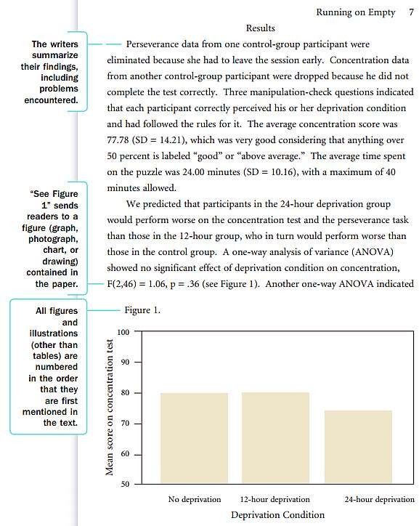
Sample Results Section

Slide 29

Sample References Page

Slide 30
References
Gay, L.R. , Mills, G.E.& Airasian, P. (2008).
Educational Research(ninth edition). Prentice Hall;
Pandya, S.R. (2010). Educational Research. New Delhi; A P H Publishing Corporation.
Retrieved January 28,2015 from http://www.thewritesource.com/apa/apa.pdf

Slide 31


